Slide 1
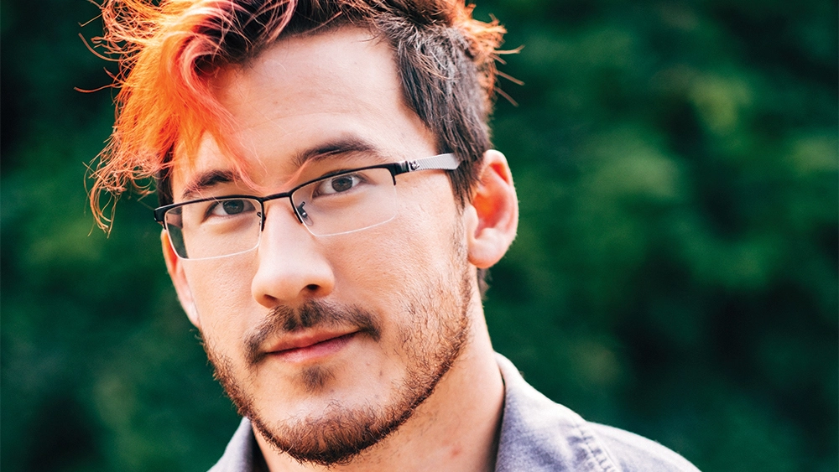
The Digital Footprint of Markiplier

Slide 2
Digital Footprint
Mark Edward Fischbach, is a YouTuber that primarily does video game lets plays on his channel Markiplier. He currently 24.6 million subscribers and he is on his way to 25. He does improv with his friends in videos and touring with them around the U.S.
Mark's digital footprint is vast. He has numerous social media accounts and his YouTube helps people get updated with any major things going on in his life. He posts videos relatively often and same goes with his social media. He and another YouTuber Jacksepticeye have also created a clothing brand called Cloak, which they mention during their videos.
While his videos don't exactly have "clean language" , he constantly does charity livestreams for multiple different causes, including cancer, children's health, etc, raising thousands of dollars.

Slide 3
Any protection?
Mark promotes his brand in multiple times, not afraid of having playful banter with Jack as well. In the description of his videos, he has his social media accounts, not hiding them. His videos do have public comments, but Mark has tried to block any spam comments with his icon that lead to scams promising discounts and giveaways.
It has been reported that a group called OurMine has hacked Mark before on January of 2016, but presently there has been no info on if he has been targeted again. Luckily, the hackers are said to only leaked his earnings, not doing any damage to his channel and Mark ended up getting his account back

Slide 4
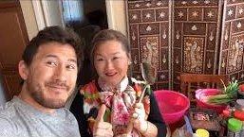
How much does he share?
Mark has told some parts of his childhood, but he has been relatively private with the details. We do know that he's lived in Cincinnati, Ohio and it is also public knowledge that he has a brother and that he currently lives in Los Angeles. We learned a lot of this due to his "Draw My Life" video to celebrate his thousandth video.
His mom has been a part of multiple of his videos and she does say things about Mark and his background. For instance, we know where he was born and some of his injuries. He's recorded some vlogs that include him in a hospital bed after he had surgery too.
We have been shown around his house and know about his 2 dogs, Chica and Henry. He's taken a video where we are introduced to his Korean relatives as well, including his brother Thomas. Mark is not afraid of telling his community things that happen with YouTube, an example being where he made a video in response to a massive ban wave onto his subs.

Slide 5
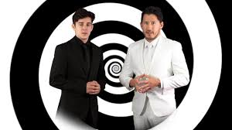
Is Mark over sharing?
Since most Mark's videos are video game related, he doesn't talk about his childhood and personal life a lot. When he does though, Mark's comments are vague. When talking about his childhood, Mark doesn't mention any names. We know a couple of his childhood friends because they were on his videos, but not much else.
Recently, Mark and his friend Ethan, creator of the channel CrankGameplays, have made a new channel called Unus Annus. In the videos they have made, Mark's backyard shows multiple times, but he doesn’t show the actual house itself. Still, people can find out where he lives.
During the "Draw My Life", we discover events that lead Mark to where he is now. We know that he was studying engineering in UC (University of Cincinnati), but he dropped out to pursue his YouTube. This video's purpose is to give some history on how Mark became who he is today, but it contains some personal things that happened in his life.

Slide 6
Some advice for Mark
Mark has been private about his personal life and the details about it. He is conscious about the details on his childhood and trys to keep them vague. My advice to Mark is to be more conscious with how much of his house he shows, as that can be dangerous. Another thing is to remember to not explain too much about his scheduele and to refrain from talking too much about his life outside of YouTube and tours. He is one of the most popular YouTubers on the platform, so he is a prime target for thieves and scammers.

