Slide 1
VenturianTale’s Digital Footprint
By Aidan Tsen

Slide 2
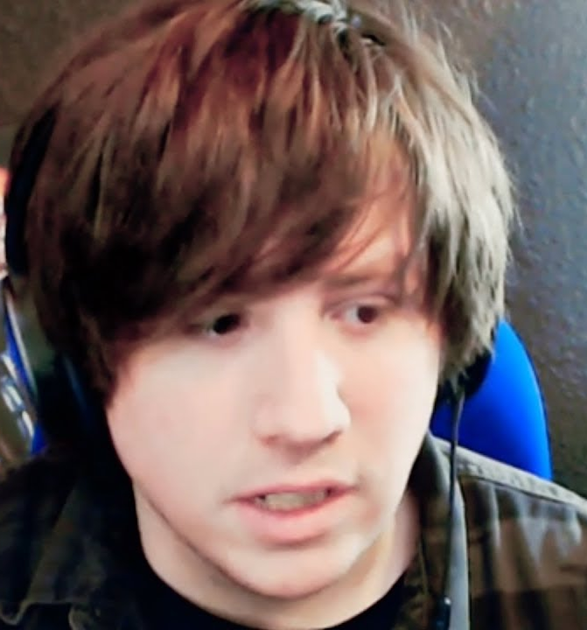
Who is Venturian?
Jordan Frye is a youtuber who post in family friendly video gaming. Quite often, the videos contain one of three other siblings (Jacob, Bethany and Sierra Frye) and more recently, his wife.
Their channel was started in 2010 and experienced rapid growth in 2013. From there, they continually expanded.

Slide 3
What does Venturian share online?
Their primary content is video games. Of the several genres they play, the most prominent is the 2005 sandbox game Garry’s Mod.
They also post vlogs somewhat frequently, which covers the current events of their life and the channel.
They also maintain social media accounts on
A fan-made Fandom wiki has been created for the channel, which is fully maintained and written by fans.

Slide 4
Is Venturian oversharing?
The biggest factor is their names. All four of the siblings first and surnames are publicly known. Their Mother has also collaborated with them on the channel. Each video also features a face-cam of the one who records.
Throughout their career, they’ve moved homes at least twice now. They are known to live in the United States and have been speculated to live in the state of Virginia.
With all these details, I believe that they are oversharing. Their names, home country, faces and family are out there.

Slide 5
Conclusion and Opinion
Venturian is indeed oversharing, and the effects are impossible to reverse in my opinion. The information given can be used to further uncover other details about them.
These various issues can be solved by reducing the amount of unnecessary details in vlogs and instead only covering important events.
The details they’ve shared is far beyond anything I would ever do and what my peers would recommend.
In my honest opinion, it's their family-friendly style that saves them from any major harm by malicious people.

