Slide 1
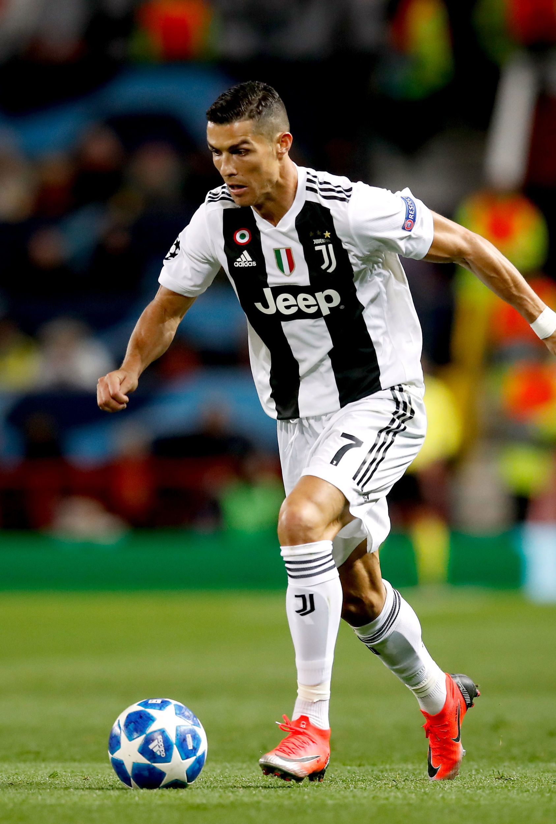
Cristiano Ronaldo's Digital Footprint

Slide 2
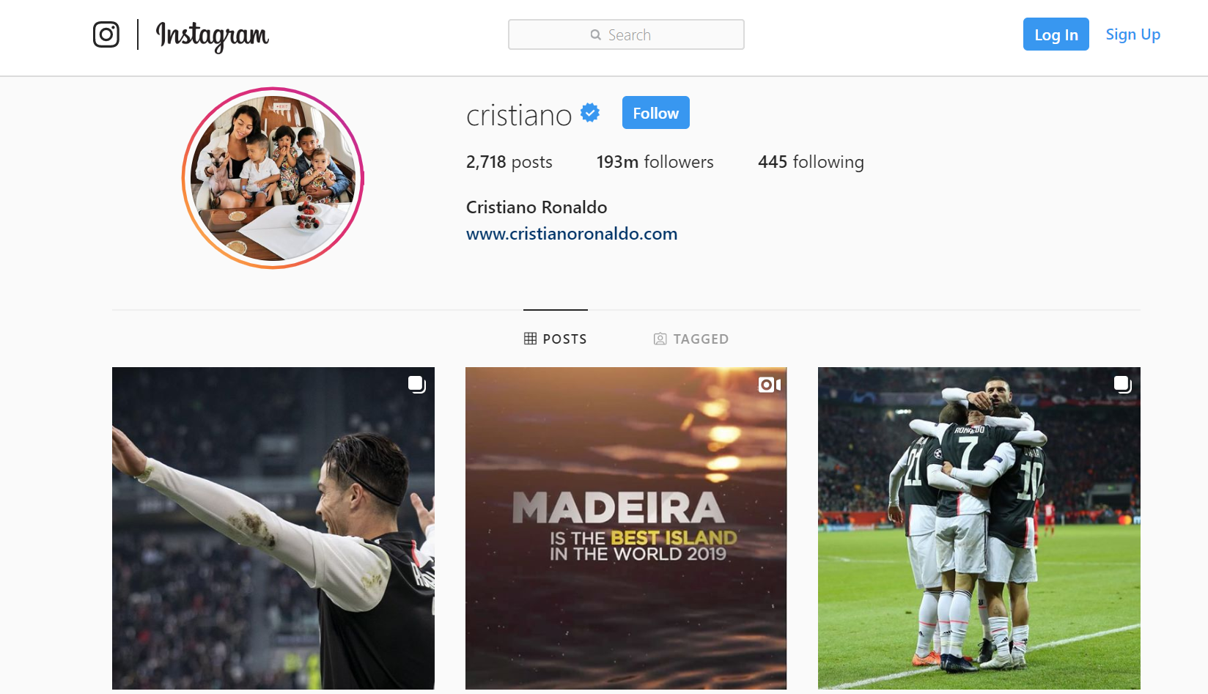
Digital Footprint
Cristiano Ronaldo dos Santos Aveiro, known as Cristiano Ronaldo, is a professional soccer player playing for Juventus in Turin, Italy. His main use of social media is on Instagram, on which he has over 193 million followers, the most followed person on Instagram. While he is mainly a soccer player, as reflected by most of his content on his social media, a sizable part of his digital footprint includes his promotional work for both his and other brands, usually in fashion, as well as his family. He is extremely active, posting around 4 times a week, and adding to his story daily.

Slide 3
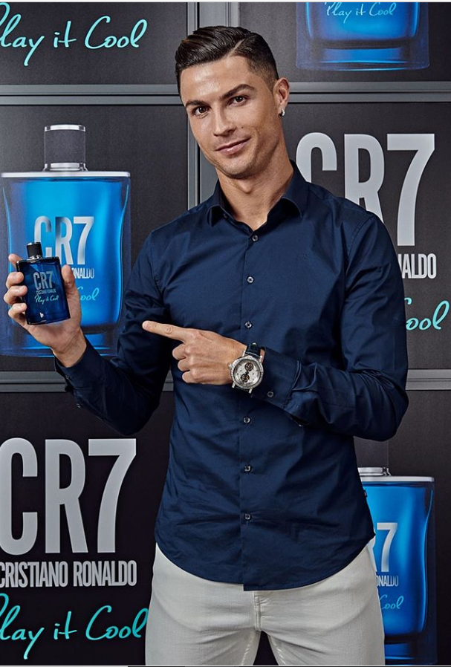
Protections
Cristiano Ronaldo's Instagram account is public, meaning that anyone in the world can see his posts. He has not had any problems with hacking or personal information being revealed due to the fact that his social media is a carefully curated image that is created by him and his team, ensuring that he and his personal information is secure.

Slide 4
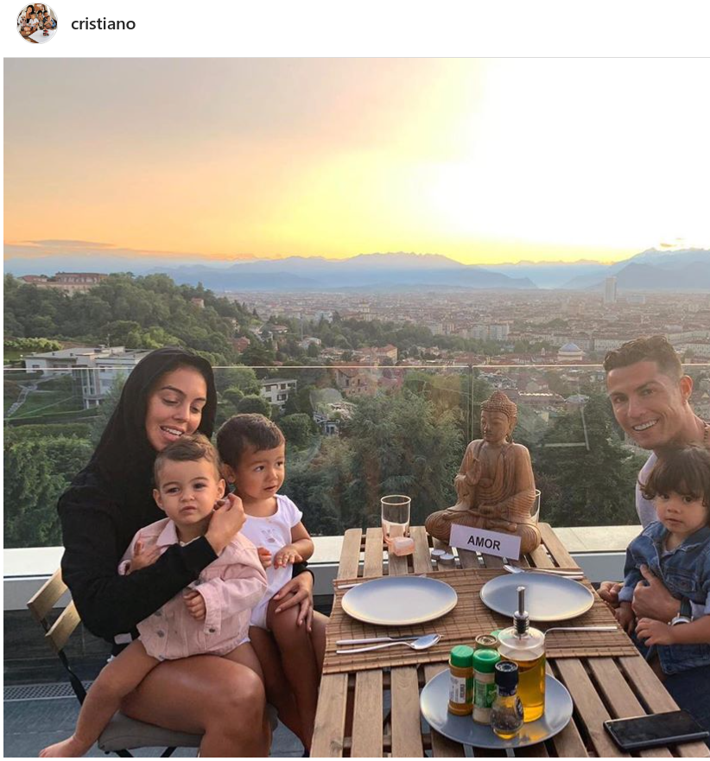
Information
Ronaldo shares a lot of information about his location, often including recognizable landmarks and using location tags to show his location. He has also shown parts of his home on many occasions, both on his own social media and on other media. His updates on his Instagram show his location on an almost daily basis.

Slide 5
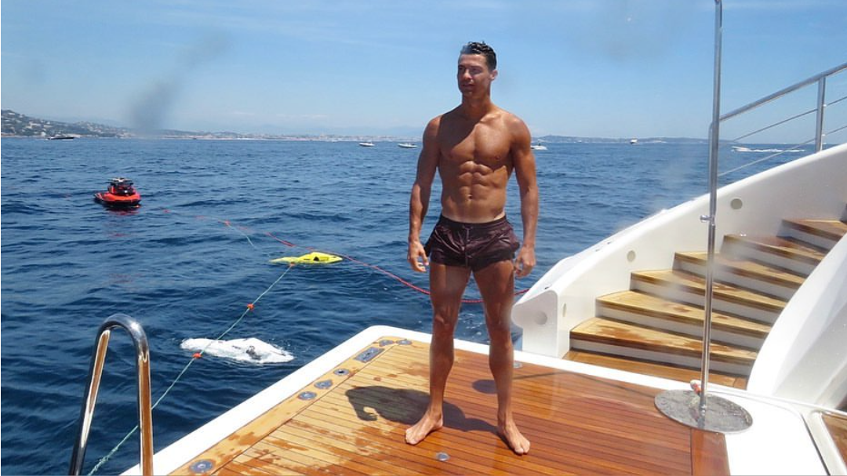
Oversharer?
Based on Cristiano's social media, he could be viewed as an oversharer. However, due to his status as a celebrity, he is not oversharing. His public image is very carefully constructed so as to not share anything that could harm Cristiano. He also lives in a very private area and has security when in public. He has never had any instance of being in danger as a result of his social media. Because of his situation, he is not an example of an oversharer.

Slide 6
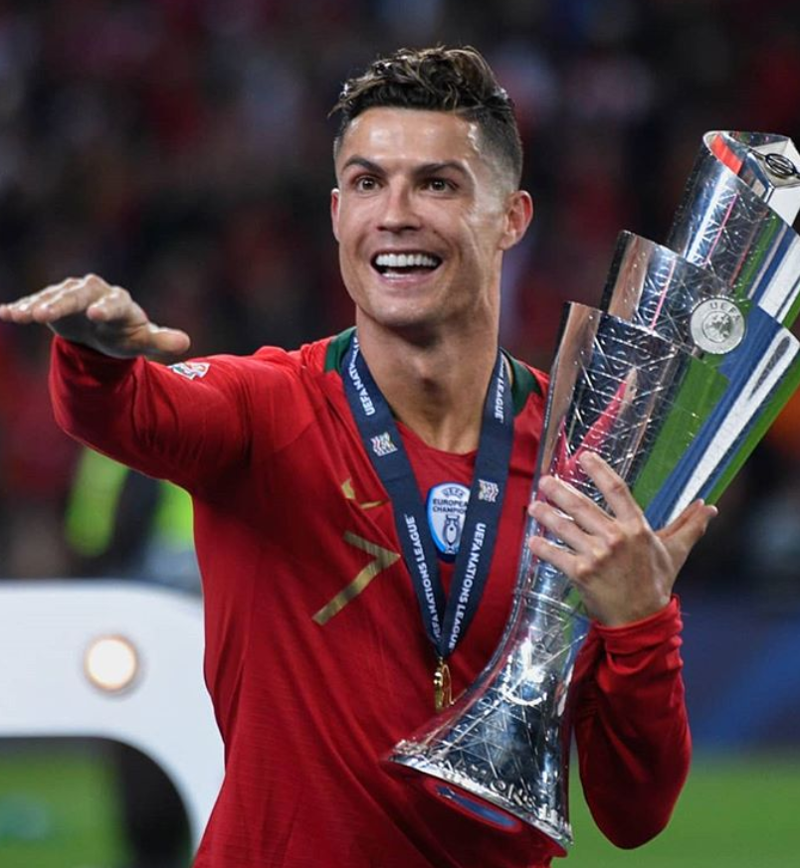
Advice
While Ronaldo is a very solid example of how to run a social media account as a celebrity, it is only because of his status that he is able to share the amount that he does. An average person should not share their precise location as frequently as Ronaldo does, and also should not share as many pictures of his family, especially when their account is public. Additionally, sharing when they are away from their home, as well as parts of their home is not wise if their home is not as private and secure as Ronaldo's, as it could lead to burglaries. Overall, Ronaldo's social media is run very well, but it is not an example for an average person to follow.

