Slide 1
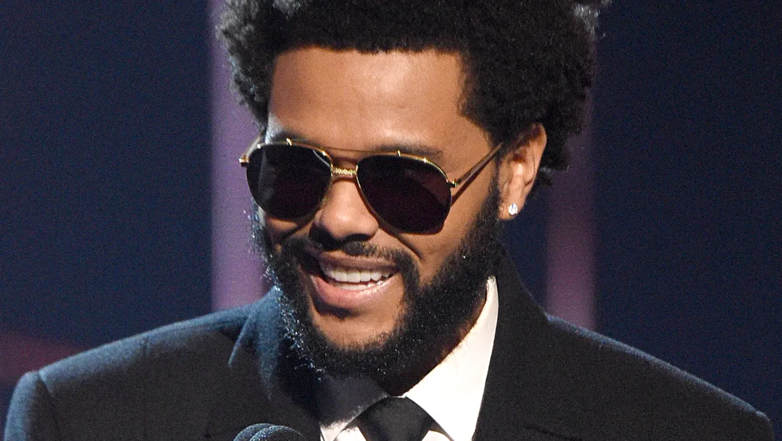
The Weeknd
(Also known as Abel Makkonen Tesfaye)

Slide 2
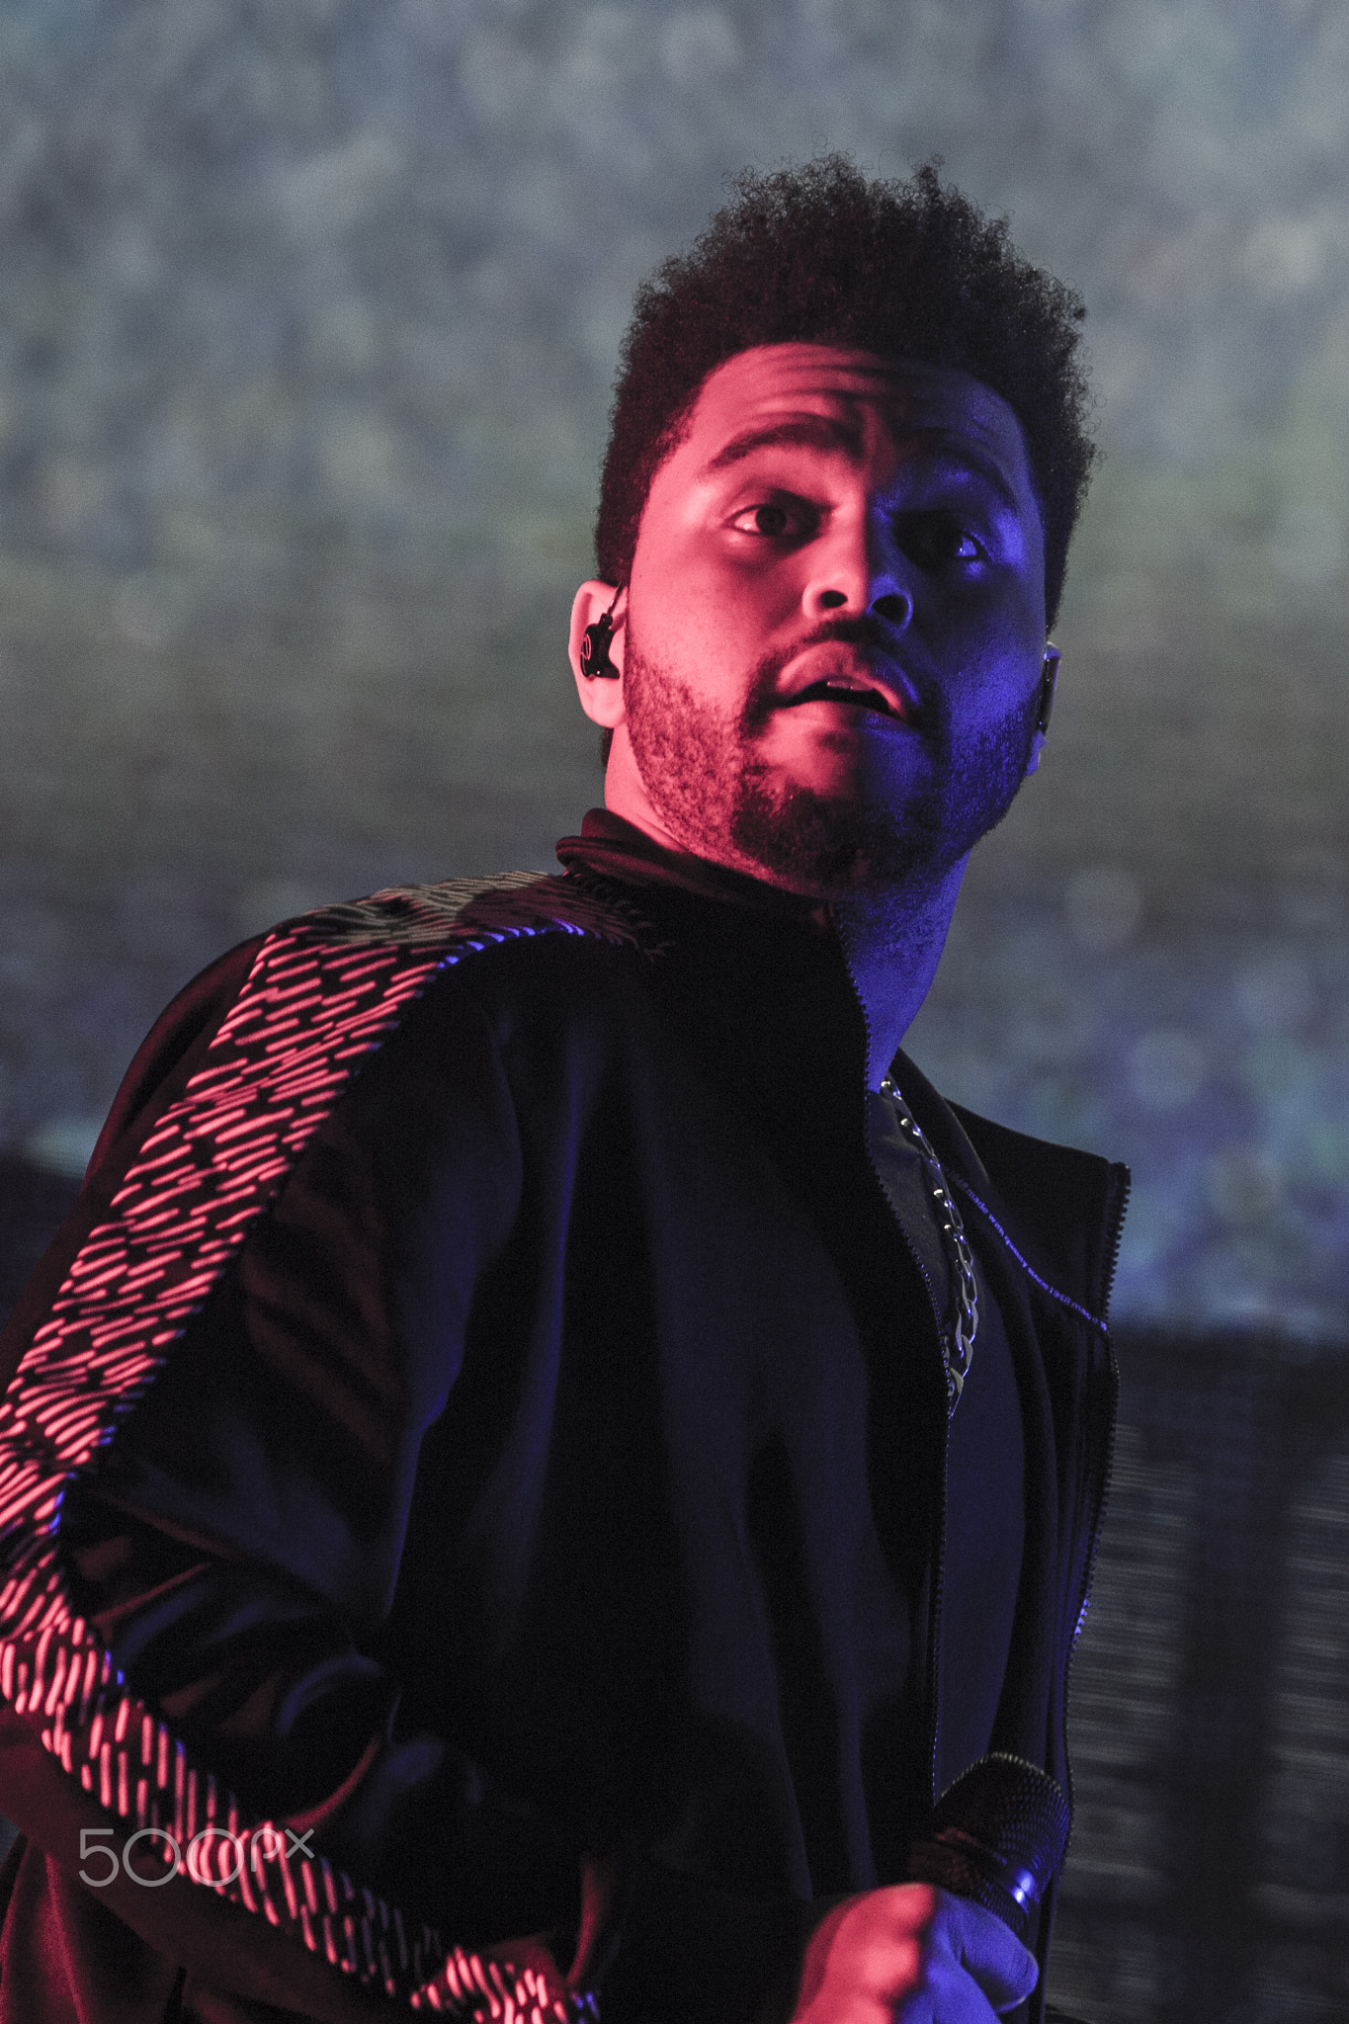
The Weeknd
Abel Makkonen Tesfaye (The Weeknd) is an R and B songwriter and singer. He is notable for his songs on explicit subjects and is considered and influential person in the music industry. The Weeknd has a Twitter, Instagram, FaceBook, and YouTube(All public). He posts every week and has released 4 studio albums, 3 compilation albums, 1 Eps, 51 Singles, and 3 mixtapes.

Slide 3
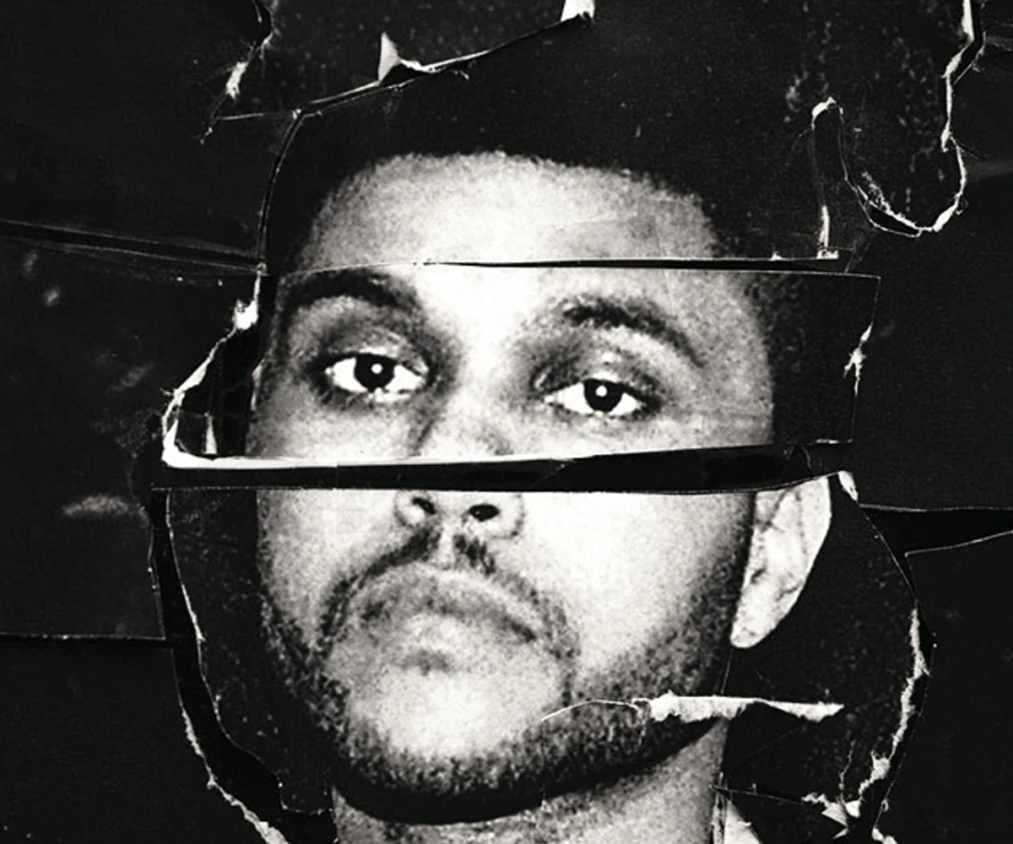
His privacy
The Weeknd’s Instagram Account was hacked in May 2020, along with a few other influencers like Drake and Nicki Minaj. The hacker wanted the company of these influencers to pay up if they wanted their personal information to be private. The information claims to be contracts, settlements, and e-mails, the hacker threatened to publicize this information unless they payed $21 Million.
He has his full name out in the public (which is normal for celebrities and singers) but uses a stage name “The Weeknd”. His accounts are public and his posts never has a location tag.

Slide 4
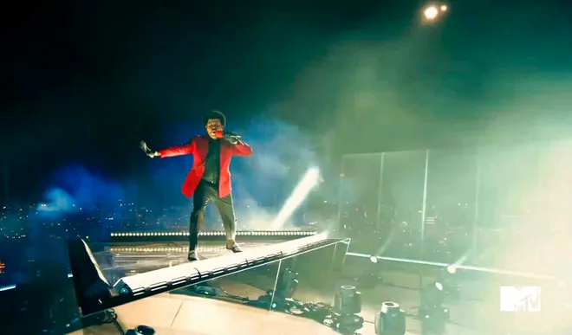
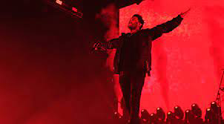
What’s does he post?
Abel Makkonen Tesfaye posts regularly, mostly about new album releases. He posts pictures of his back yard, back stage, photoshoots, and concerts. None of which have a tagged location. The pictures of his backyard isn’t easy to track back to where he lives. Since he is a famous artist, its normal for him to tell his fans about where and when his concerts and shows are.

Slide 5
IIs The Weeknd an Oversharer?
I would say that The Weeknd. Is NOT an over sharer. Why? Well, he is a celebrity, his full name being in the public is normal nowadays, interviewers ask about that kind of stuff. When singers do concerts, they tell their fans where and when they are, and security is always on stage. He posts regularly about his concerts and only a bit of his back yard, with no location tags. The hacking incident was major of course, but it didn’t risk his life, only career which is bad but its not worth more than life. The hacker had information about contracts, and e-mails, nothing about his location, and such. Other than that, I think he is not an oversharer.(this is all my opinion)

Slide 6
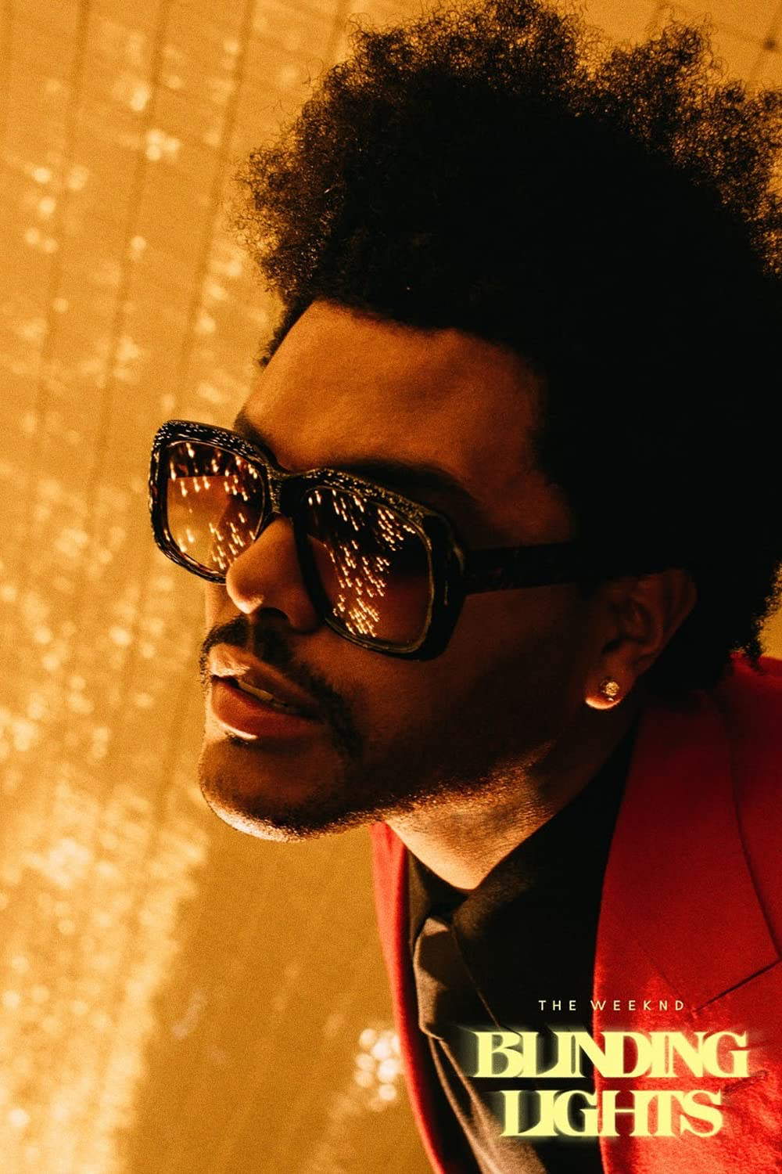
My Advice..
to not get hacked again, I would advise verifying your account regularly, making sure there aren’t any suspicious e-mails and just anything to avoid hackers. Other than that, I advise to keep the location tags out of the posts, and be more discreet about where they are.

Slide 7
Thanks for reading

