Slide 1
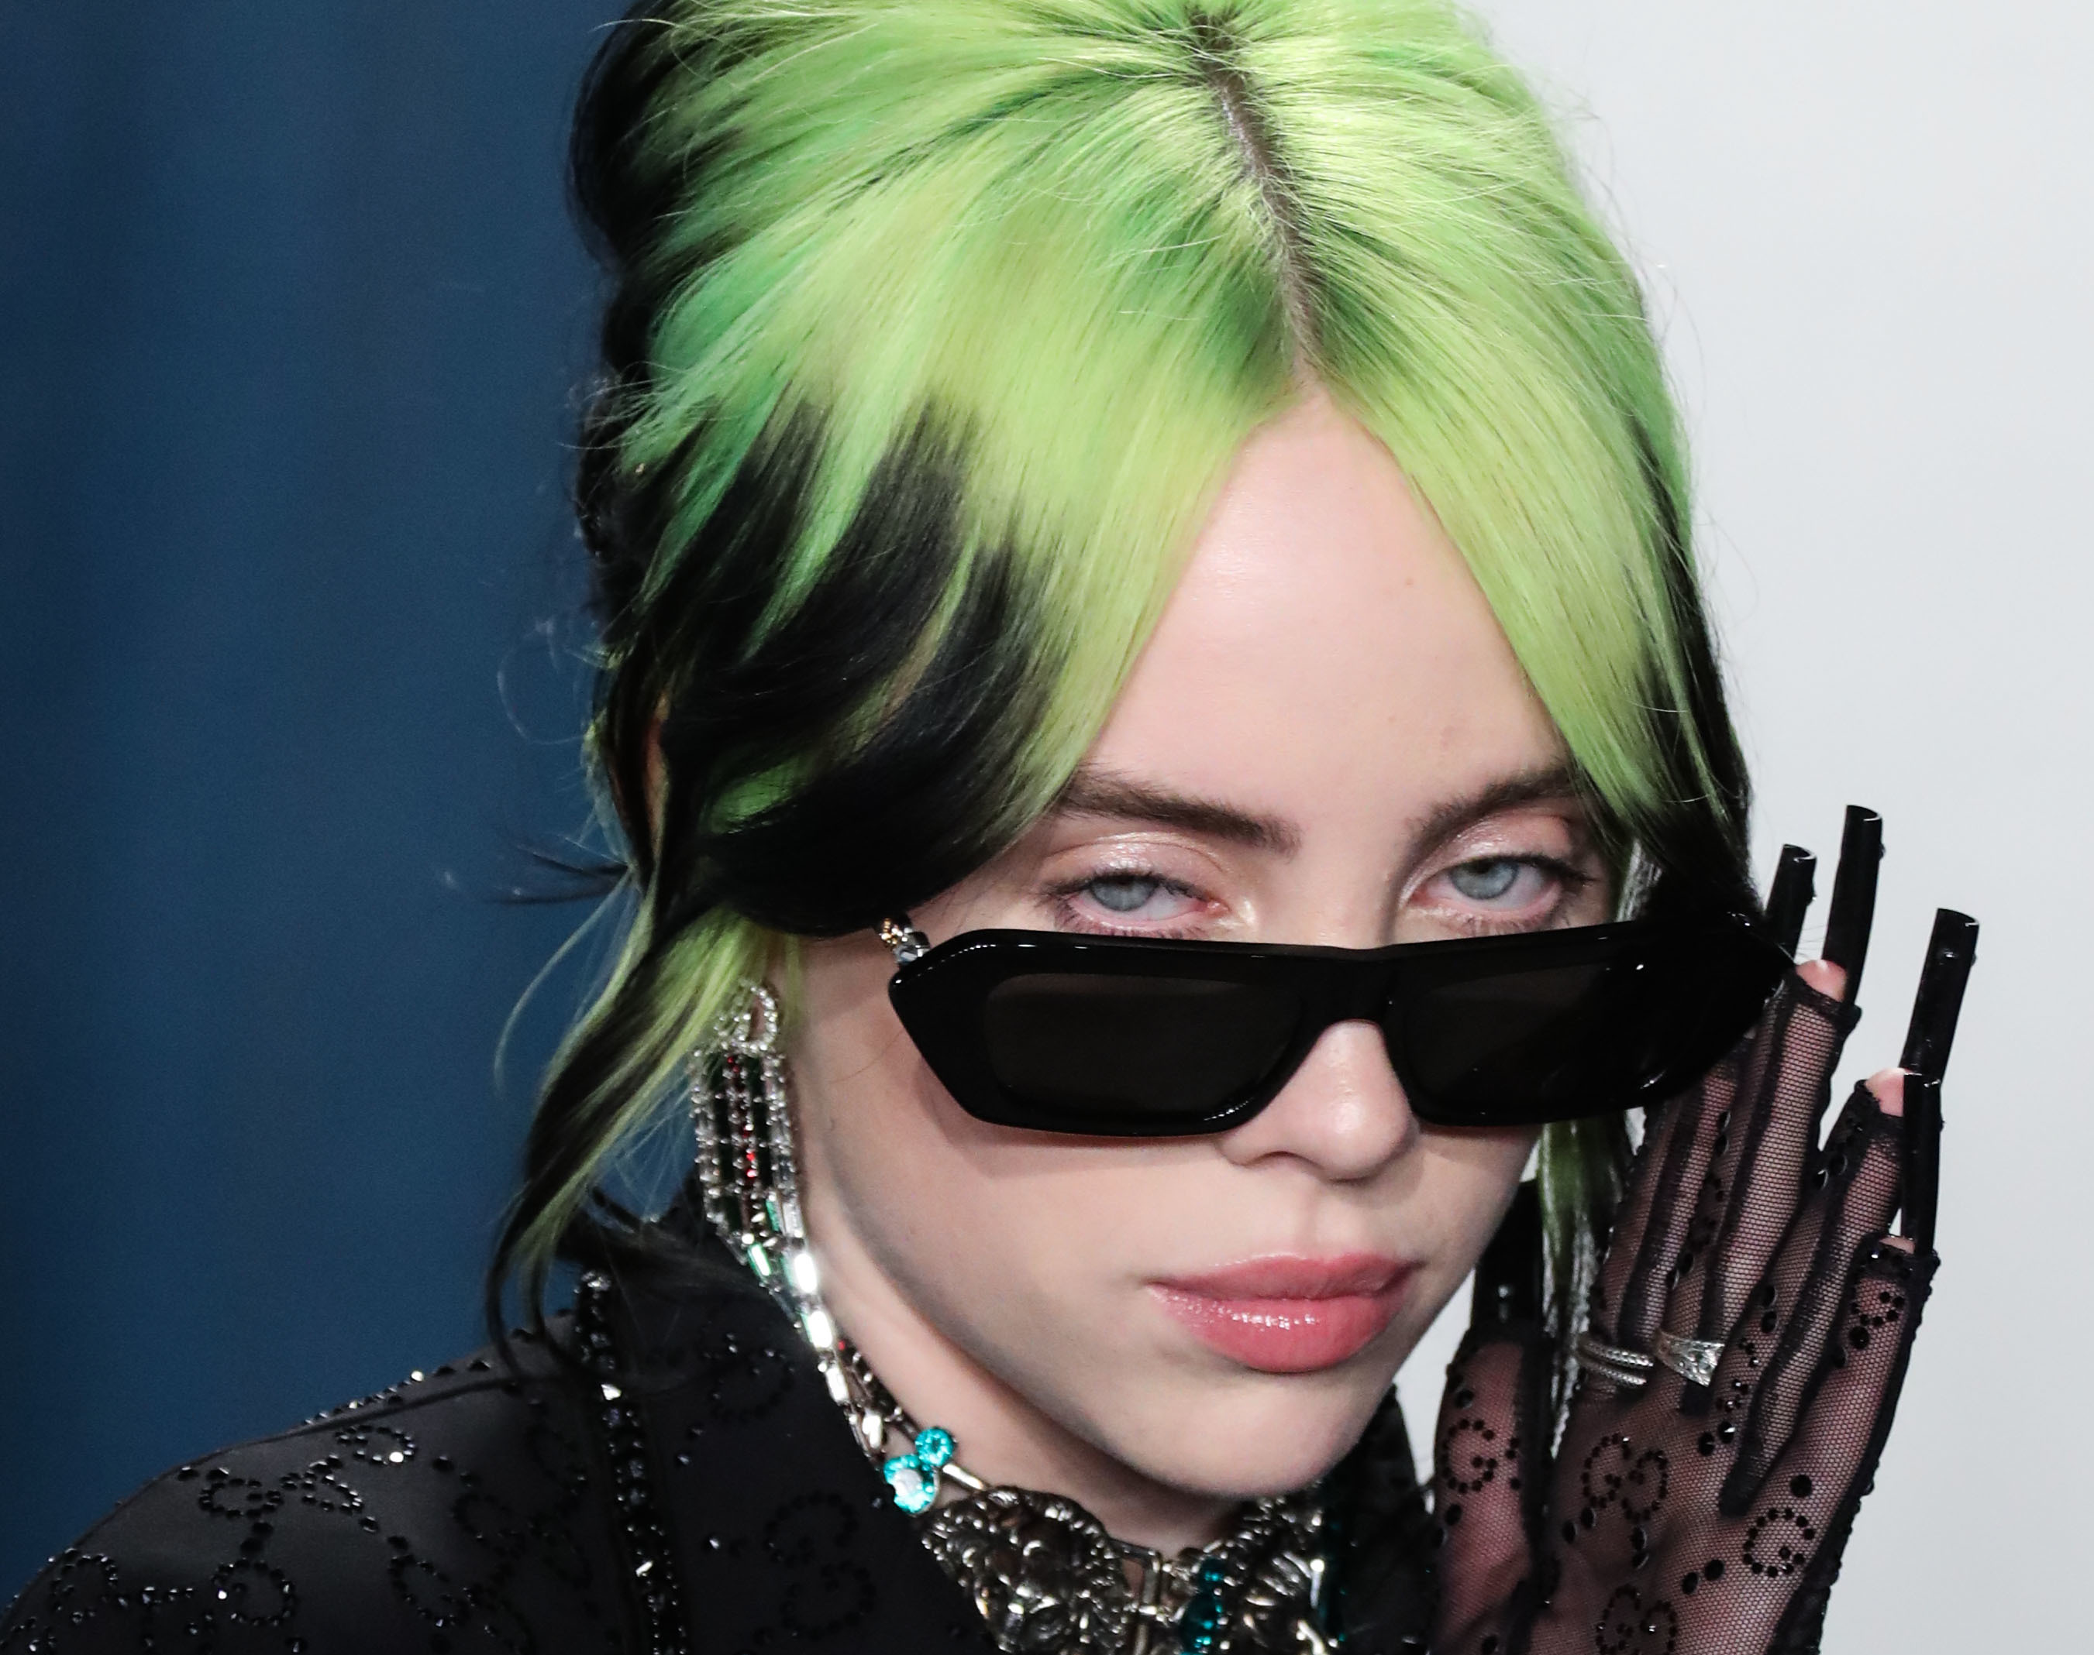
The digital footprint of Billie Eilish

Slide 2
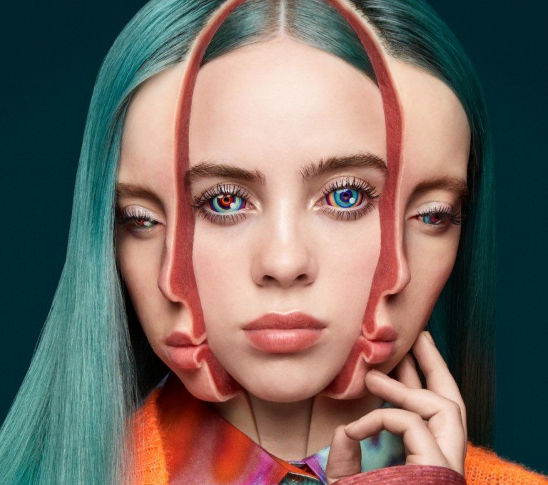
Digital footprint
Billie Eilish is a singer-songwriter from Los Angeles, California. She writes some of her songs on her own, but she creates most of them with her brother/collaborator.
Billie Eilish released her first album in 2017 with the help of her brother, called “Bellyache”.
She is active on Instagram, Twitter, Snapchat, Facebook, TikTok, and YouTube.
With over 76.3million followers, Billie Eilish is known to regularly post on her Instagram account.

Slide 3
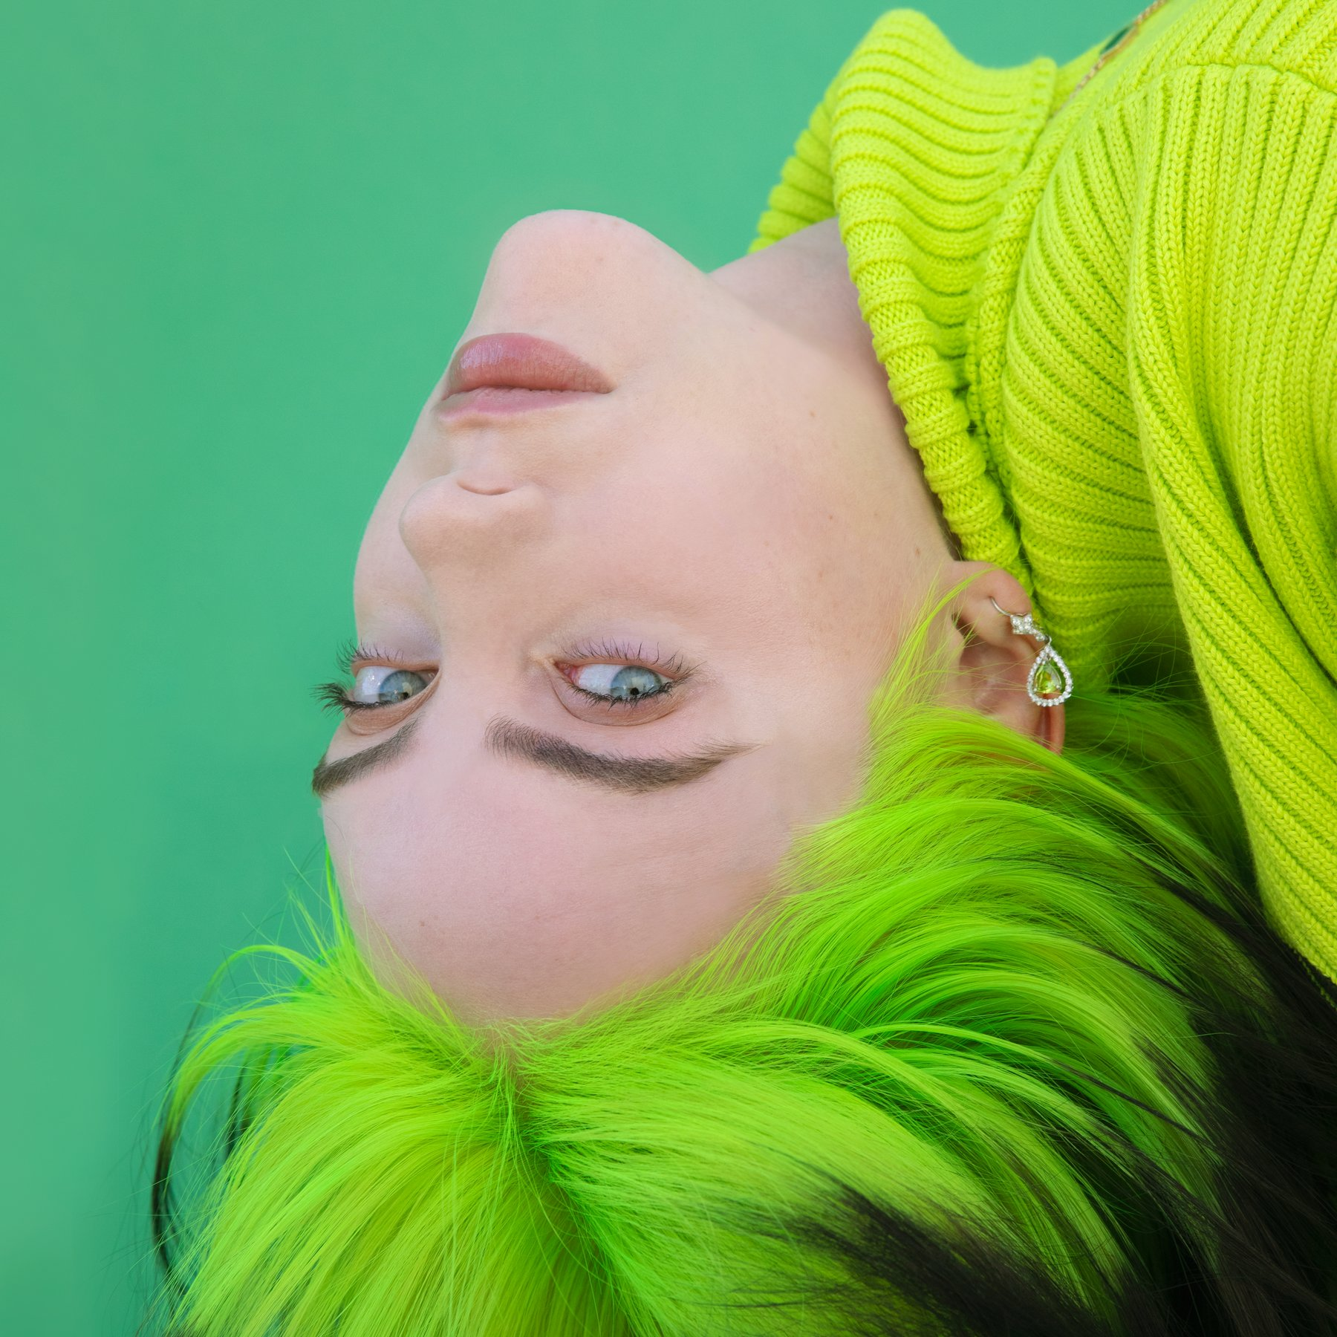
Protections?
Her accounts are public, and everyone can easily access her platforms.
Although many celebrities have been hacked before, fortunately Billie has not.

Slide 4
What does Billie want us to see?
Billie Eilish is such a positive, and a happy person.
The concept of her songs are mostly about love, loss, depression, and self-image, and most of the meanings behind her songs are from her everyday experiences with her brother O’Connell.
Billie usually posts about her upcoming albums, behind the scenes of her music videos, and her fashion.
She tags studios, artists, magazines, her own merch and so much more.
Billie Eilish does not post any videos or photos about her personal information.

Slide 5
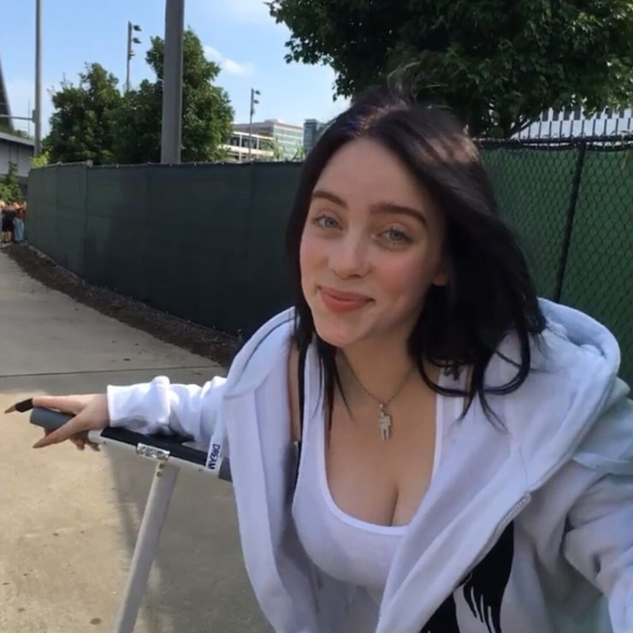
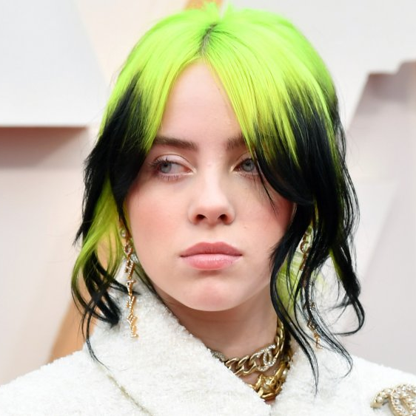
Is Billie Eilish an over sharer?
In my opinion, Billie Eilish is not an over sharer.
She has never exposed her address, or any other personal information on her platforms before.
I think she is very careful with keeping her information to herself, because she is aware of the consequences.

Slide 6
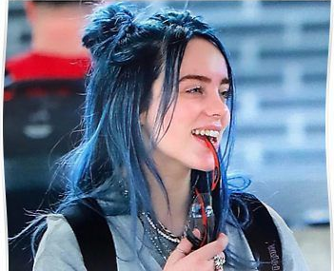
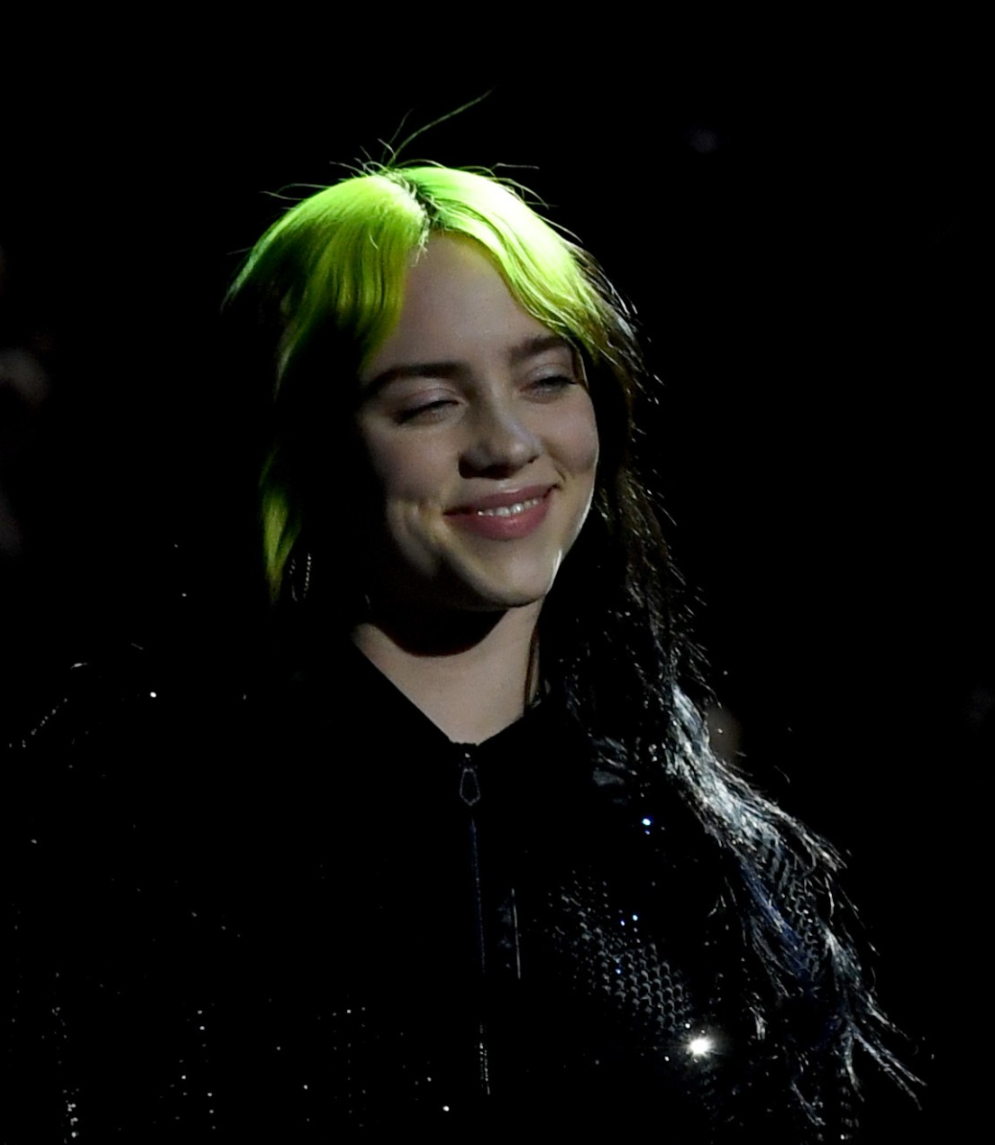
My advice for Billie Eilish
I think Billie Eilish is fine the way she is, but she has been unfollowing everyone on Instagram. I am not quite sure what the reason is, but if she needs a break, I would love her to take one.
She became very popular at a really young age. I hope she doesn’t pay attention to the hate comments as much and focus on herself more often.

