Slide 1
PEWDIEPIE’S DIGITAL FOOTPRINT
By: Andrei

Slide 2
What is a digital footprint
A digital footprint is the information that a normal person leaves on the internet as result of their online activity
Ex: posts, messages, tweets, stories etc.

Slide 3
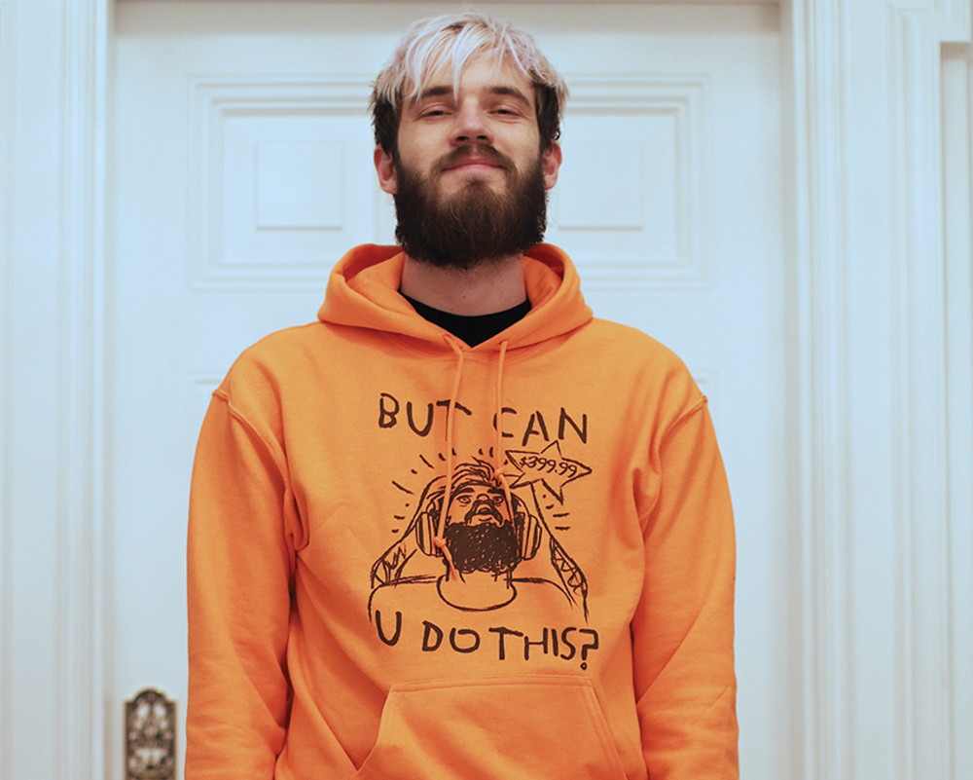
How expensive is PewDiePie's digital footprint
PewDiePie is the second youtuber with the most subscribers on YouTube, I personally watch his videos since 2016 he started YouTube in 2010 and he’s still posting videos now
PewDiePie's posts videos on YouTube every once at 3 days, besides YouTube he posts on Instagram and Twitter, but he doesn’t post that much on any of those, only when it’s a specific occasion and if he has to say something like an announcement or a response to someone

Slide 4
What protections does PewDiePie put on his account
PewDiePie's channel and his other social medias accounts are all public and accessible by anyone.
PewDiePie has never said anything about being hacked or having problems with one of his social media's accounts, he’s sponsored by Nord VPN, Nord VPN hides your Ip address while surfing on the internet while it’s a great adblocker for other sites like YouTube, Instagram and others

Slide 5
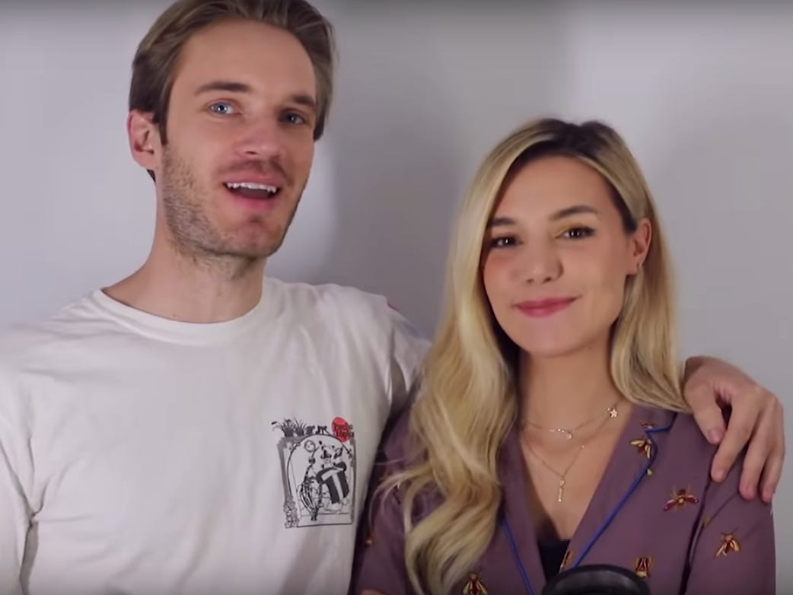
What information do they wasn’t you to see, and what information do they keep private
PewDiePie has his own life before YouTube, he is married and he is probably planning to have children, but that’s all we probably see about his personal life
He shows his room where he records his videos and did a house tour, all we know that he lives in Brigham in England, but no idea exactly were, he is 33 years old and he’s from Sweden and his wife is from Italy

Slide 6
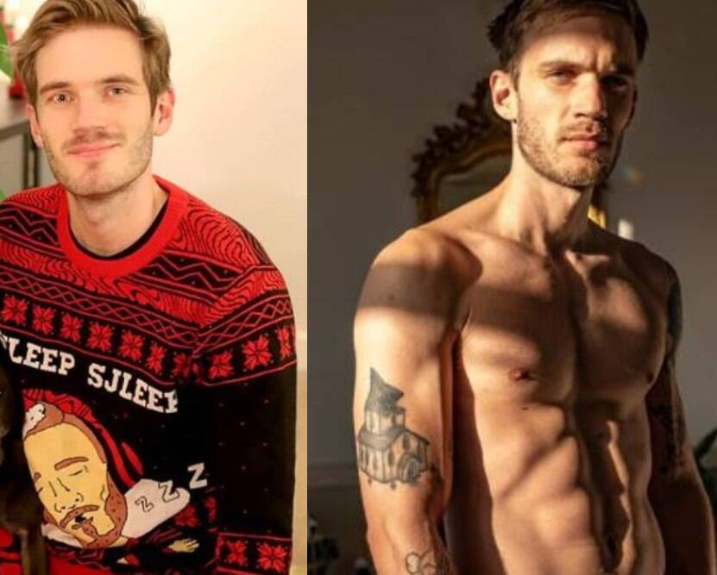
Is PewDiePie an example of overshare
I would say that PewDiePie is not an example of overshare, he keeps his address and other personal stuff that could link to losing information away from YouTube

Slide 7
What advice would you give to PewDiePie about his digital footprint
I would say that he’s doing a really good job and to keep it the way it is right now

