Slide 1
Digital Footprint on:
Hayley kiyoko

Slide 2
Who is Hayley kiyoko?

Slide 3
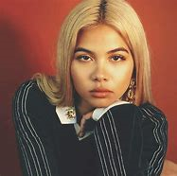
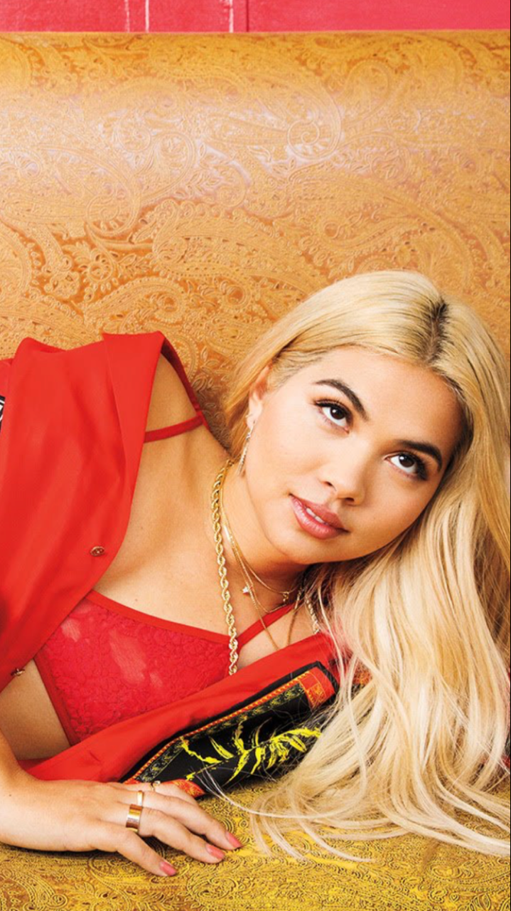
Hayley Kiyoko was born on April 3, 1991, in Los Angeles. She started out as an actress in films and is now an iconic singer in the music industry. Her music has helped impact the lives of people in good ways, as well as helped people feel more free and comfortable in the world. Hayley Kiyoko is also an active advocate for LGBT+ rights and widely regarded as an icon in this community.

Slide 4
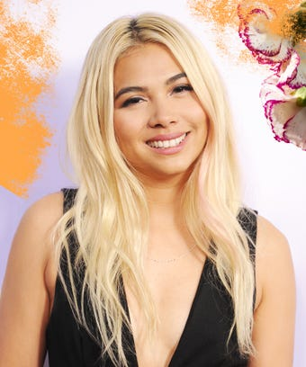
How expansive is this person’s digital footprint?
Hayley Kiyoko uses social platforms such as Twitter and Instagram to keep in touch with fans and celebrities. She tends to post and retweet more than 20 times in the span of a few days on Twitter, but on Instagram she posts less in a week. Kiyoko also has a YouTube channel, however, she uses it to upload her music videos and soundtracks on there. Aside from social media platforms, she has an official website that contains tour dates, new music videos, and an online shop where people can purchase merch. Her music can be found on many music platforms (e.g. Spotify).

Slide 5
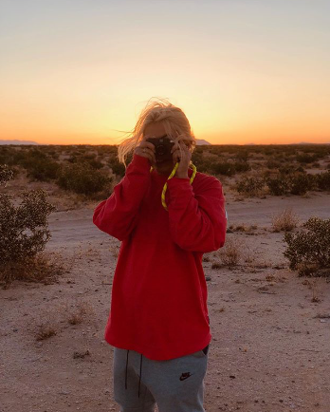
What protections does this person keep on their accounts?
Hayley Kiyoko’s accounts are all fully public and anyone can view them. Although she played a role of a hacker in one show, she has not been hacked in any of her public accounts before. No information that could be harmful or private has been leaked or released onto her accounts before.

Slide 6
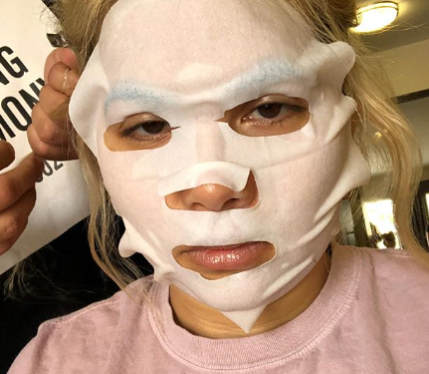
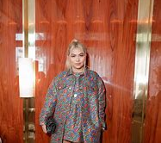
information
Hayley Kiyoko posts a lot of photos of only her upper torso, but occasionally has poses with her full body. She mainly posts pictures with scenery outside like on a beach or in greenery. She also posts pictures at special events, or modelling shoots. Kiyoko rarely puts a location tag on her posts and does not always have location indicators in pictures. Most of her posts are either outside, events, or new music, and almost never shows her house. She uses platforms for showing her trips and concerts, or albums being released and making music. Her platform is also being used to spread LGBT+ awareness and equality and is not being used in any negative ways. Her Twitter and Instagram just show modelling photos, concerts, and relatable pictures and videos. She also posts funny selfies and videos.

Slide 7
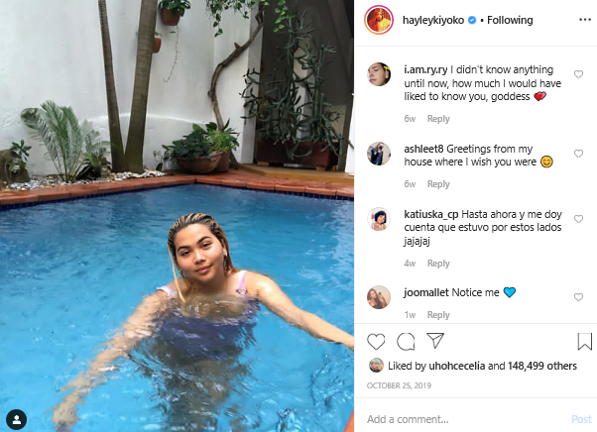
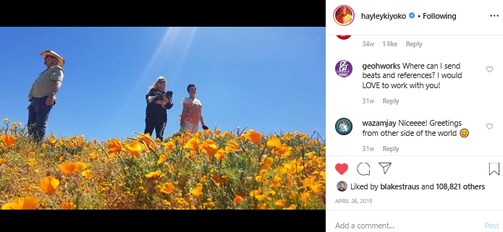
Is this person an example of an “oversharer?”
I do not believe that Hayley Kiyoko is an example of an “oversharer,” because she doesn’t include a lot of location tags or stories that contain too much private information. She uses her platforms as a positive way to spread equality and to show her new music, as well as share pictures and selfies from her trips or events.

Slide 8
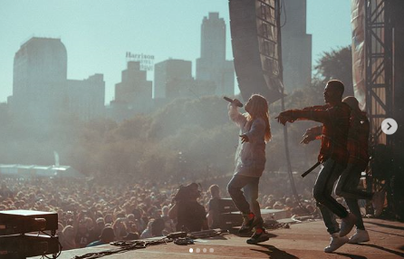
What advice would you give to this person about their digital footprint?
I would not give too much advice to Hayley Kiyoko because she’s doing a good job in not over sharing and keeping private information to herself. She only posts photos that are funny and cool, or letting people know about new music. She also activily advocates for the LGBT+ community and it helps the community a lot.

