Slide 1
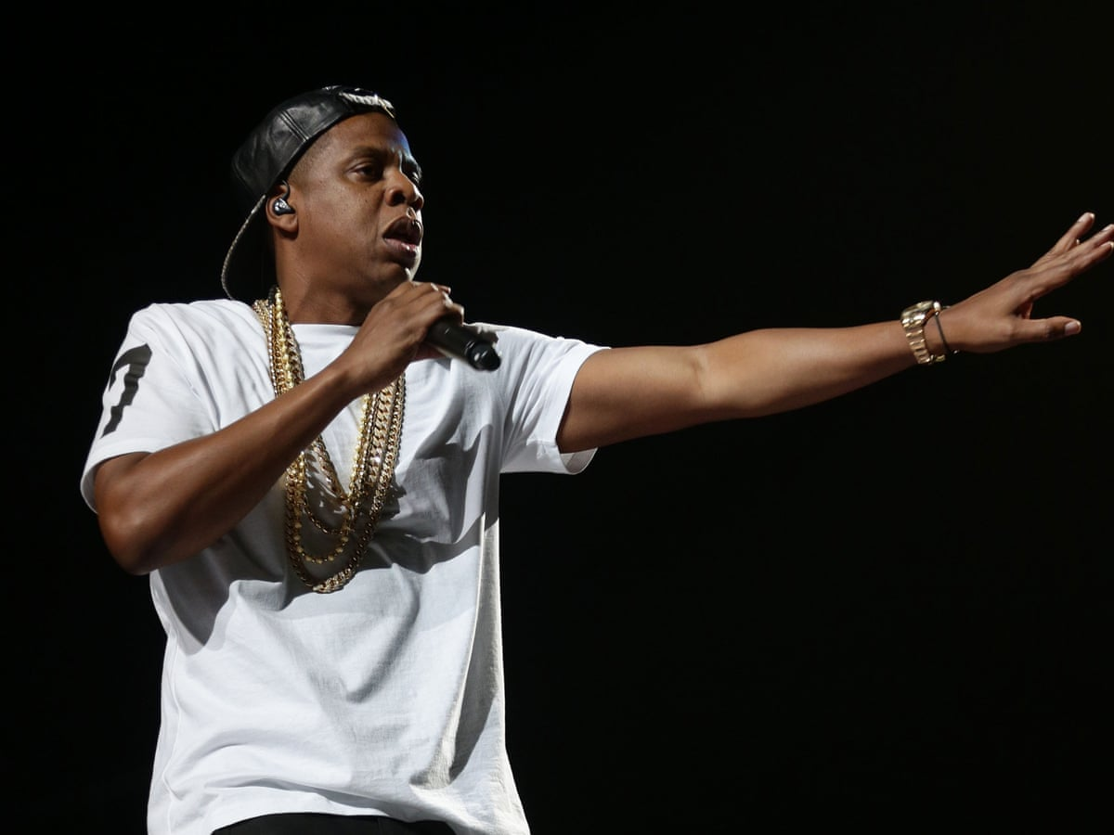
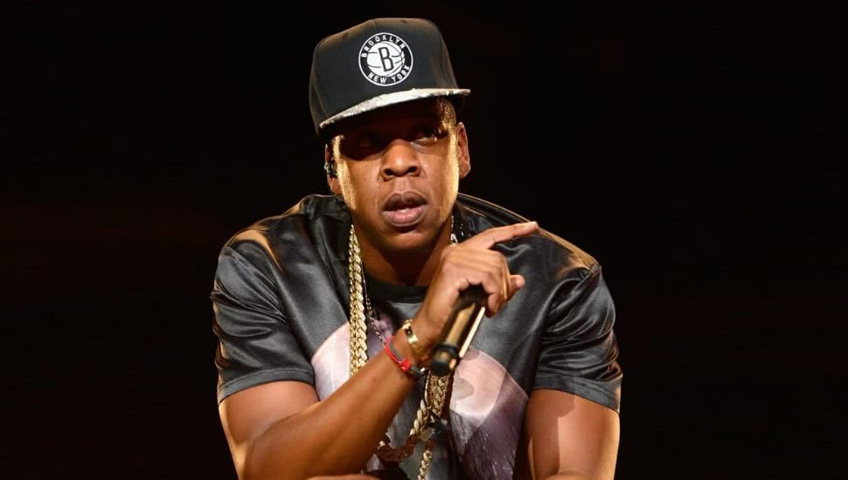
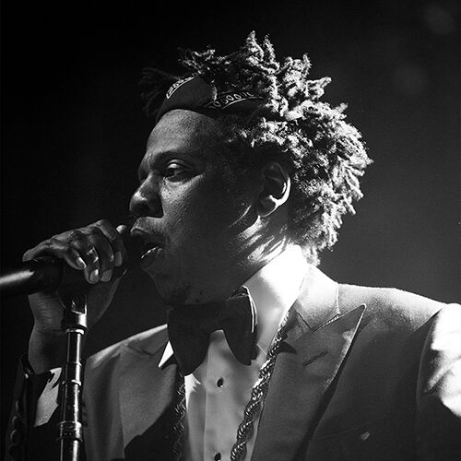
Jay-Z
Analyzing His Leadership Skills

Slide 2
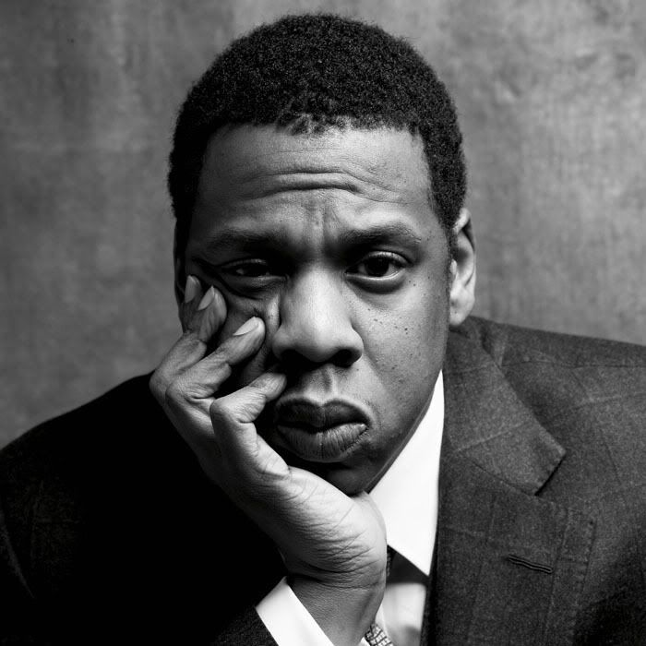
Introduction
Jay-Z, also known as Shawn Carter, grew up in the Marcy Projects, a low-income neighbourhood in Brooklyn that was funded by the government. Being raised by his mother, he was dealing drugs from a young age to make money. His debut album, “Reasonable Doubt” came out in 1996, and sold more than a million copies in the United States. He later developed his career as the most influential artist often being a role model for many modern artists today. From a low-income background to a billionaire in the music industry, What skills did he possess to make this dream come true?

Slide 3
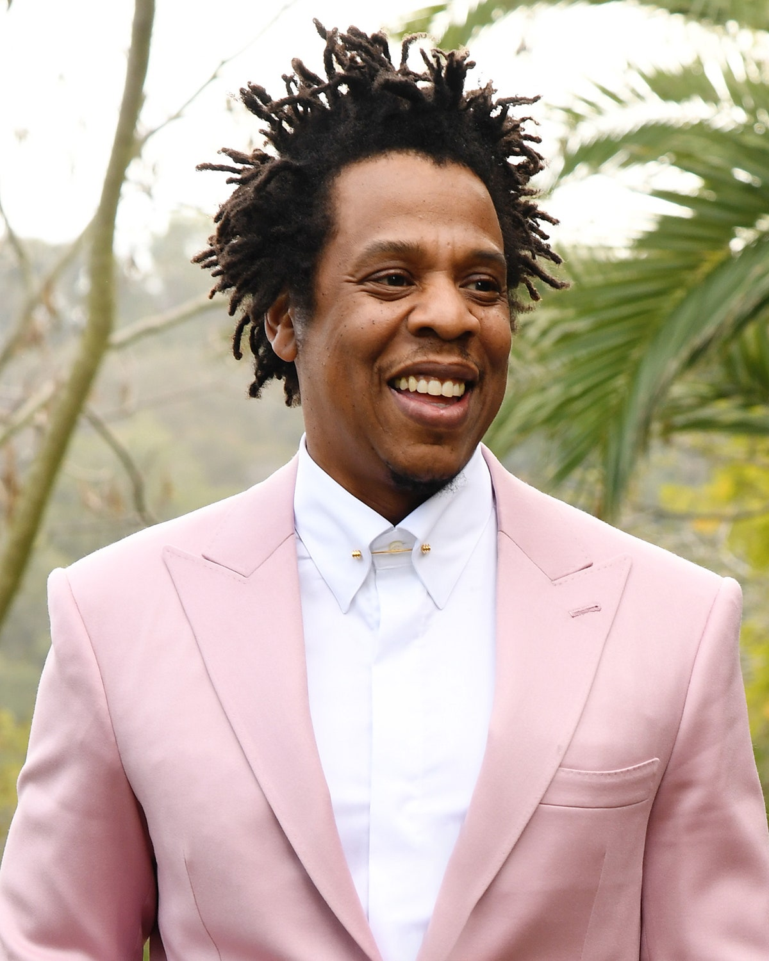
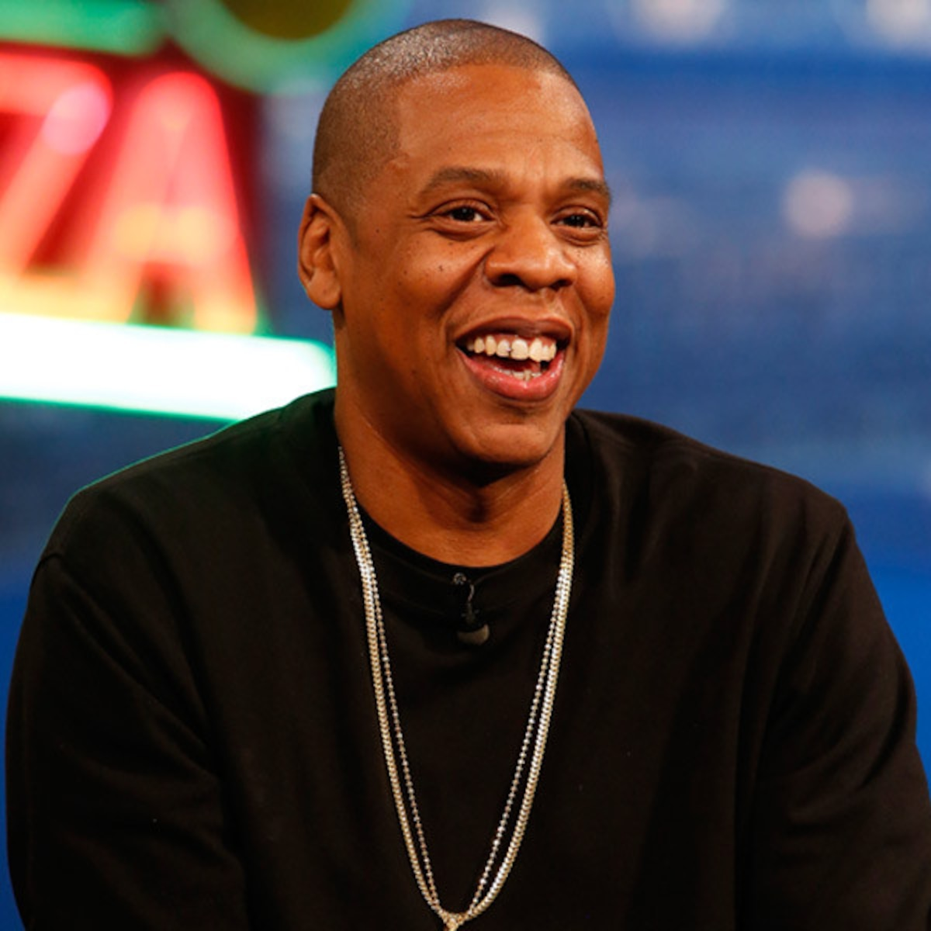
01
Determined/Passionate
The most motivating force

Slide 4
How did he make use of This passion?
“The genius thing that we did was we didn't give up”
Like any good leader, Jay-Z remained passionate about his goal even when things were getting hard for him. When he felt like giving up, he decided to use his commitment in order to keep reaching for new things. Are you even a good leader if you are willing to give up at any minor inconvenience?
He maintained attention with the goal of always reaching big. He pursued his intended goal with constant faith and commitment, and he saw each day as an opportunity. This was shown in his life when he continued to engage with DJs to record new songs, but he had no luck getting a record contract. He was rejected by every major label, and he soon realized that he would never be able to support himself as an artist. Instead of allowing that news to stop and drive him back to his previous life of drug dealing, Jay-Z attempted a different approach by being the producer this time.

Slide 5
Using his passion to set the standard
From his passion, he was able to reach his intended goal. This goal then helped set the standard in the rap industry where many other artists hope to reach the same level of success as him. Even Grammy-winning artist, Kendrick Lamar stated, “I came in a point in time where who we looked up to was JAY-Z, The Dynasty era. That was me…I studied JAY”. Jay-Z has inspired and shown others that with passion, you can achieve anything.

Slide 6
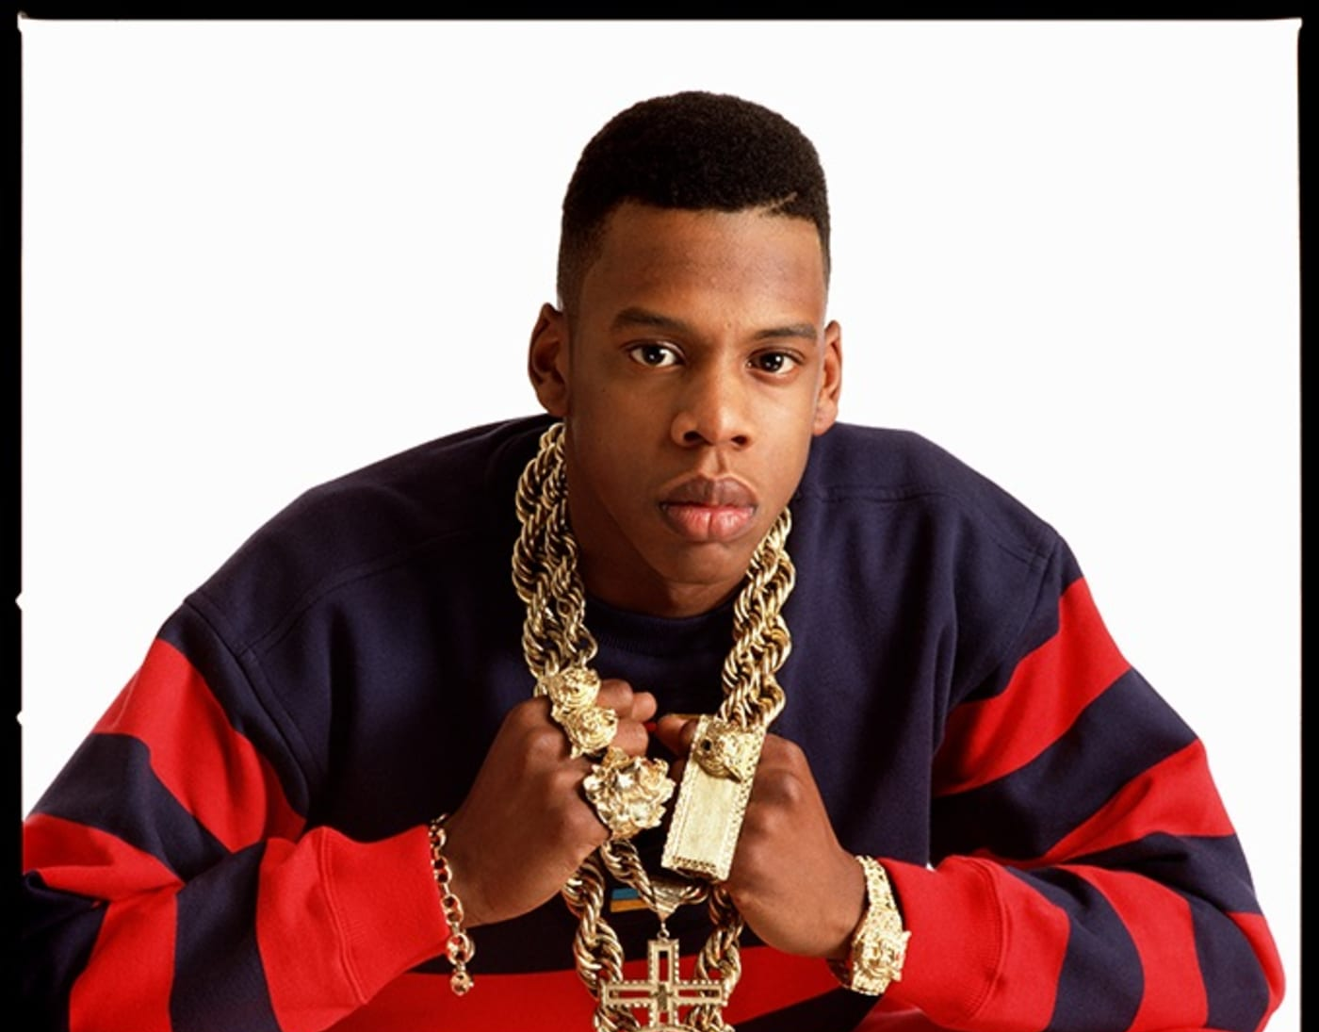
02 Willingness to learn
Changing his rap style
Since Jay-Z has been in the rap industry for a long time, he has learned to adapt to the changing music styles. He had the willingness to learn and adapt to different musical styles, especially when collaborating with other artists. As he collaborated with artists that have different musical styles he was able to find a way to communicate with them where they produced a cohesive project. This was mostly seen in his collaboration album with Beyonce where he showed great variety in his voice, one that was different from his usual tone.

Slide 7
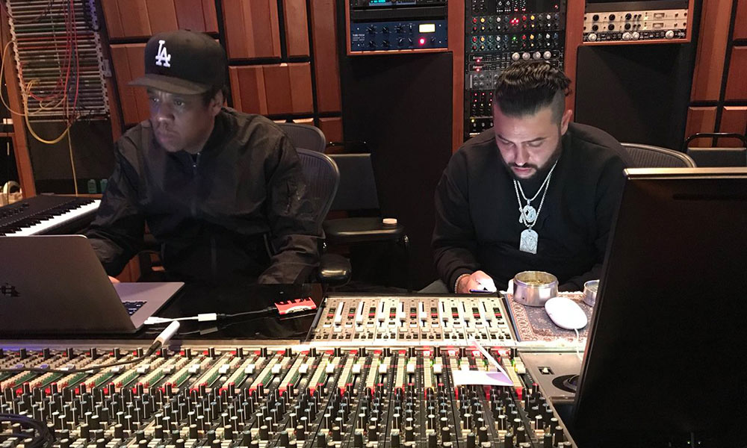
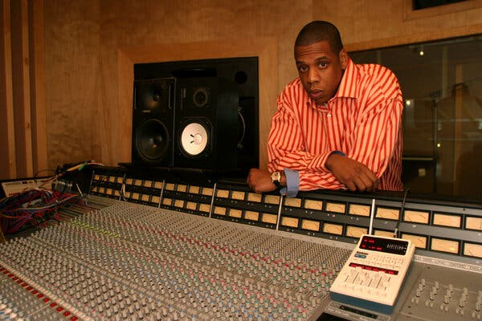
03 prioritizes time
Recording Sessions
To prioritize other people’s time, Jay-Z had all his lines memorized and made sure his levels of energy are at their highest before a recording session.
How is This a habit of a good leader?
His ability to constantly demonstrate his skills showcases that he values the time of others in order to minimize wasting time. As a leader, this showcases his level of respect for other people’s time as well as his own time. This means that he achieves deadlines to continue accomplishing new goals.

Slide 8
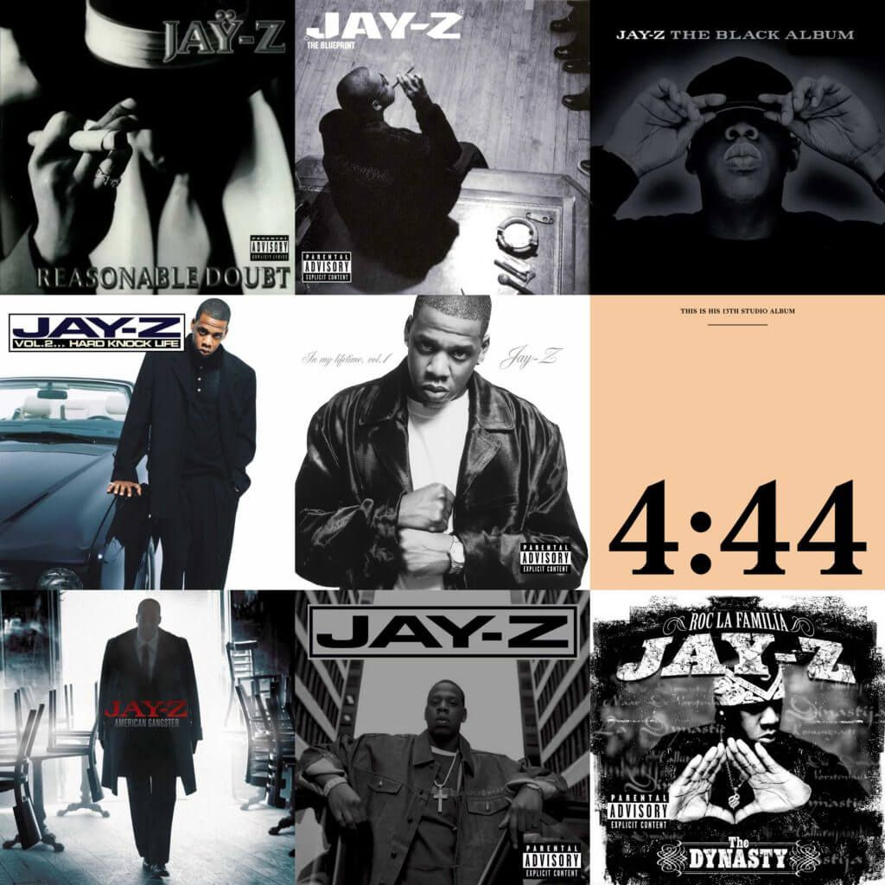
04 Dependability
Unlike other artists in the rap field such as Drake, Kendrick, and J. Cole, Jay-Z manages his time where he releases new music constantly. Extending beyond this idea, he has the integrity not to waste other people’s time by falsely stating that new music is on the way when it is not. When Jay-Z says he is going to release new music, he makes sure to follow through with his promise rather disappointing his fans. This level of integrity can be applied to leadership skills. If you say you are going to do something, it is expected that you follow through with it because people may be counting on you. As a leader, you must be dependable so you can get your tasks done efficiently.

Slide 9
05 Creative/Innovative
The reason that Jay-Z was able to make it so big in his career was that he changed the rap industry with his creative flow and rhymes. His creative and innovative thinking skills are how he managed to create a record label having not been able to secure a contract himself. Rather than conforming to a boss, he was creative enough to set new boundaries within the rap industry and change the rules for the next 30 years.
Even Pharrell said, “when he writes and he’s just sitting there mumbling to himself”. This showcases how his creative process and problem-thinking skills may be odd to others, but it reaches new limits for him.

Slide 10
06
Collaborative Viewpoint

Slide 11
Implementing this viewpoint
Praises collective achievement
Working with other Artists
Accepting Help
As much as a leader wants to reflect on their own success, they must be able to recognize how successful others are. From collaborating with other artists to remove the competitive industry, Jay-Z praises other people’s success often opening the door for many young artists. An example of this is Rihanna, who signed with Jay-Z.
Removes the stereotypical competitive nature in the rap industry to one that is more collaborative. He implements this by working with many different artists that possess different vocal capabilities such as Rihanna, Coldplay, and Mariah Carey. As a leader, he has adapted to many different skill sets to achieve a common goal.
Jay-Z has made it so far in his career by realizing it’s okay to accept help from others. For example, he advocates for many rappers to attend therapy to resolve their issues. As such, he understands the importance to ask for help and to not tackle so much as 1 person.

Slide 12
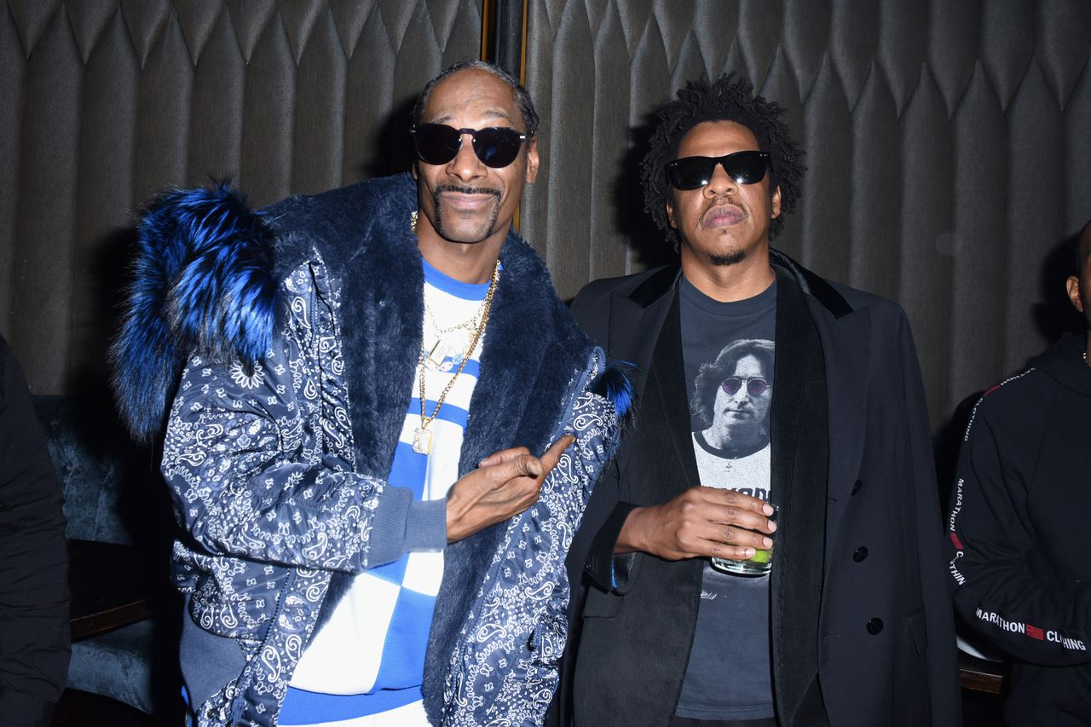
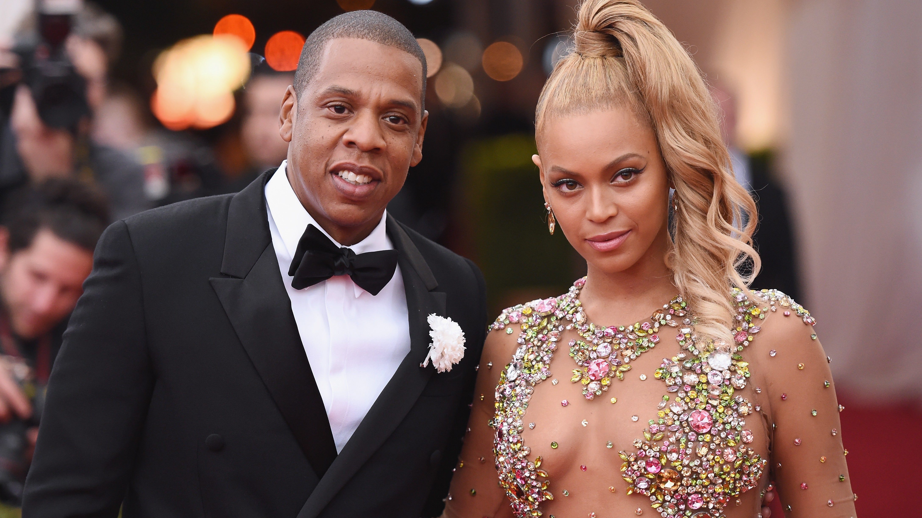
why I think He is outstanding
From nothing to a billionaire
As said before, I believe Jay-Z is outstanding because he was able to overcome huge obstacles in his life such as poverty. He was able to do so by remaining resilient, committed, and determined.
Career in multiple fields
Jay-Z is not only successful in the music industry as he has expanded into the entertainment field with his company called Roc Nation. He has learned to use all of his skills to pursue other interests.

Slide 13
Thanks

