Slide 1
Pewdiepie

Slide 2
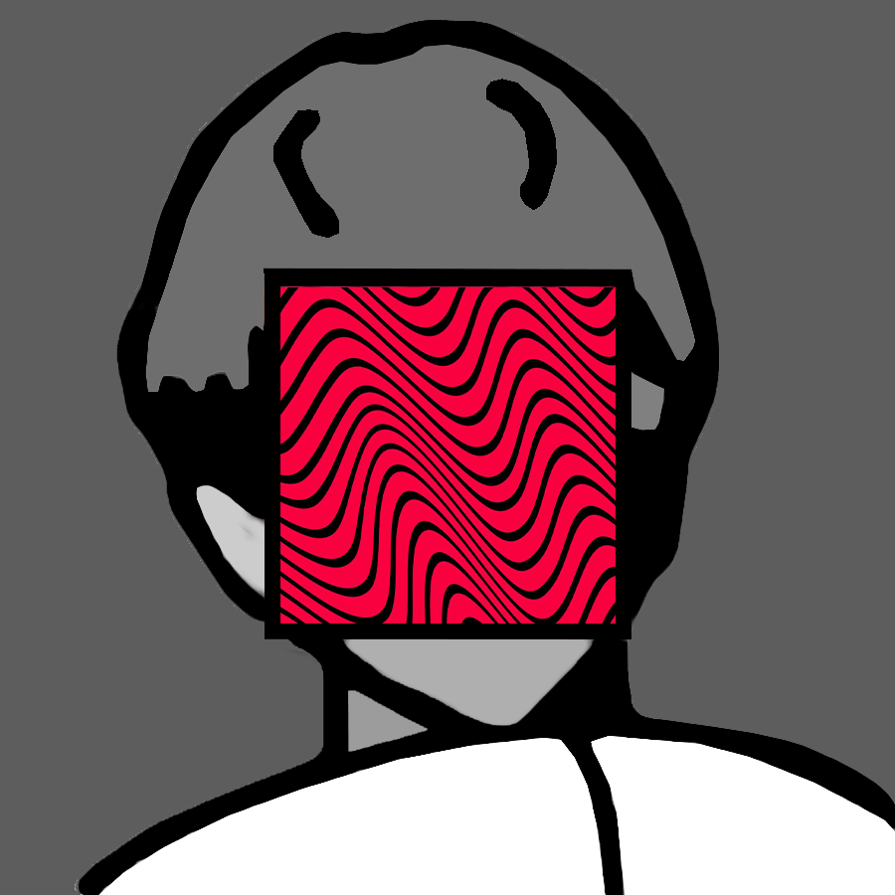
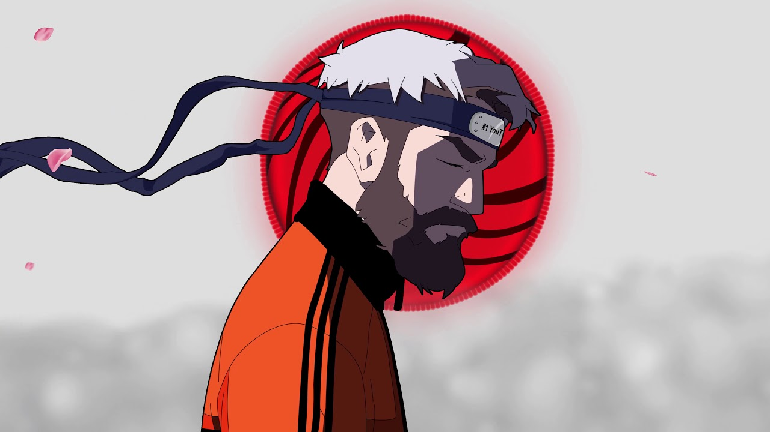
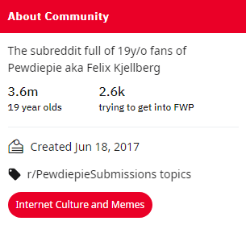
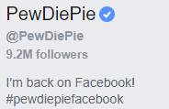
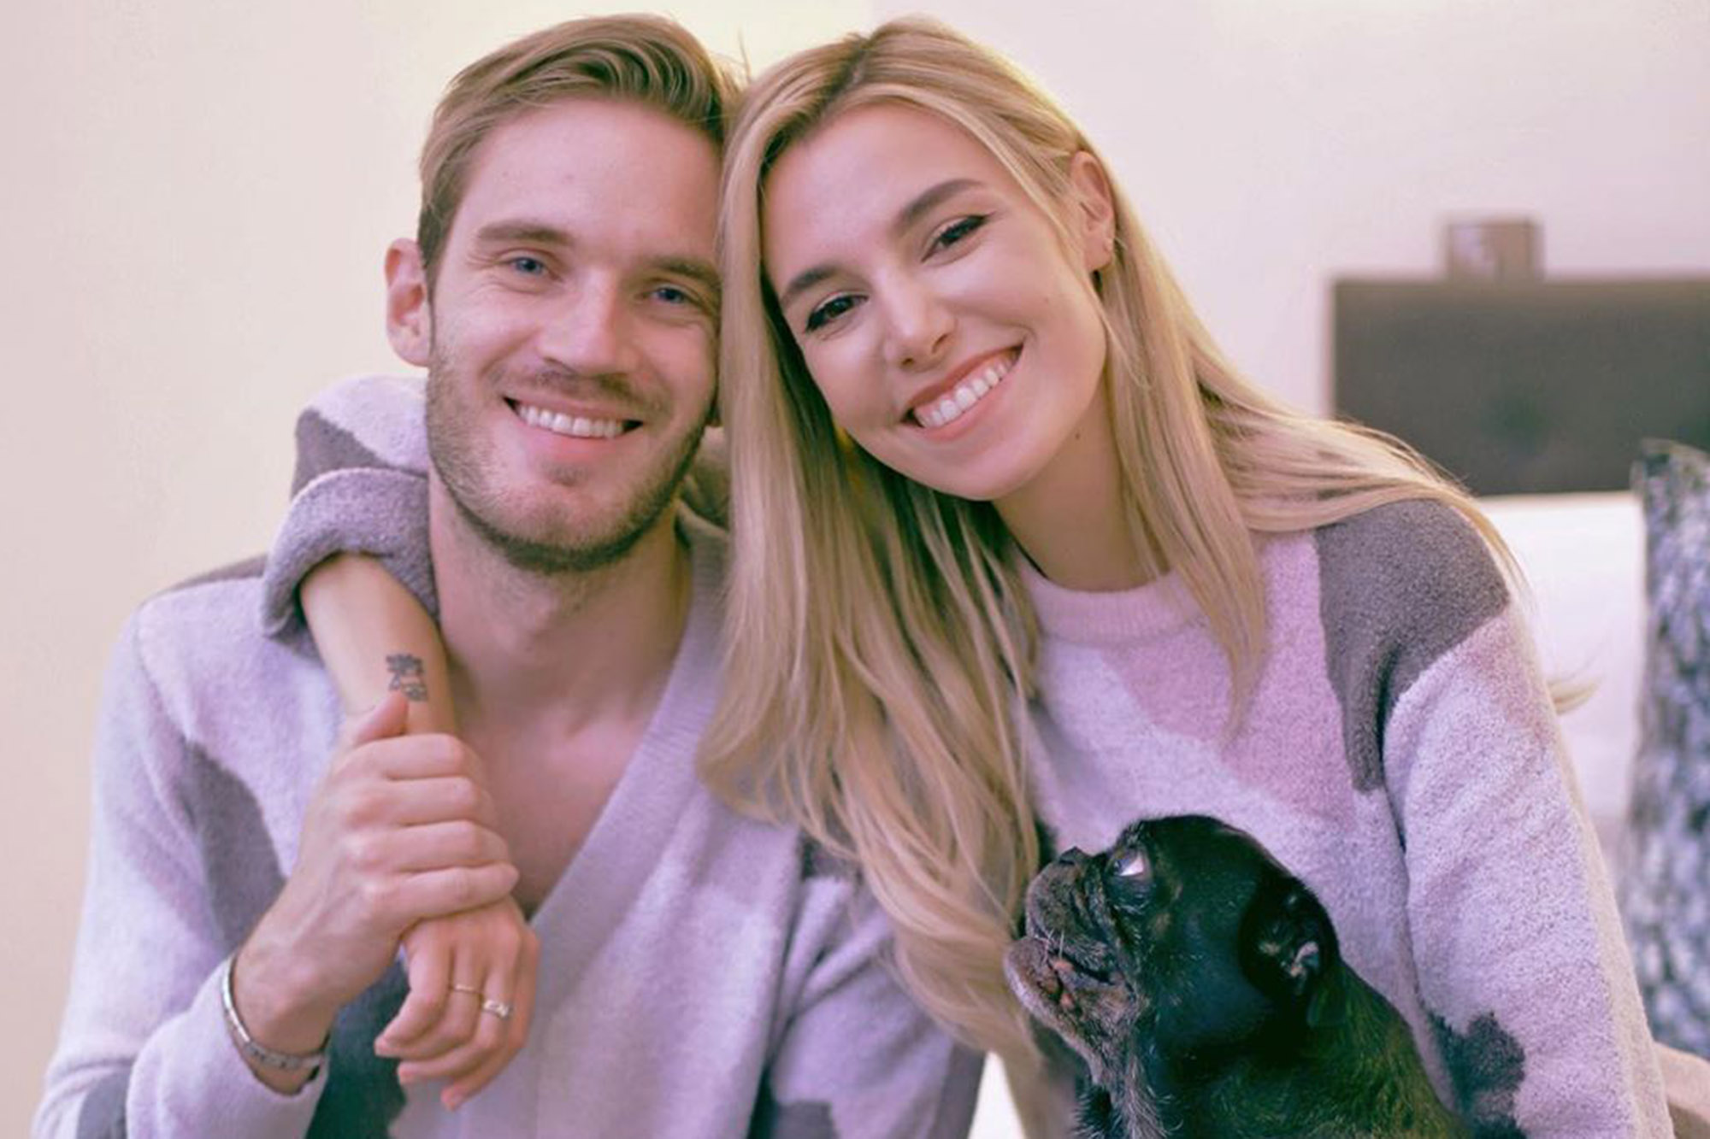
Digital Footprint
Felix Arvid Ulf Kjellberg
(Pewdiepie) is a gaming/reacting Youtuber who has a YouTube channel with over 110 million subscribers. Felix has a comprehensive digital footprints and uses: Instagram, Reddit, Facebook, and YouTube. He also has an online merchandise store where he sells Pewdiepie themed clothing.
His videos are quite funny, however, there is lots of swearing in his videos. He posts videos 3-5 times a week on YouTube and is quite active on Reddit and Facebook.

Slide 3
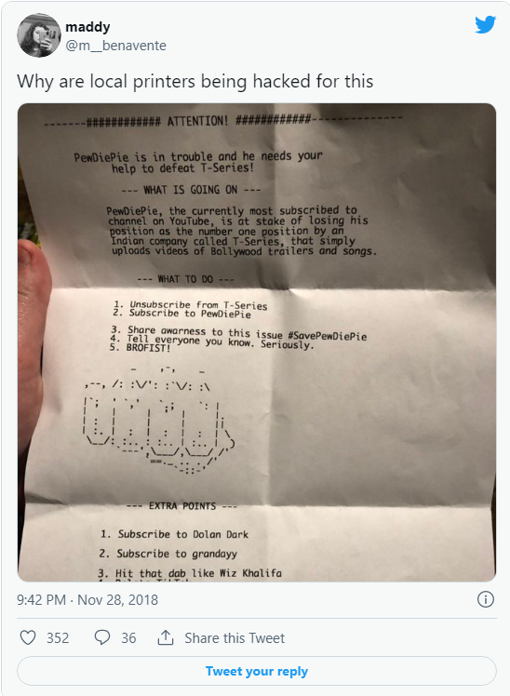
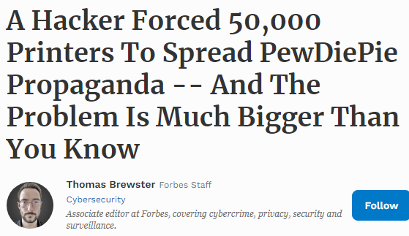
Protections?
However, PewDiePie fans have hacked other things. An example of this is when a hacker hacked thousands of printers around the world with a promotional message to subscribe to PewDiePie.
PewDiePie has a very public digital footprint and is all his social media accounts are public and visible to everyone, anyone can leave a public comment that anyone else can see. PewDiePie hasn’t gotten hacked on a major social media account but got his Minecraft account hacked once. It was not a malicious hack, and the hacker just changed the skin and name of the Minecraft account.

Slide 4
What Does He Want Us To Know?
PewDiePie shares details about his life but not enough for it to be malicious or dangerous. We know some facts bout PewDiePie though; he was born in Gothenburg, Sweden, is married to a girl named Mariza, has a house in England and one in Japan, has 2 dogs named Maya and Edgar and that he went to Chalmers university until he dropped out to focus on YouTube.
In Felix’s videos if there is someone else in the video, he doesn’t show them and respects the fact that they might not want to be in the video. He also never shows any information of the people around him, he blurs license plates and keeps the camera on himself.

Slide 5
Is Felix Oversharing?
My Advice For Felix
Felix has quite a lot of in real life vlogs, so we can see the background of his house and the places he goes too outside. However, when he does an in real life vlog you can’t see lots and most of the time the camera is on his face.
I feel like he does overshare but very slightly, he shows his house layout and the positioning of his furniture. However, other than a couple specific videos he doesn’t overshare and stays safe online.
PewDiePie knows what he is doing online and keeps himself safe, however, I think he should try to not show his houses too much and when he does an in real life vlog, he should start the episode outside of his own house to not expose its location. He also has earned millions from sponsors and YouTube so he should try to stay safe from scammers.
This Photo by Unknown Author is licensed under CC BY-SA

Slide 6
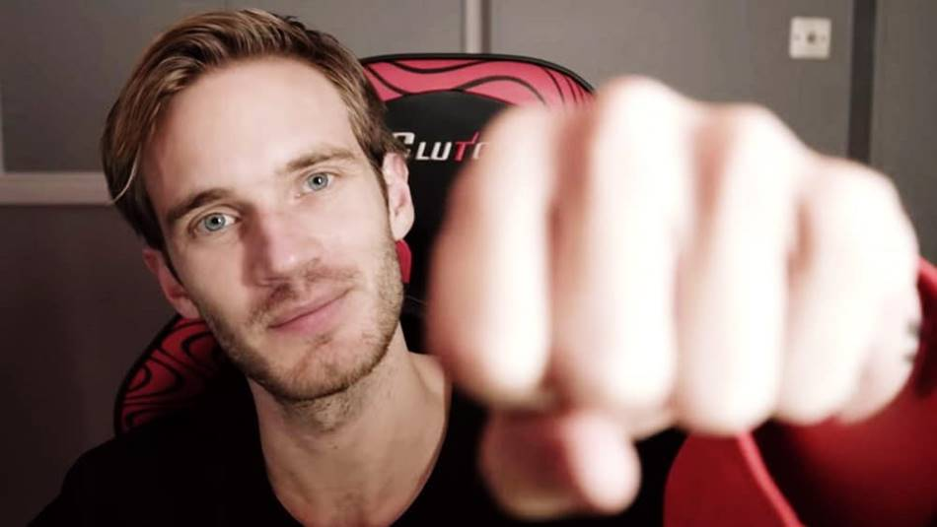
The End!

