Slide 1
digital footprint assignment
By: Briana Luu

Slide 2
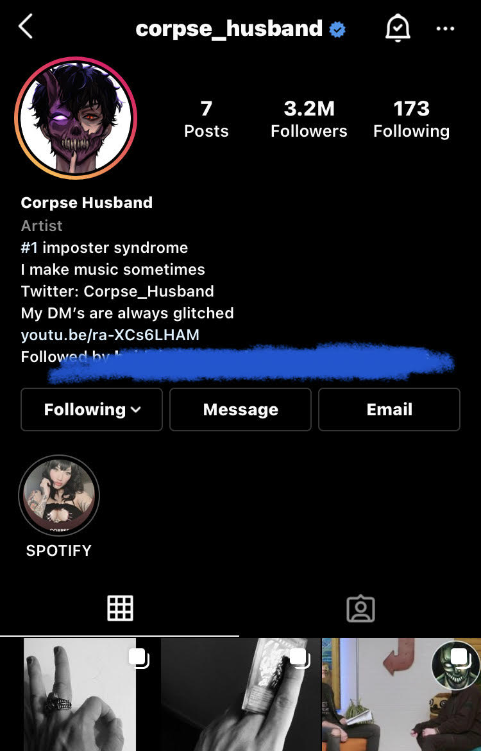
CORPSE
CORPSE, also known as Corpse Husband is a singer-songwriter, youtuber and gaming streamer.
Corpse has a twitter, youtube, snapchat, instagram and other platforms like spotify and apple music, too.

Slide 3
Protection
All of Corpse's known accounts are public and has never had any sort of hacking/information leak. He is very private on social media; his name has not been revealed let alone his face despite having many social media accounts and gaining a massive following (youtube:7.2M, instagram:3.2M).
Though he has been on youtube since 2015, it is said that he has only revealed his face once or twice on livestream, when he had a much smaller following.
He rarely shares any private information about himself. The closest thing I can think of being "private" that he has shared is that he lives in California (which is still a big place).

Slide 4
Is he oversharing? +my advice
Of course not! I think that it's amazing how he could gain such a massive following without ever having anyone know what he looks like.
He does not fit the characteristics of an over sharer on social media.
Out of all the social media influencers, I think he is probably one of the most private about their life.
I don’t have any advice for him. What he's doing seems to be working for him and I support him in whatever he decides or decides not to share.

