Slide 1
Bruce’s Career Path
How to become a computer scientist.

Slide 2
My Career Goal
I want to become a computer scientist by 2029-2030
To get there, I will need to:
Graduate high school by 2024
A master degree in software engineer and computer science
Experience with computer programming or system analysis.

Slide 3
What is a computer scientist?
A computer scientist uses technology to solve future or current problems. Uses algorithms to tell a computer what to do.
Analyze problems and develop solutions for them
Write programs that would help people interact better with software and hardware.
Program new software applications that would benefit society.

Slide 4
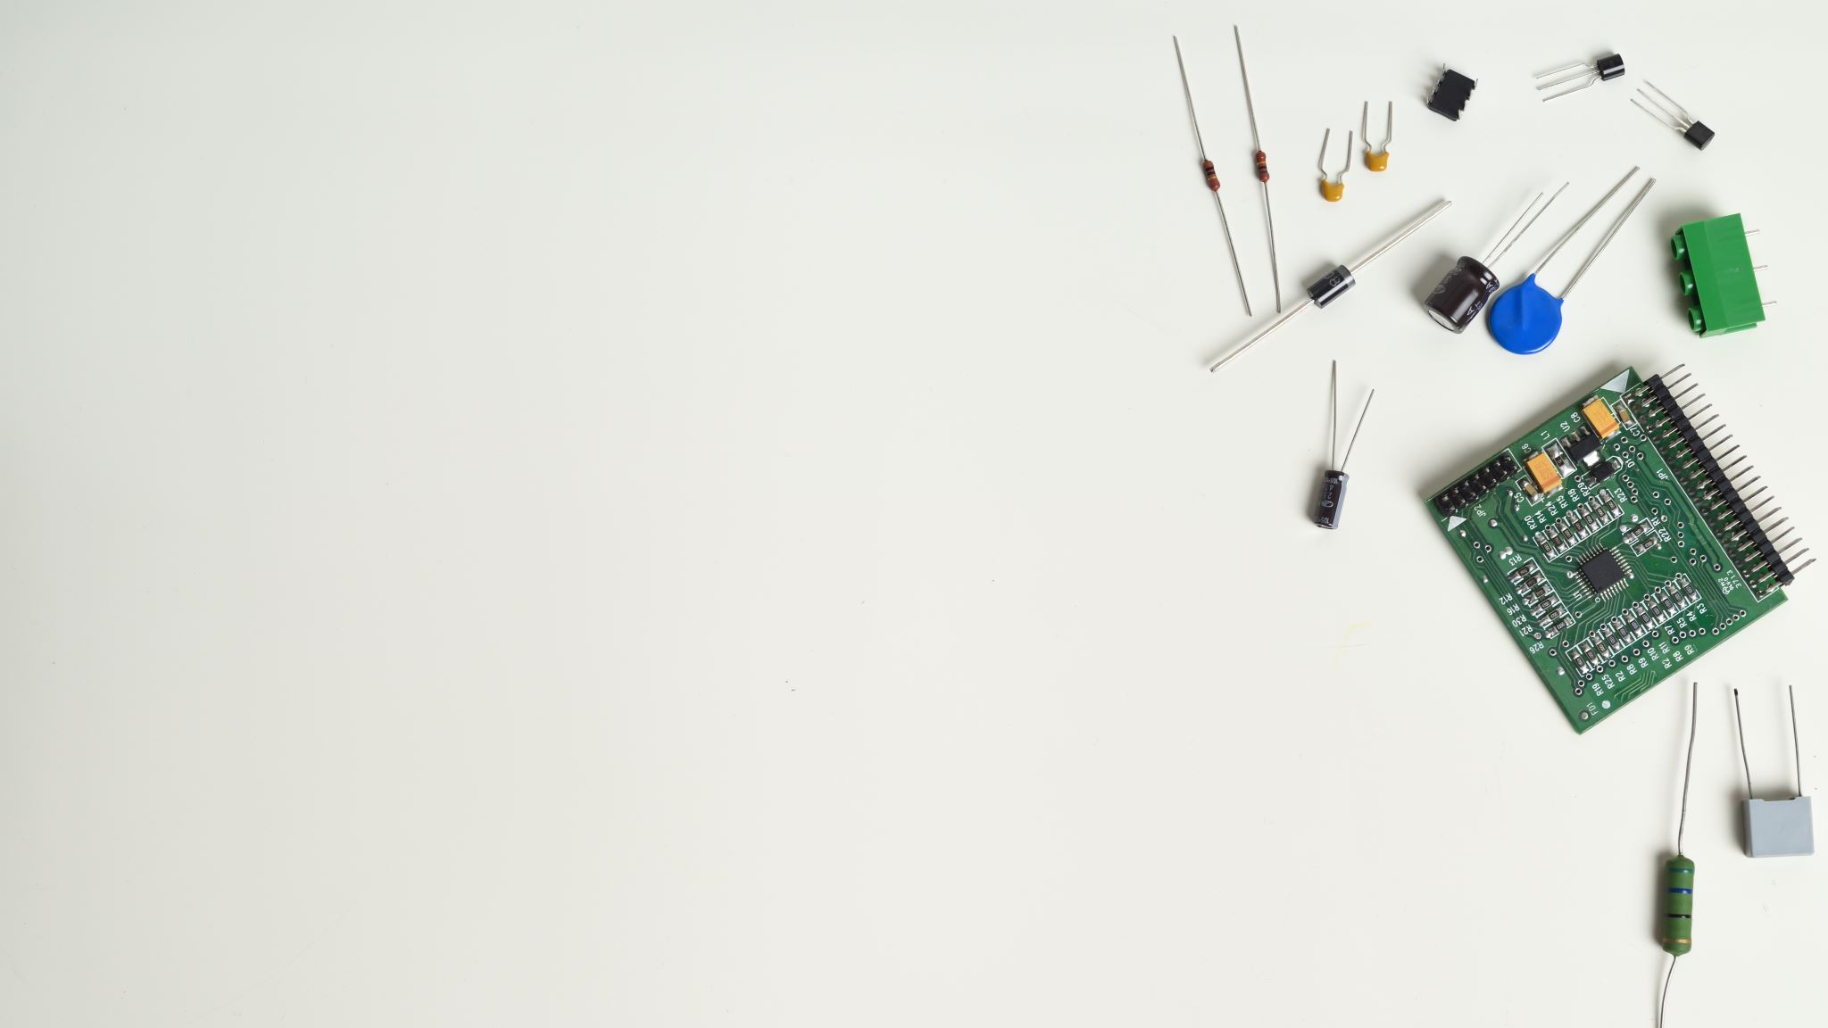
About my future career
A computer scientist usually works full time in a comfortable office. Their schedules are very flexible and independent.
The salary range for this job is $54,995 to $140,795 year.
A computer scientist usually works for 40 hours a week.

Slide 5
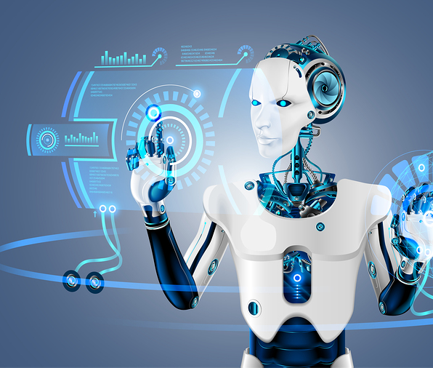
1.5% chance of becoming automated
Given the percentage rate to be very low, it is very unlikely that a computer scientist’s job would be automated.
Reasons:
A computer scientist’s job is to create new complex algorithms, and robots are unlikely to do that soon.
Currently, lower leveled programming are being automated, but as programming gets more complicated, the more complex programming is unlikely to be automated.

Slide 6
My compatibility
Based on the myBlueprint quiz, I am 75% compatible with this job.
The skills this job requires are:
Bachelor’s or master degree in computer science, engineering, commerce, or business administration.
Some years of experience with system analysis, software engineering, or computer programming

Slide 7
Computer scientist would be great for me because…
I already have these skills for this career:
Knowledge about Python coding
Knowledge about engineering and robotics
I have taken business 9
Great critical thinking and communication skills

Slide 8
I am not quite ready for this career, but I will get there!
These are skills for the job I still need to learn:
Learn how to commercialize a product
System analysis
Business administration
This is how I will get those skills:
Take business class in grade 11 or 12.
Take computer programming 11 and 12.

Slide 9
Job Outlook
In BC, the job outlook is 3 of 3 stars.
Here are 2 reasons why:
Employment growth is growing steadily.
With technology advancing every year, there will be more and more opportunities to become a computer scientist.

Slide 10
Safety in the Workplace
In this career, I need to:
Do not post harmful content of any kind in social media
Do not write programs or algorithms that are bias to anyone.
Use a mouse and position it within good reach.
Do not sit and stare at the screen for too long. Take frequent short breaks.
Choose a brightness level that fits the lighting condition

Slide 11
This is what appeals to me with this career
I am very interested in technology and computers in general. I would want to create algorithms that would solve real life problems and make a difference.
I have a passion for robotics, coding, and math and I think being a computer scientist is perfect for me.
I would want to make technology better for everyone, and I want to do this because it’s something I would enjoy doing.

Slide 12
These are some things I find less appealing about this career.
Always working in a office environment might not be a good fit for me. I would want to be able to talk and work with other people physically.
I find system analysis to be less appealing to me because looking for errors in a code doesn’t seem interesting for me.

Slide 13
Potential obstacles to getting this career
3 possible obstacles:
Getting a Bachelor’s degree in computer science is hard, and it will be a challenge to get one.
High education requirements

Slide 14
Potential obstacles to being successful within this career
3 possible obstacles:
The field of computer science is very competitive, and it will be hard to be successful.
People all have different opinions, and algorithm biases will start to appear.
Need to constantly update your knowledge

Slide 15
The training/education required for my career
Graduated university
A bachelor’s or master’s degree in computer science, commerce, or engineering.
Some years of experience with computer programming, system analysis, or network design.

Slide 16
2 options for acquiring the training/education I need:
Option #1
Option #1
Studying 4-5 years for a Bachelor’s degree in computer science
Studying 4-5 years for a Bachelor’s degree in Engineering, and take a extra-curricular class about computer programming.

Slide 17
I intend to go to Waterloo for that career
Water is located at Ontario Canada, Waterloo
I would want to take the Computer Science program
Length of the program: 5 years
Certification earned: Bachelor’s degree, Co-op, and honours.

Slide 18
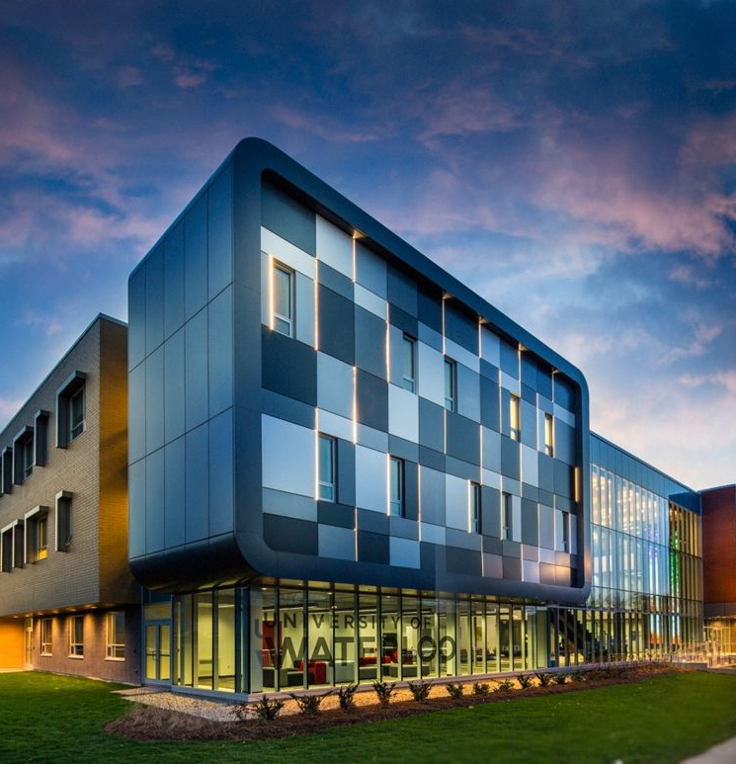

Slide 19
High school courses required for admission
Grade 11 courses:
Computer science 11
Grade 12 courses:
Grade 12 English (min 90%)
Grade 12 Advanced Function
Grade 12 Calculus and Vectors

Slide 20
Scholarships/Bursaries/Grants
President’s scholarship. $2000 entry scholarship. Early May admission average of 90% to 94.9%.
In grade 9, my average grade is around 94%, which meets the criteria. If I could keep it up, I can meet the criteria of 90%-94.9%.
Various entrance scholarships. $1000-$5000 a year, $8000-$15000 over the degree. Academic performance and performance in Euclid contest and Canadian Senior Mathematics Contest.
I have done every well in CIMC contests. I scored the highest in Pinetree Secondary School for Pascal and Fryer.

Slide 21
High results in Canadian Computing Competition, Canadian Senior Mathematics Contest, and/or the Euclid Mathematics Contest can help your application.
The University of Waterloo is famous for its engineering, math, and science programs.
I chose this institution because the programs that they offer will help me in my career a lot.

Slide 22
Financial Plan - Tuition
Total cost of program: $15900 per year. $79500 for 5 years.
I am going to pay for my program:
My family would pay for part of my loan.
Try to get a scholarship and pay some of the loan
Get a part-time entry job.
Student loan

Slide 23
Some related occupations:
Computer programmer
Web designer

Slide 24
Computer scientists are awesome!!!
The computer science field is growing 16% every year.
80% of computer scientists are male
Every year, 5000 new computer viruses appear.

