Slide 1
Digital Footprint
By: Bryan Chang

Slide 2
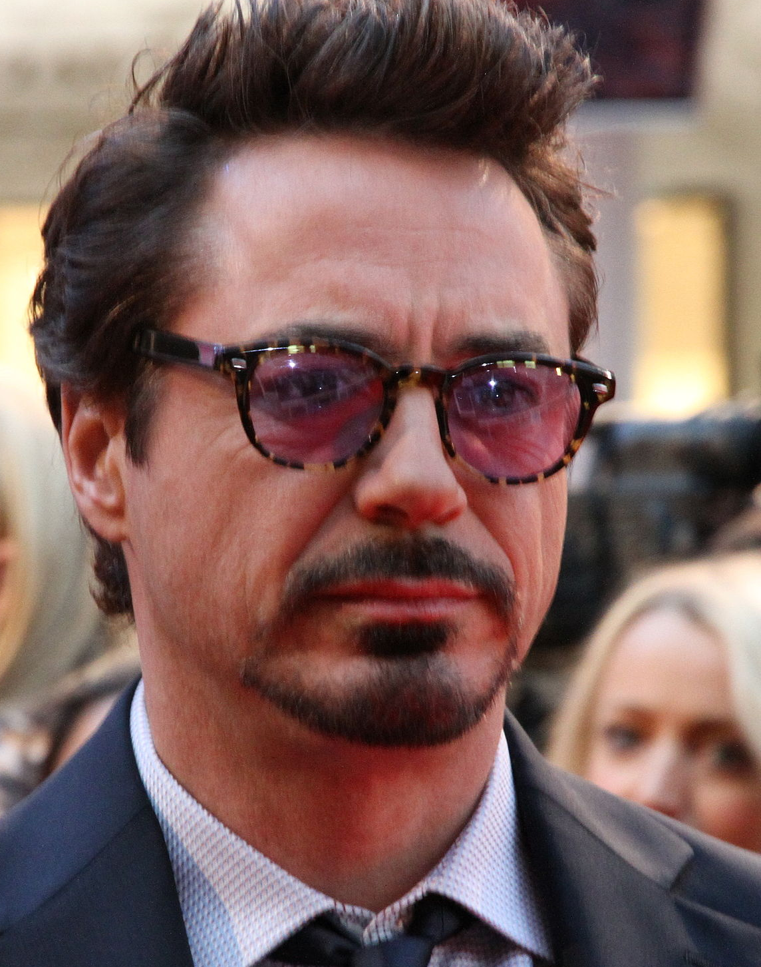
Robert Downey Jr

Slide 3
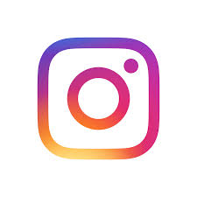
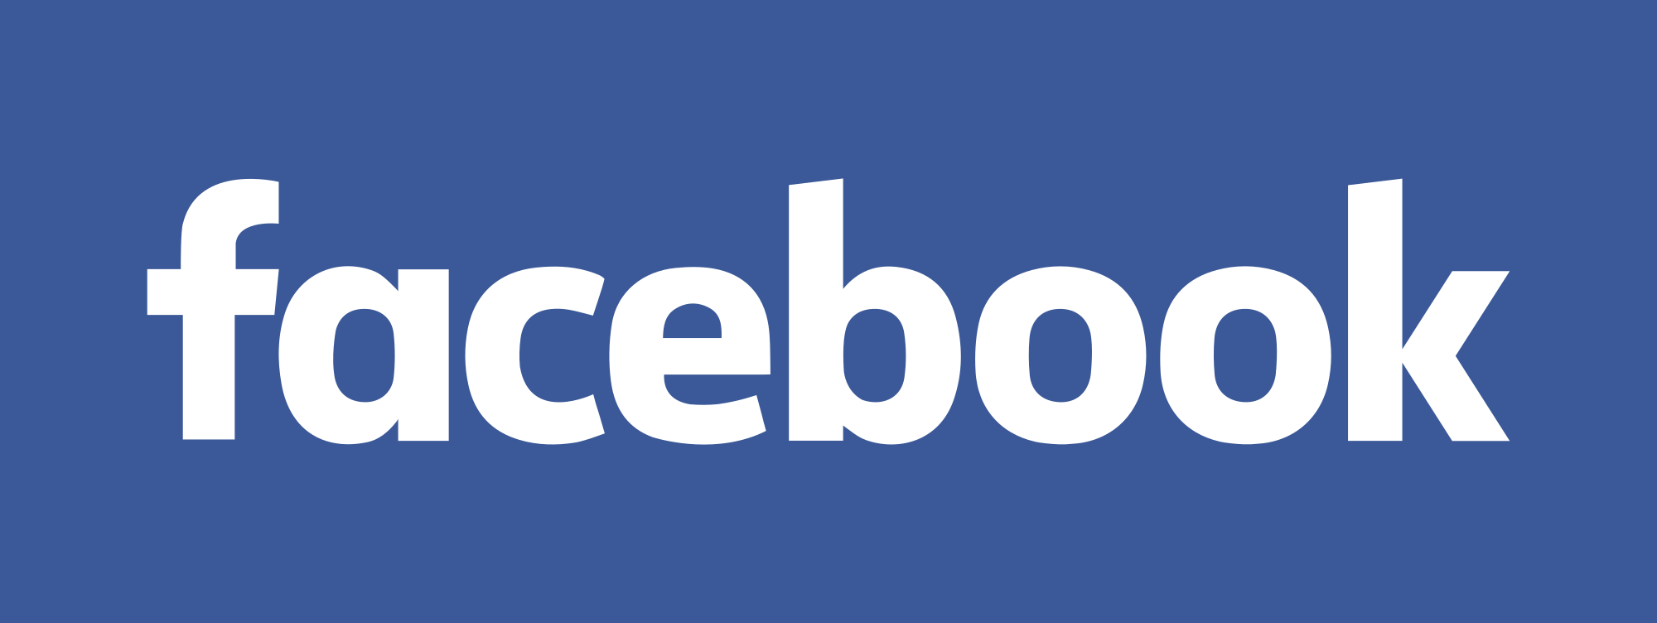
How expansive is Robert's digital footprint?
Robert has 3 known social media platforms, Twitter, Facebook and Instagram.
Robert normally post when there is a special event, holiday or to promote something. Robert posted a trailer of a movie called Dolittle to promote a movie that is acting in.

Slide 4
What protection does Robert have on his accounts?
All of Robert's accounts are fully public. Robert's Instagram account has been hacked before and he warned everyone on his other accounts that his Instagram has been hacked. The hack was doing a phone give away, which is clearly fake.

Slide 5
What information do they want you to see and what not to see?
Robert only wants us to see upcoming events or movies he is staring in. He might post some personal things like a Happy Birthday to his wife. Every now and then he might post a meme on his twitter. Robert doesn’t hide much from us, but he does hide his sensitive personal which is obvious.

Slide 6
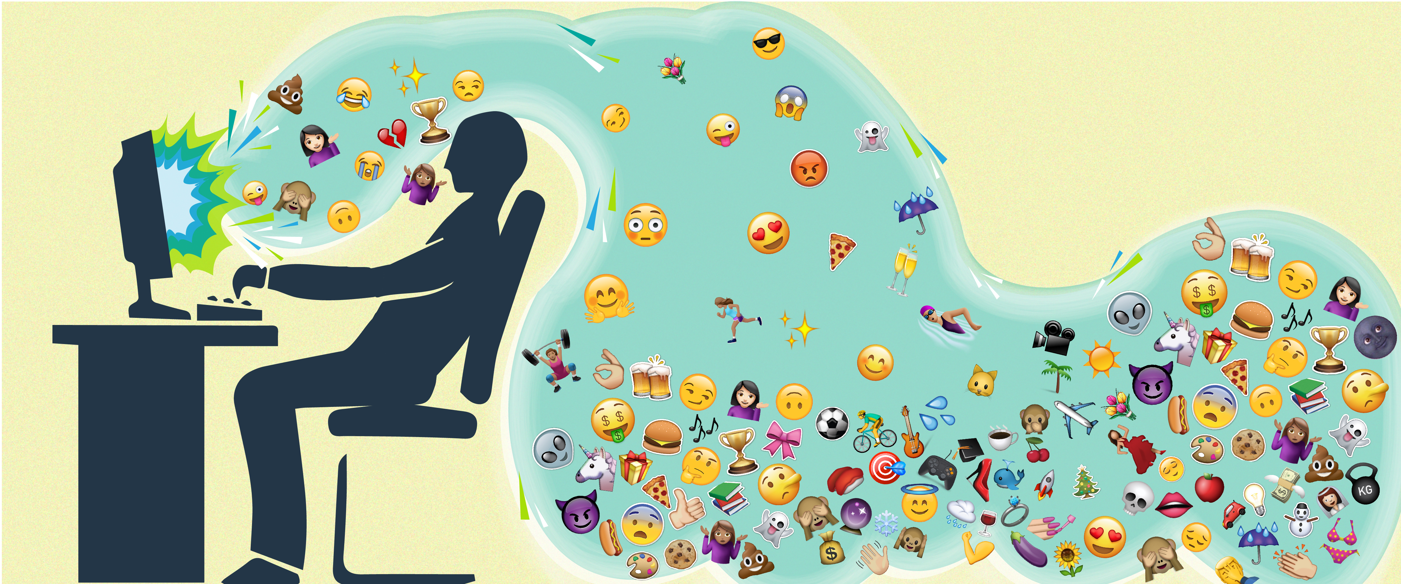
Is Robert over sharing?
I think Robert Downey Jr is not over sharing because he is famous, most famous people have an article about their back stories and life. The majorities of Robert's post are promotions for movies he is in. The information Robert is sharing to us isn't too personal for us to use against him.

Slide 7
Advice to protect their digital footprint
I don't have any advice for Robert Downy Jr because I think he is doing a good job to not over share his personal information's to the public.

Slide 8
The End
Thank you

