Slide 1
Kareem Hesri (Keemokazi)
By Charlotte Lee

Slide 2
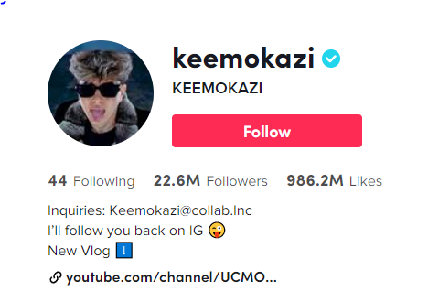
Short Description
Kareem Hesri, also known as Keemokazi, is a famous tiktoker who creates comedy or funny short videos like playing pranks or tricks on his family and friends, who almost reached 23 million followers and a billion likes on his Tik Tok account.

Slide 3
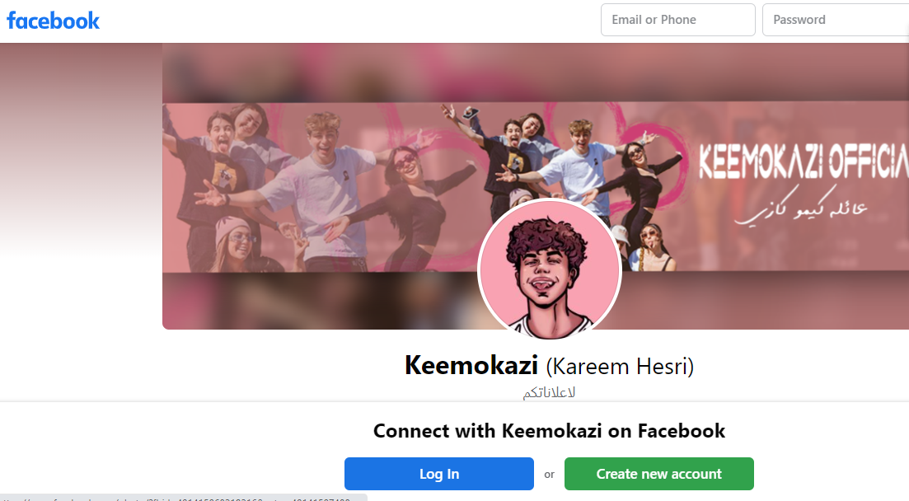
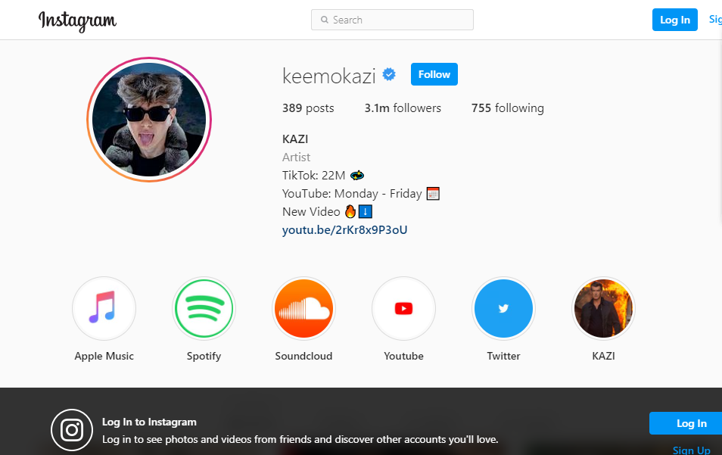
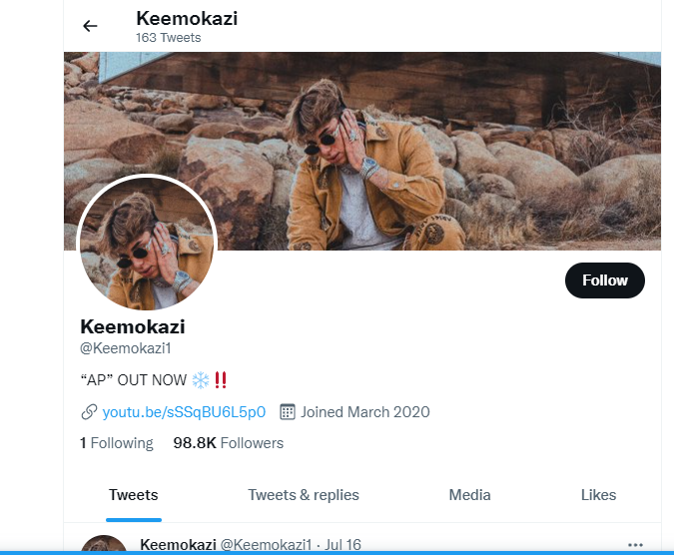
Social Media Accounts
Kareem also has his own Instagram, Facebook, Twitter account, and Youtube channel. He sometimes makes his song, music video, and several contents, games, or challenges. He posts new posts on his social media, especially on TikTok, 6 or 7 times a week. His account is fully open to the public, which means that people whoever has access to his account can see his videos.

Slide 4
What He Posts On His Accounts
Karem mainly posts videos of pranking his family, making fun of his family, or blogs of his adventures. Sometimes, he shows other people on his screen or camera and shares his private thoughts. For example, when Kareem tries to show the quality or mood of things around him, he also shows people around him. Also, he tells the viewers where he is and take videos of his house. In some videos, he talks about his friends and family.
This Photo by Unknown author is licensed under CC BY-SA.

Slide 5
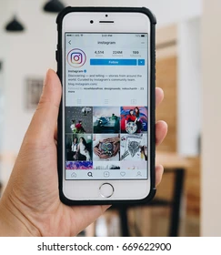
Why This Person Can Be An Oversharer
I think Kareem would be an example of an oversharer because he doesn't really keep things privately. He even reveals his childhood video that are almost as old as 5 years ago, or he sometimes posts videos that shows his family when they don't want him to film them like when they're sleeping, getting their private time alone, or when they do something secretely. Also, he tells us about facts of his family like what his siblings are scared of or what his siblings like.

Slide 6
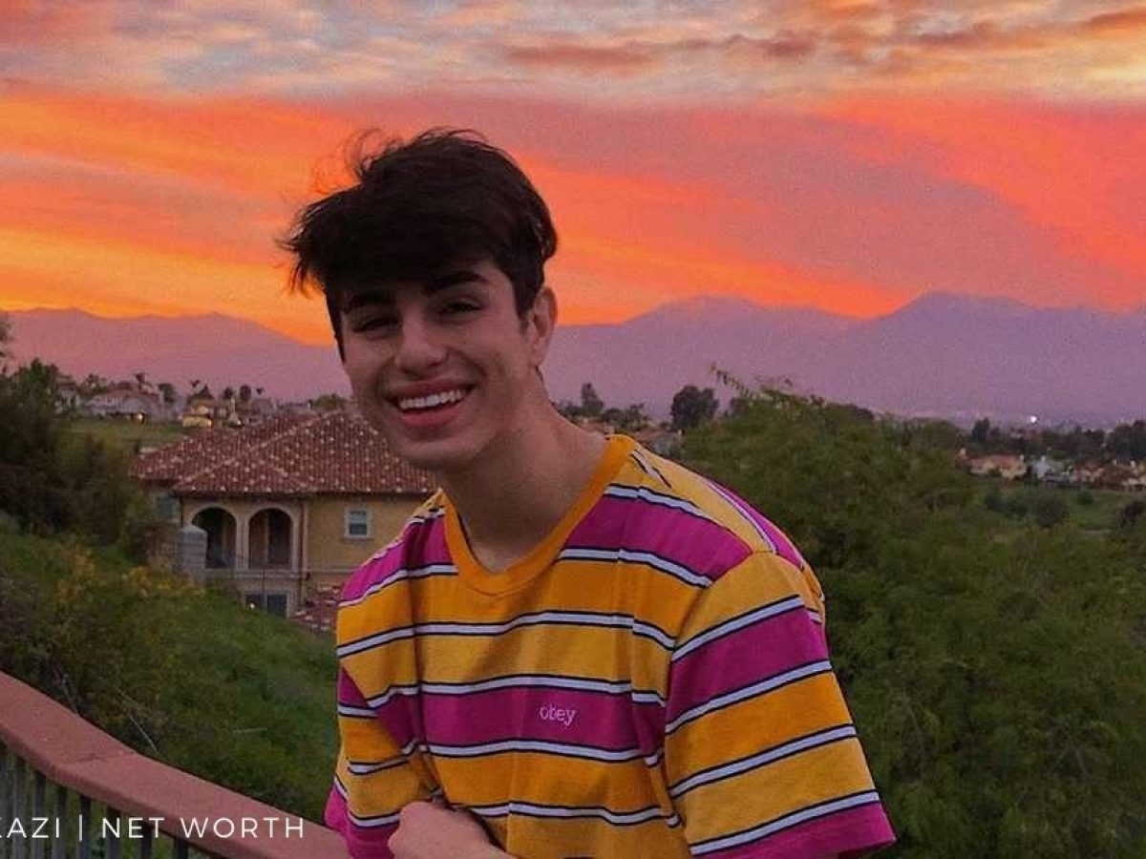
If I can give this person an advice about their digital footprint, I would tell him to make his account private or if he wants it to be public, he should better stop filming bad things with people around him even though others like them or he thinks they're fun. I'm also going to tell him that it would be unsafe to show too much of his things.

