Slide 1
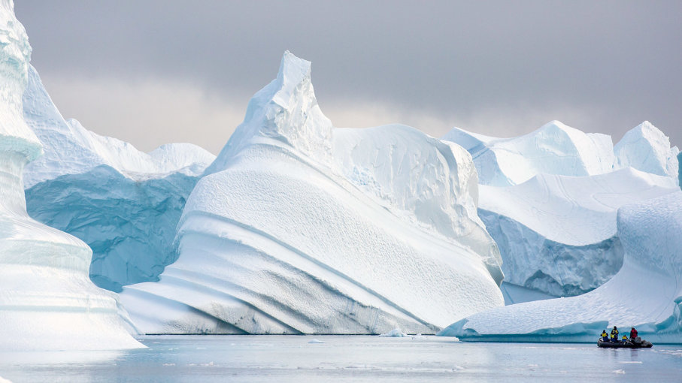
Arctic Poetry
By: Connor Scott

Slide 2
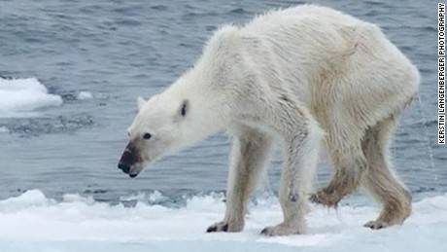
Why did I choose this region?
Determined to convey the beauty of the Arctic
It seemed to be easiest to have an emotional effect
Research had begun prior to the poetry

Slide 3
What can you expect from my first poem?

Slide 4
Daybreak
Frozen tides crash against the icy shore
Battling with the chilling wind
Chilling wind, which howls through the night
It’s screeches and wails cutting to the bone
Men who dwell here, do not even shake
It’s the ice that was always destined to break
A few hundred men, is all that it takes
To make it through the night, survive until daybreak

Slide 5
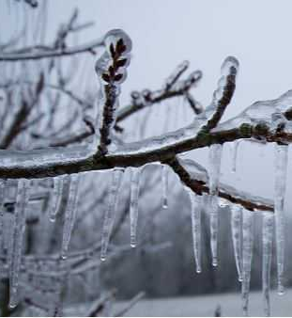
A glacier crown, stares from above
Spitting shards of ice at the men below
Women and children, sit by the fire
Willing its flames to reach their souls
Burn away their doubt, make the wind less cold
But their faces turn blue, and they can’t get warm
“Another minute by the fire...” a girl would say
Just to delay the inevitable, of the cold Arctic day
A few dozen men, is all that it takes
To make it through the night, survive until daybreak

Slide 6
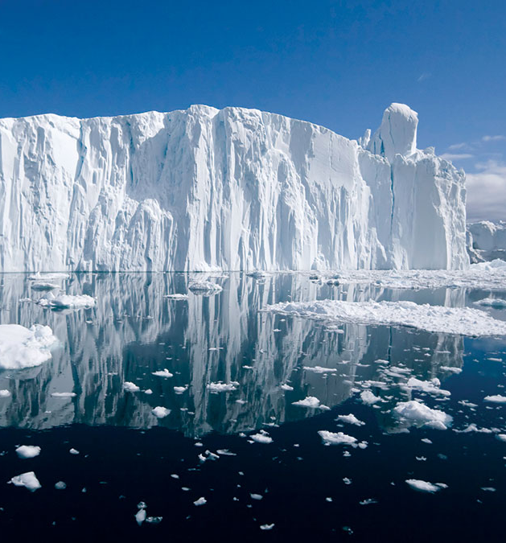
“Day at last!” The children would say
As they dare to play, as they dare to stray
Yet a glacier crown, still stares from above
It casts shadows of dominion, all over the crowds
“Take them away”, it seems to say
Before the blizzards take the children away
“Where have my babies gone?” A mother can pray
But the ice beneath their feet, rarely answers such calls
There is no higher force, but the Glacier Crown’s maul
And so it spits its ice, rains its fury
Until the people below, know no safety
The frozen tides take more away
But a few men, is all that it takes
To make it through the night, survive until daybreak

Slide 7
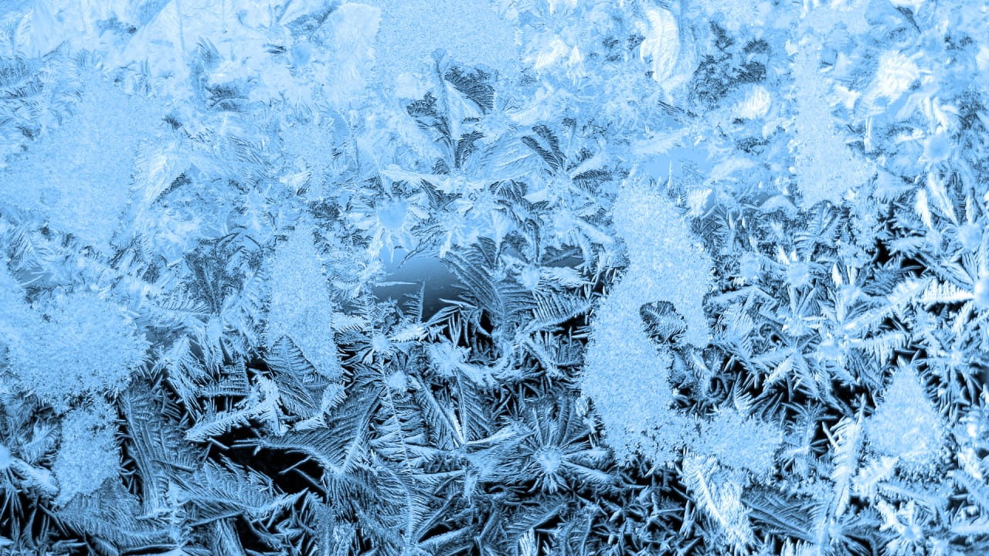
One family left, another to mourn
Their suffering was one, destined to be born
The wind still pierces, and the chills still dig
But now even the fires, burn with an icy touch
Perhaps that was the doing, of the frozen air
The frozen world, it’s always been everywhere
As long as the glacier crown is all but aware
The frozen tides, once at arm's reach
Now grip the spines of children, snapping them as they screech
Maybe the tides, and the crown and the wind, were always too much to take
Maybe it’s impossible, to survive until daybreak

Slide 8
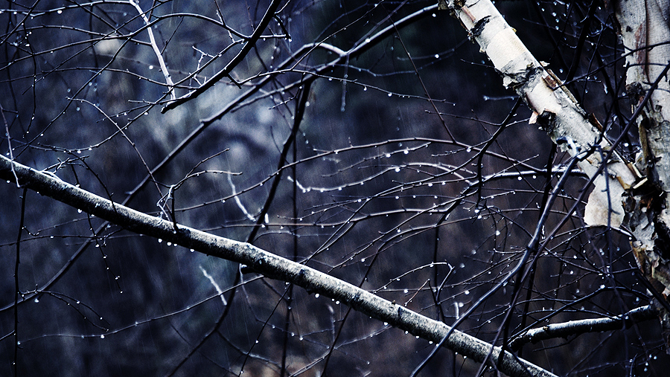
A little girl, no older than three
Felt that she could finally be free
“Don’t play in the tides”, her mother would say
Her mother wasn’t there, when they took her away
A boy with no sister, waited until dawn
Hoping he would find the chills to be gone
But they were fiercer than he thought,
And they worked with the tides
One lost body, sinking to the floor
One night outside, and he was nothing more

Slide 9
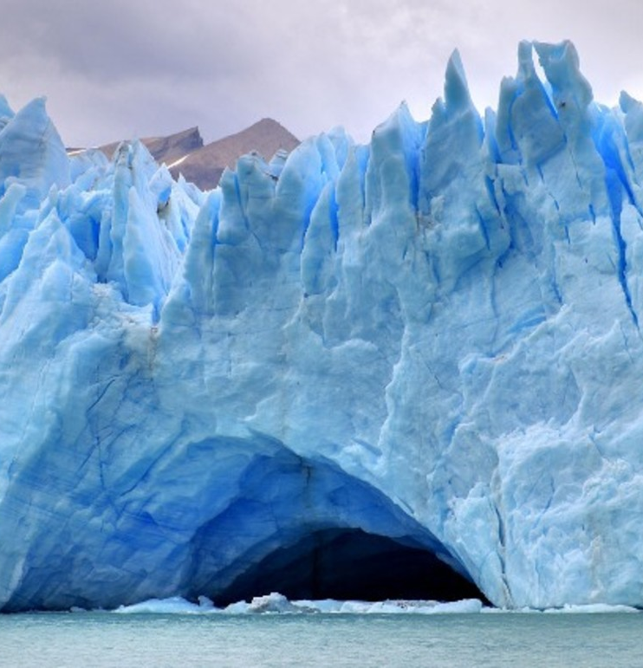
A childless father, soothed his wife
The woman mourning, cursing her life
Maybe if they had been there,
Maybe if they had dared
Then the wind and the waves and the crown would have cared
But it was wishful thinking, and the father knew
So he traveled up a mountain, to face what he knew

Slide 10
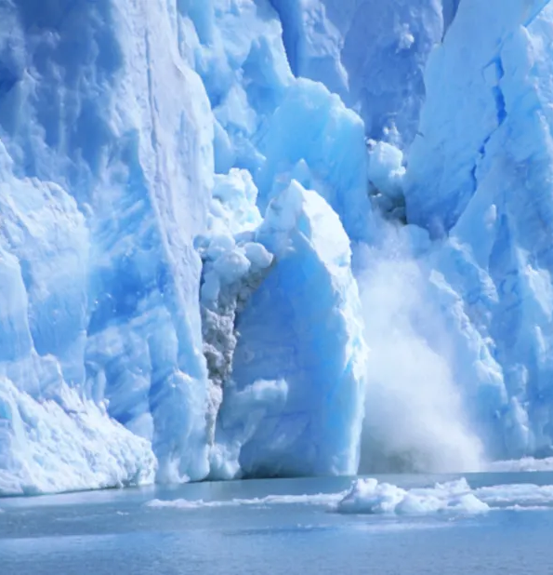
The glacier crown, was a sight to behold
With glistening ice and snow, as deadly and beautiful as gold
Frozen streams seemed to show him the way
Perhaps he would find his way up, before the end of day
Day didn’t last, and now here he was
Broken by the chills, ice crawling up his spine
His breath billowed before him, turning to frost out of spite
Why hadn’t he been there, on his son’s darkest night?

Slide 11
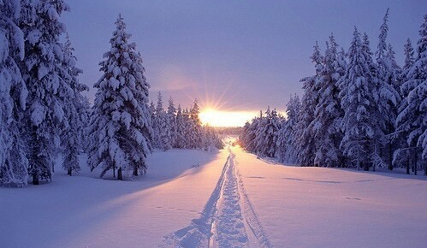
Couldn’t he had saved, that poor helpless girl,
When she had played with what should never have existed?
What can a father do, if not save his children?
Perhaps that was simply, the way of the Arctic
The glacier crown is not to be beaten
The frozen tides can never be warm
Fires don’t last
The wind kills on its own
With all of this, in the heart of the crown
The father was gone, his body left to be found

Slide 12
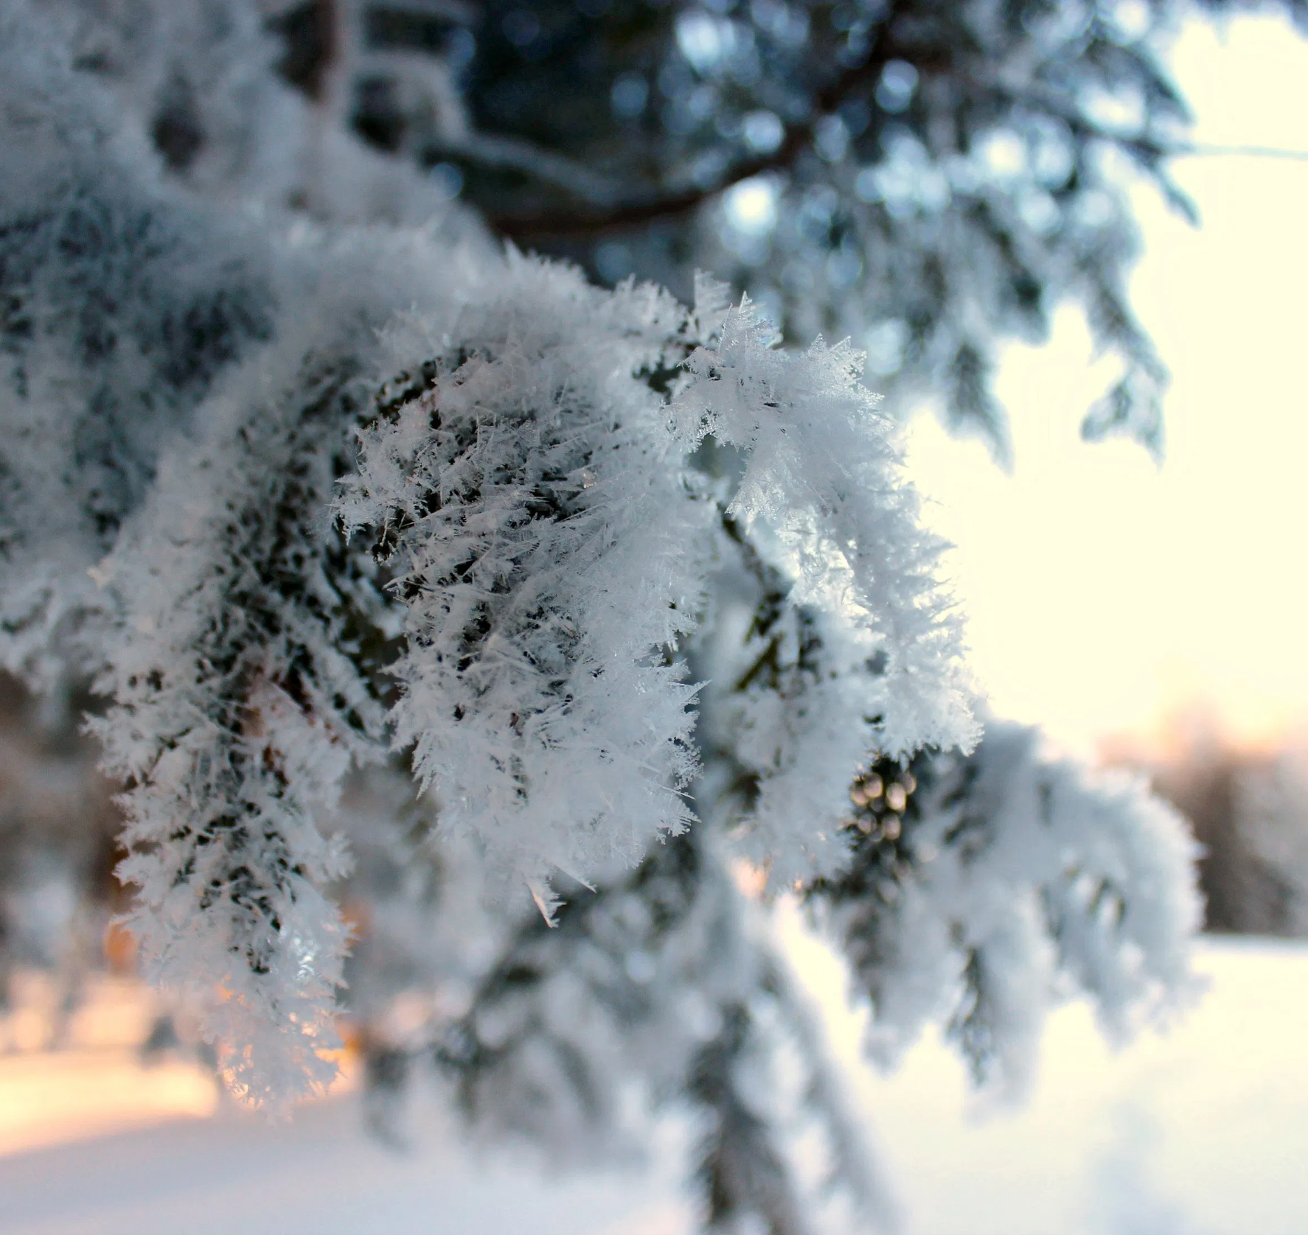
A mother left, all alone in her home
She knew what had happened, she could feel it in her bones
The winds of the north,
Tides of ice
They had taken her children, her husband, her life
And so she rose, summoning a little bit of fight
Enough for her to walk, through the thick summer snow
She walked and she walked
And she walked some more
Days may have passed, months or even years
Maybe it was hard to tell, without her heart to help hear
Carried away with the wind, it had been
Not that it mattered now, of course
As the mother was ready for the tides to take her in

Slide 13
One day soon, she arrived at the edge.
The edge of everything she’d known
The edge she’d always feared
But now, how could she?
After all these years
Left broken, and shattered, wasted all her tears
A mother steps in, the ice numbing her fear
And she takes another step, craving the cold to bite
Bite her harder than it had, her children and husband
Maybe that would take some of her suffering away

Slide 14
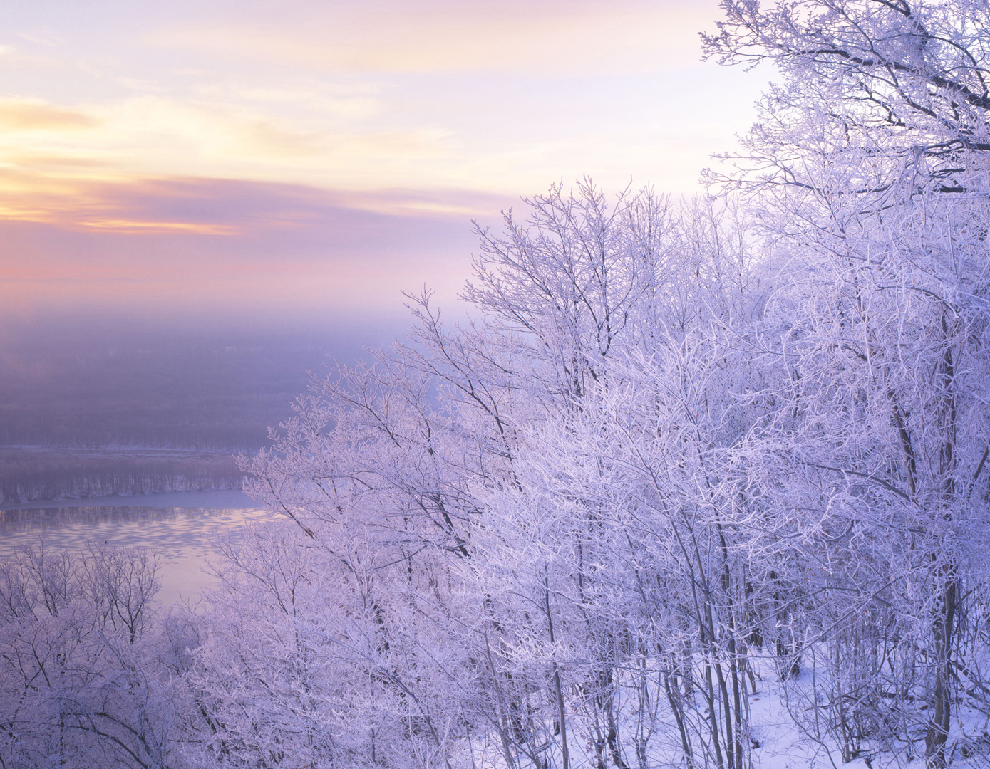
A woman is waist deep, in the endless freezing waters
Even as she stares up at the sun
It’s light had not been enough to save the ones that she loved
One woman left, but now daybreak was not enough
Now she willed the waves to take her
She willed the wind, to forever break her
Her own mother had told her, “Death is nothing... but we can have everything”
Now she knows, it was then she was betrayed
If this is the price of everything, then it’s one that cannot be paid
Why try to have everything, when she could simply have nothing?
Maybe that was worth more, than a painful everything

Slide 15
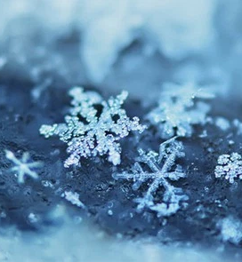
Finally, the floor is too deep to stand upon
And now the woman can finally be free
Free in death, is the only way
To stop feeling the cold, make it go away
No one can fight the glacier
No one can move the tides
Only the Arctic possess that gift
Only the Arctic, forces us to die

Slide 16
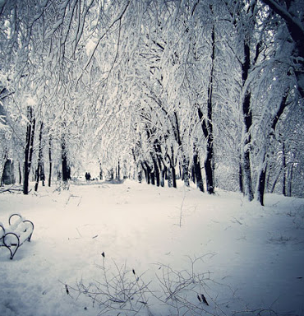
And so now a woman is free, as she stares up at the sky
Frozen water filling her lungs, awaiting her final goodbye
But one last light, flickers in her soul
Burns away the cold, reminds her of growing old
Children she could have again some day, such a wish is not so bold
So she fights and she screams, reaching for the surface
Maybe her son had done the same
the tides gripped her spine
Held her down
Filled her lungs
And so she died in darkness, as we all must do
Daybreak is an illusion, a distraction from the fight.
Don’t wait for daybreak. End it during the night.

Slide 17
What can you expect from my second poem?

Slide 18
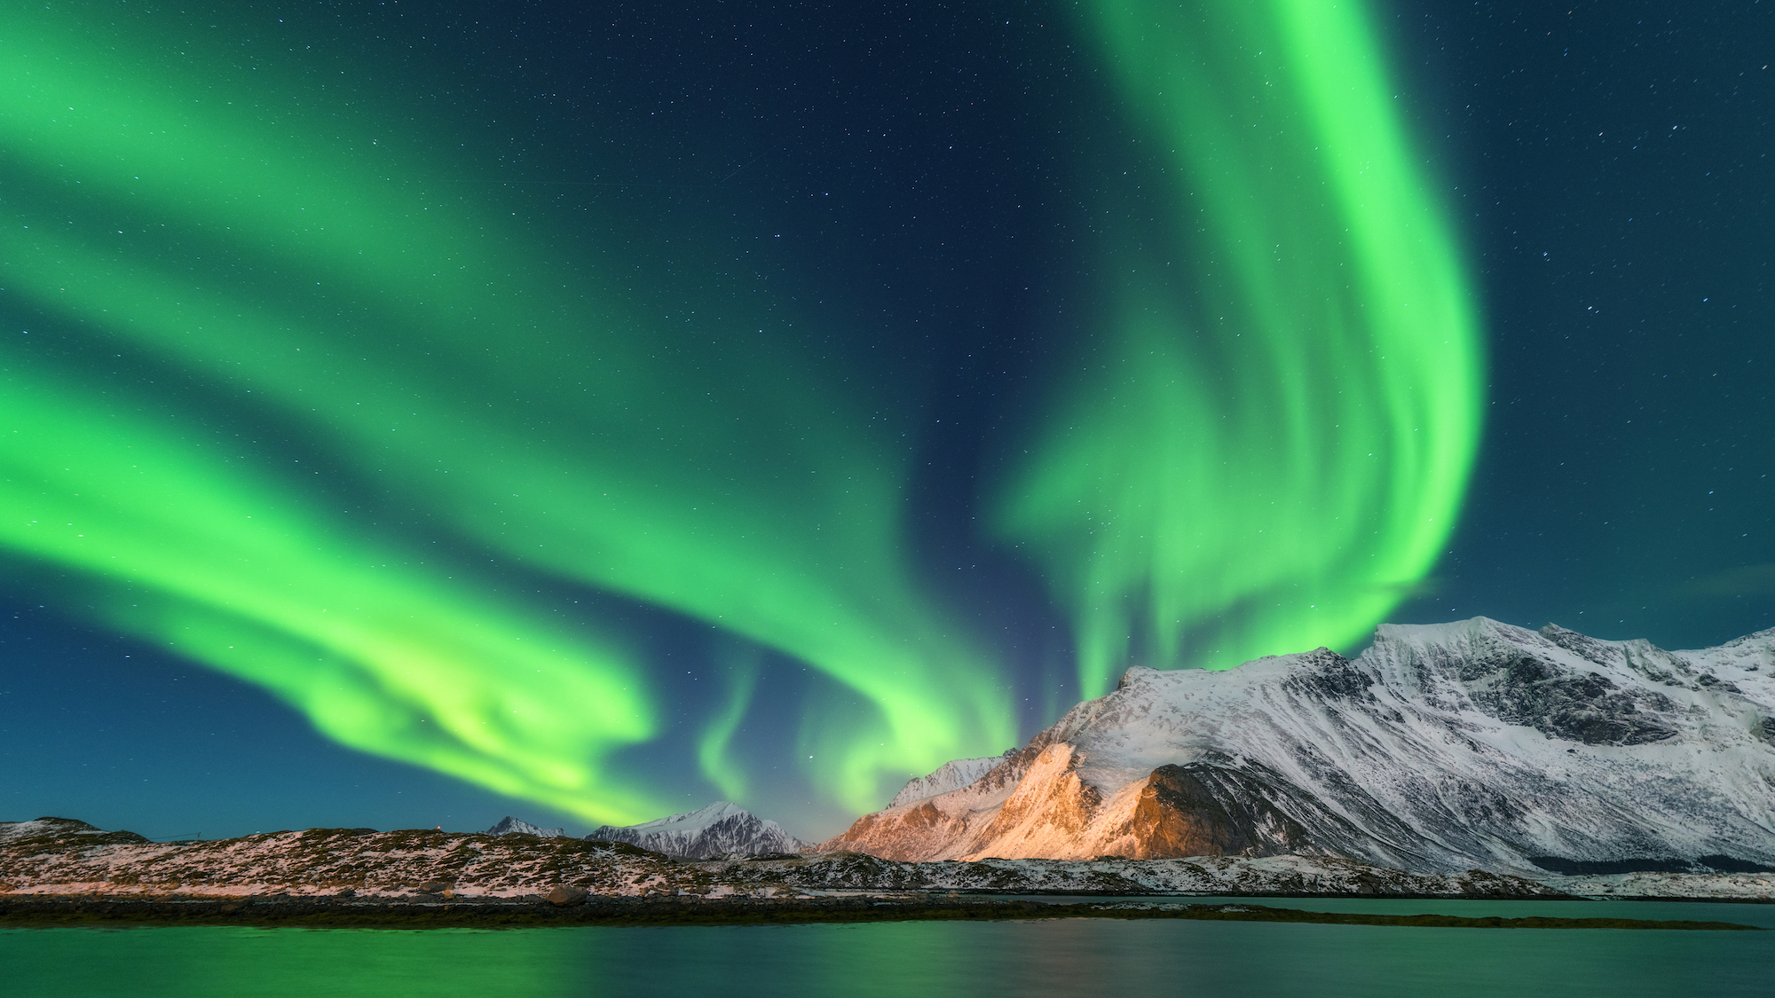
Nightfall
The sun always shines, against the glistening snow
Its rays burning deep, creating a show
Sparks of ice, dance and fly
Sending warm souls off, with a final goodbye
While the cold can bite,
And the wind put up a fight
It’s the people here, who can laugh during the night
The day is stunning, its warmth as pure as golden tears
And while the night may test, the night may try
That is when the stars don’t hide
The stars that we wish upon
The stars that we know
Look down upon the north, with a burning Arctic glow

Slide 19
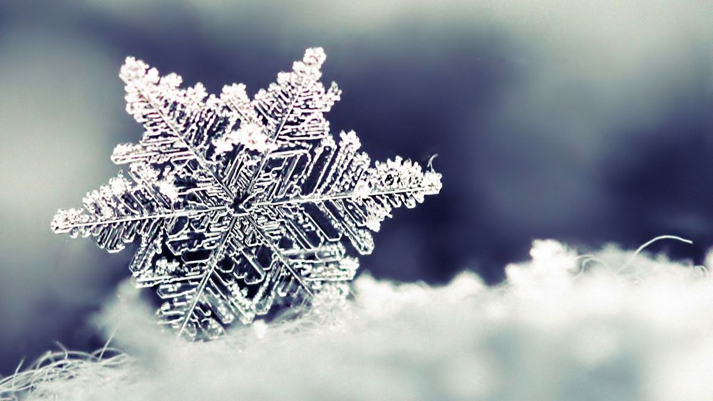
Minerals and gems, buried deep within
The people here, forever unburdened
The land solid with resolve
The cold at bay
We could all live happily, during an Arctic day
While the ice may bite, and the tides may pull
It’s all part of nature, without it, we’d be dull
The nature that birthed us, we could never turn away
The tides and the ice, are forever here to stay
We’d all be fools, to have it any other way

Slide 20
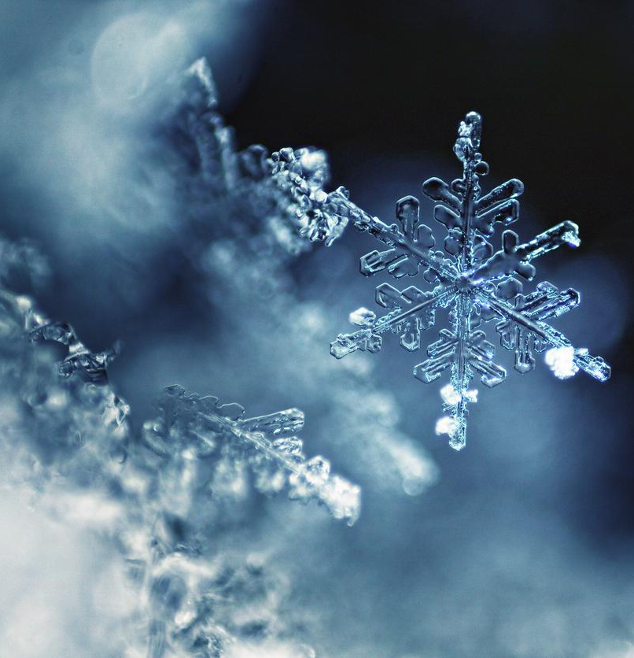
What can we see, here, in our current world?
Trees and sun, beaming tall and proud
But we will never truly see, what many fear
Never feel the ice, never know what we hold dear
The Arctic is perfect, the land is divine
Why don’t more of us go there, rather than wasting our time?
The greatest places on Earth, have always been what appeal to man’s eye

Slide 21
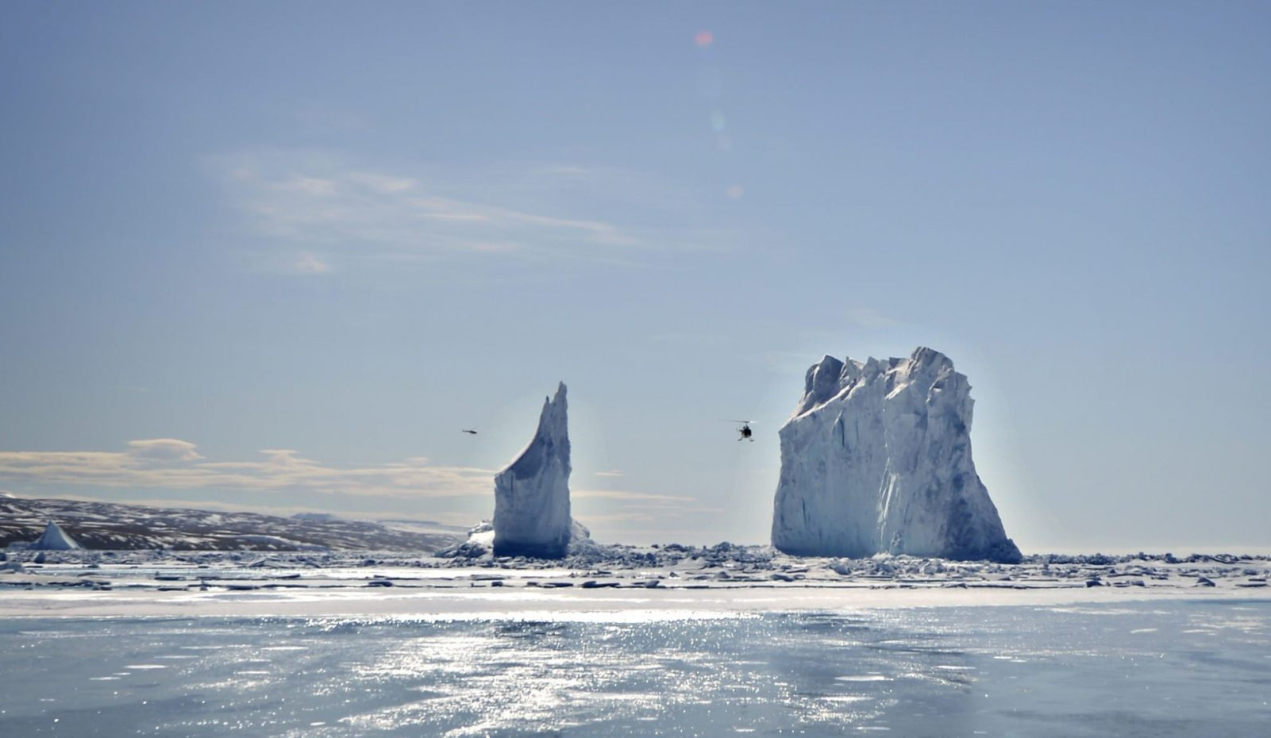
You may ask why?
Why dare to stray in such a place, where the cold will take us, forever away?
The cold is only cold, while we allow it to be so
Perhaps the warmest thing in the world, is pretending to be cold
So that we can hide away, snug, under blankets in our homes
The fires flickering, burning away the ghosts
Perhaps that is what we do, every day of our lives
Shun the true beauty, of a northern sky
Pretend it doesn’t matter
Prove we don’t care
After all, why would we want, to embrace the chilly Arctic air?

Slide 22
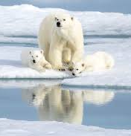
Well I’ll tell you why, loud and clear
It’s glaciers shine like crowns, its snow like gold
The animals are endangered, but a sight to behold
The ice melts, but it doesn’t leave
Not if we settle in, and roll up our sleeves
The Arctic is perfect, exactly how it is,
The resources below, spread dangerously thin
But it’s perfect this way, can’t you see?
What’s the point of a land, if all we do is flee
While those among us, want to steal the beauty
Gazing upon the Arctic, is like gazing upon the sun
So rich in its divinity, it will leave you blind
The snow and the ice, you will never leave behind

Slide 23
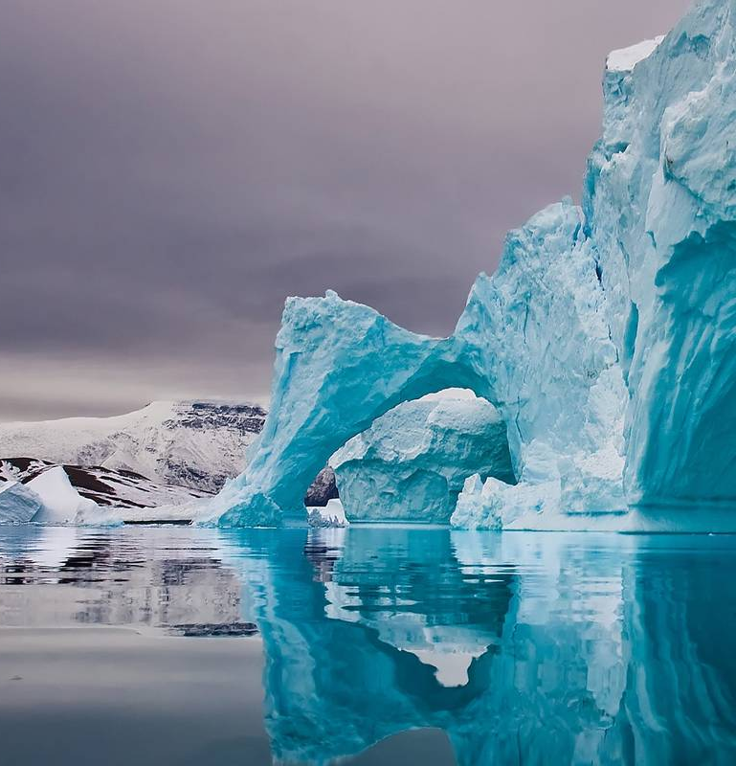
Tell me this, can you truly say? That you’ve lived your full life, witnessing all kinds of day?
Dawn is powerful, but limited in its nature
The Arctic exists, to give us adventure
The cold is what we crave, even in the warmth of day
The tides are what we want to see,
When we claim to be afraid
The sight of the Arctic, is all it will take
To leave us speechless, joyful and with glee

Slide 24
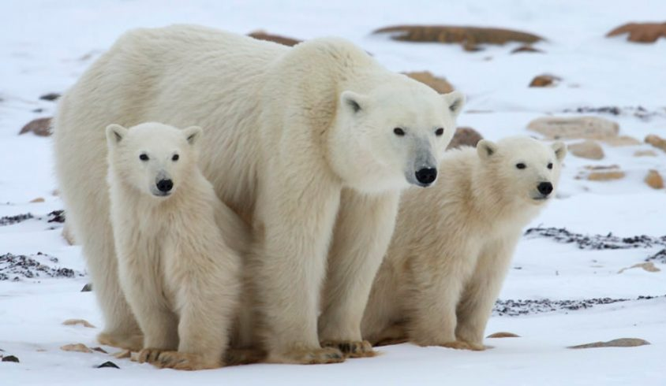
So next time someone tells you, “Daybreak is not enough”,
remember that the Arctic, is not about the sun
It’s about the sky, it’s about the land.
It’s about everything, which is not so bland
Why must we survive until daybreak, when we can bask in the night? Lifted up by the darkness,
Happy in shadows or light

Slide 25
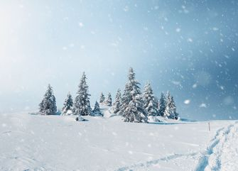
Everything everything, the cold can give us
More than I can say, with our current dilemma.
The stars will be clear, the northern lights here to stay,
If only we saw the Arctic, during the night and the day.
When we say its too harsh, when we say its too cold
Perhaps this, is when we’ve dropped the ball
The ice burning away chills, the Arctic’s pull not so small
It was never about Daybreak; embrace the nightfall.

Slide 26
The Power of Place-Based Poetry
Encourages deeper research
Helps us see from different perspectives
Helps us grow as people

Slide 27
Sources Cited
https://www.nationalgeographic.com/environment/oceans/reference/arctic-ocean/
www.britannica.com › place › Arctic
https://nsidc.org/cryosphere/arctic-meteorology/arctic.html
https://www.natgeokids.com/za/discover/geography/general-geography/ten-facts-about-the-arctic/
https://www.arcticcentre.org/EN/arcticregion
https://en.wikipedia.org/wiki/Arctic
https://unsplash.com/s/photos/arctic
https://www.vox.com/energy-and-environment/2018/3/15/17099686/arctic-warm-winter-sea-ice-melting-facts
https://www.mnn.com/earth-matters/climate-weather/stories/18-perfect-snowflakes-photos
https://earthsky.org/earth/best-snowflakes-photos-from-earthsky-friends
http://bianet.org/english/environment/194959-polar-bears-losing-struggle-for-their-lives

Slide 28
Thank you!

