Slide 1
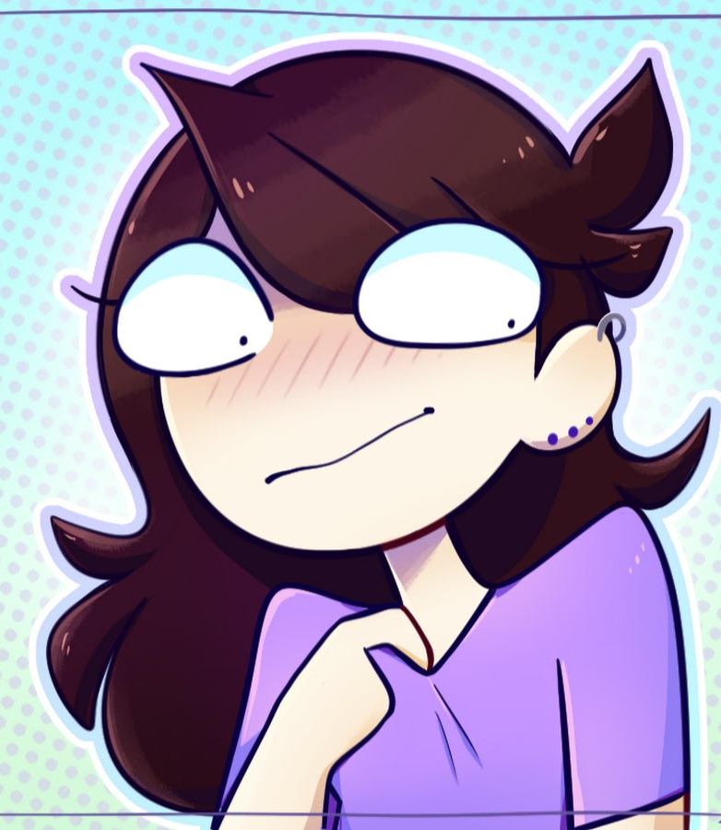
Eimmerin Alago

Slide 2
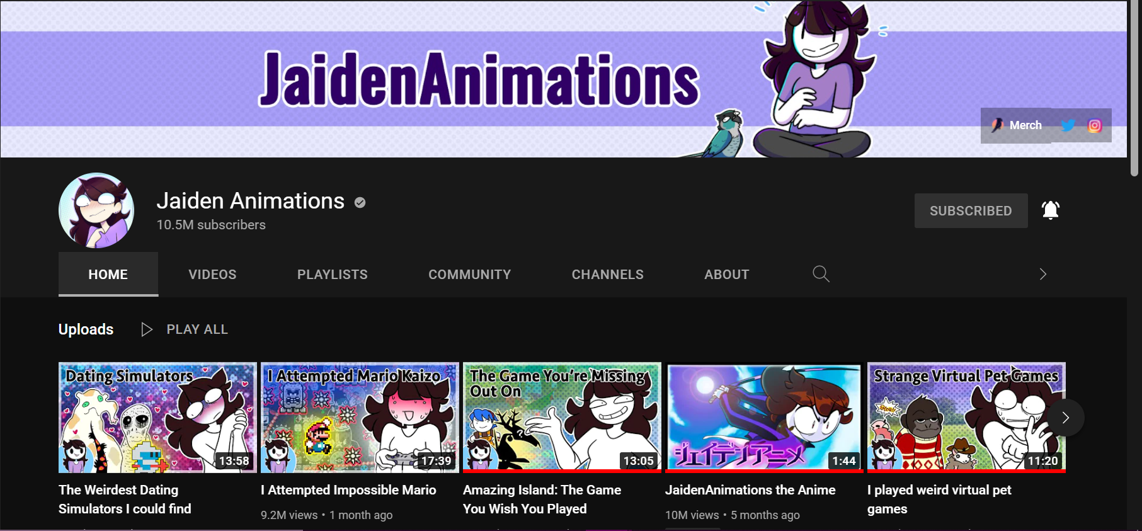
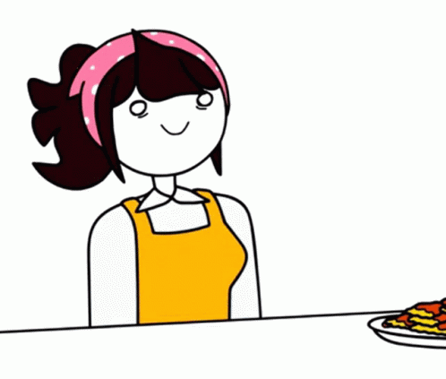
Jaiden’s Digital Footprint
Jaiden Dittfach is an American youtuber and animator who is known for making story time videos through animation. She has 10.5 million subscribers as of right now and her content is based of her experiences, personal stories and gaming. She was born on September 27, 1997.
Her videos mainly target young teens but honestly anyone can watch it. She posts once every 1 or 2 months and her work is usually silly and fun to watch but can also be serious.
Jaiden also uses Instagram, twitter and also has a website for her merch. She hasn’t posted on her Instagram since December 10, 2020 and has mainly posted about her birds, Ari and Tofu. She is more active on twitter where she tweets about new videos, tours, information about her channel and her birds but she does not tweet everyday.

Slide 3
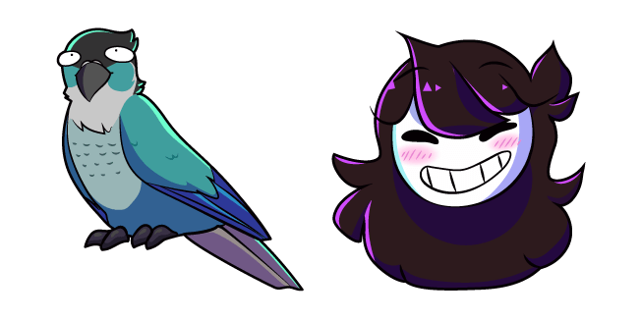
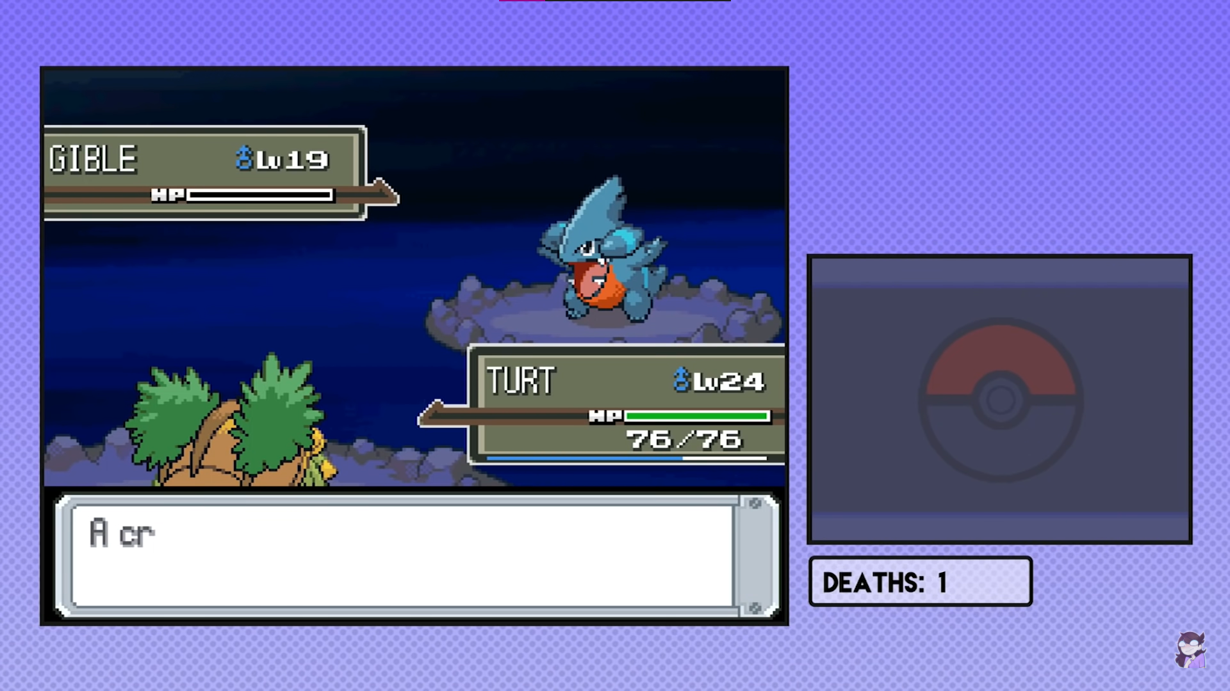
Protection
All of Jaiden Animations known social media accounts are fully public and people are free to share and comment. There has been no news of her being hacked.

Slide 4
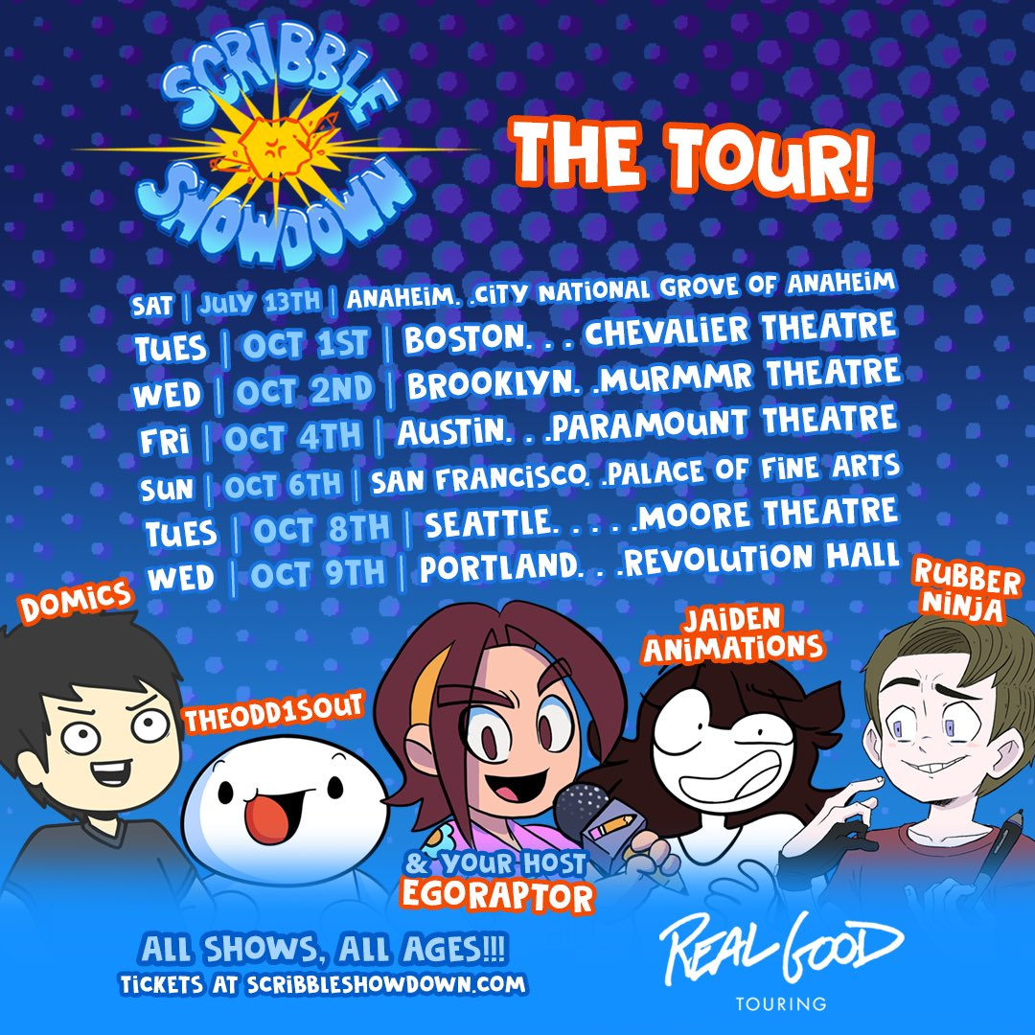
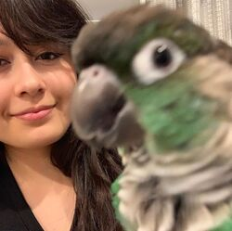
Public and Private Information
Since most of Jaiden’s content has to do with animation, she doesn’t post a lot about her in real life. She has shown the inside of her home like her kitchen or office, but nothing that can really identify her home. She grew up in Arizona and currently lives in Los Angeles. Jaiden only talks about her location when she goes on tours like scribble showdown. We know that she has a mom Lynn Dittfach, a dad, Hugo Dittfach III and a younger brother, Jack Dittfach.

Slide 5
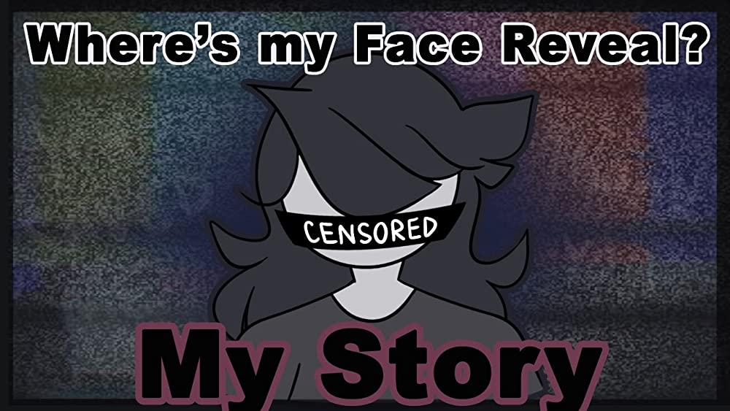
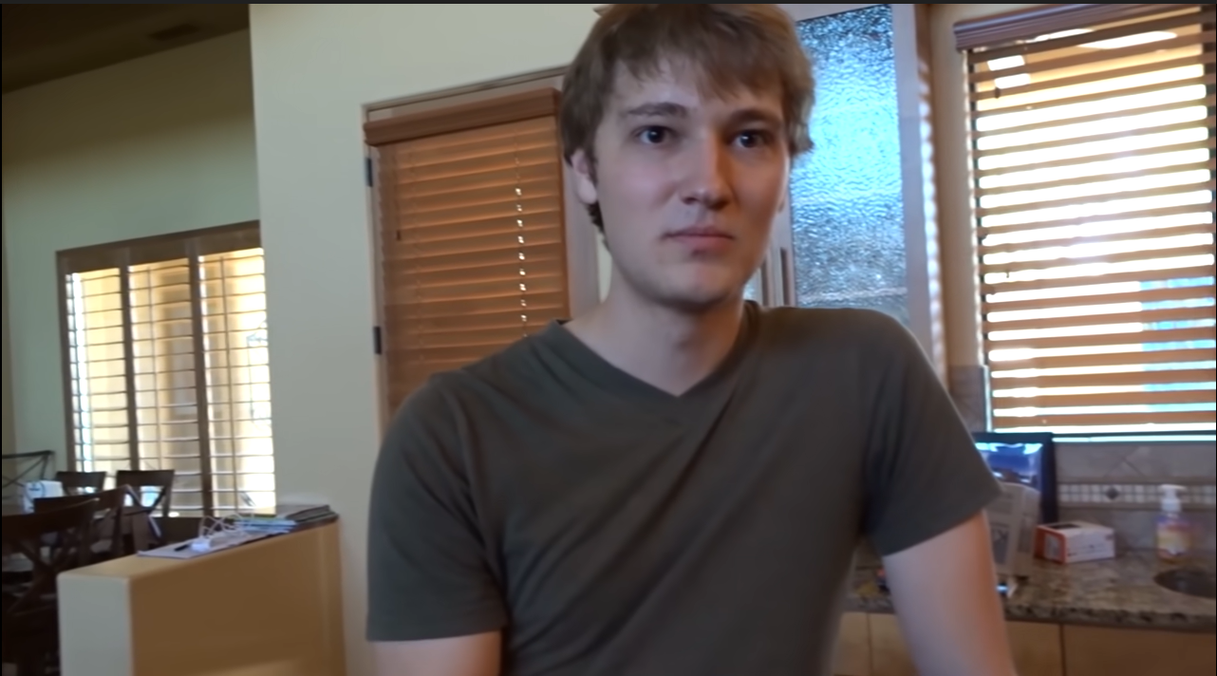
Is Jaiden an Oversharer?
Since Jaiden is a story time Youtuber, she talks about herself a lot and very personal topics. For example, she has talked about her struggles and mental state because she had eating disorders. This can make her vulnerable, especially on the internet. However, it can be a learning experience for others who struggle with the same problems.
I personally think Jaiden is not an oversharer. Her blinds in her kitchen are closed throughout a video in her home, so it’s hard to make note of anything specific. She doesn’t post anything that reveals her location specifically and I’ve never seen the outside of her home.
Jaiden with James (TheOdd1sOut) trying vegan foods

Slide 6
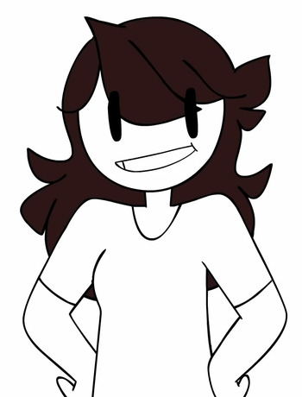
My advice to Jaiden
Thanks for reading
I believe that Jaiden is fully aware about the dangers of social media. She is sharing enough information for her viewers to imagine and get a good picture of her life. At the same time, it isn’t too specific and leaves her with her privacy. I would advise Jaiden to continue what she is doing. To me, she isn’t showing to much personal information where she could be targeted for scams or theft. It would be a good reminder though to always be careful and aware of what you post online.

