Slide 1
Digital footprint
Kim Kardashian

Slide 2
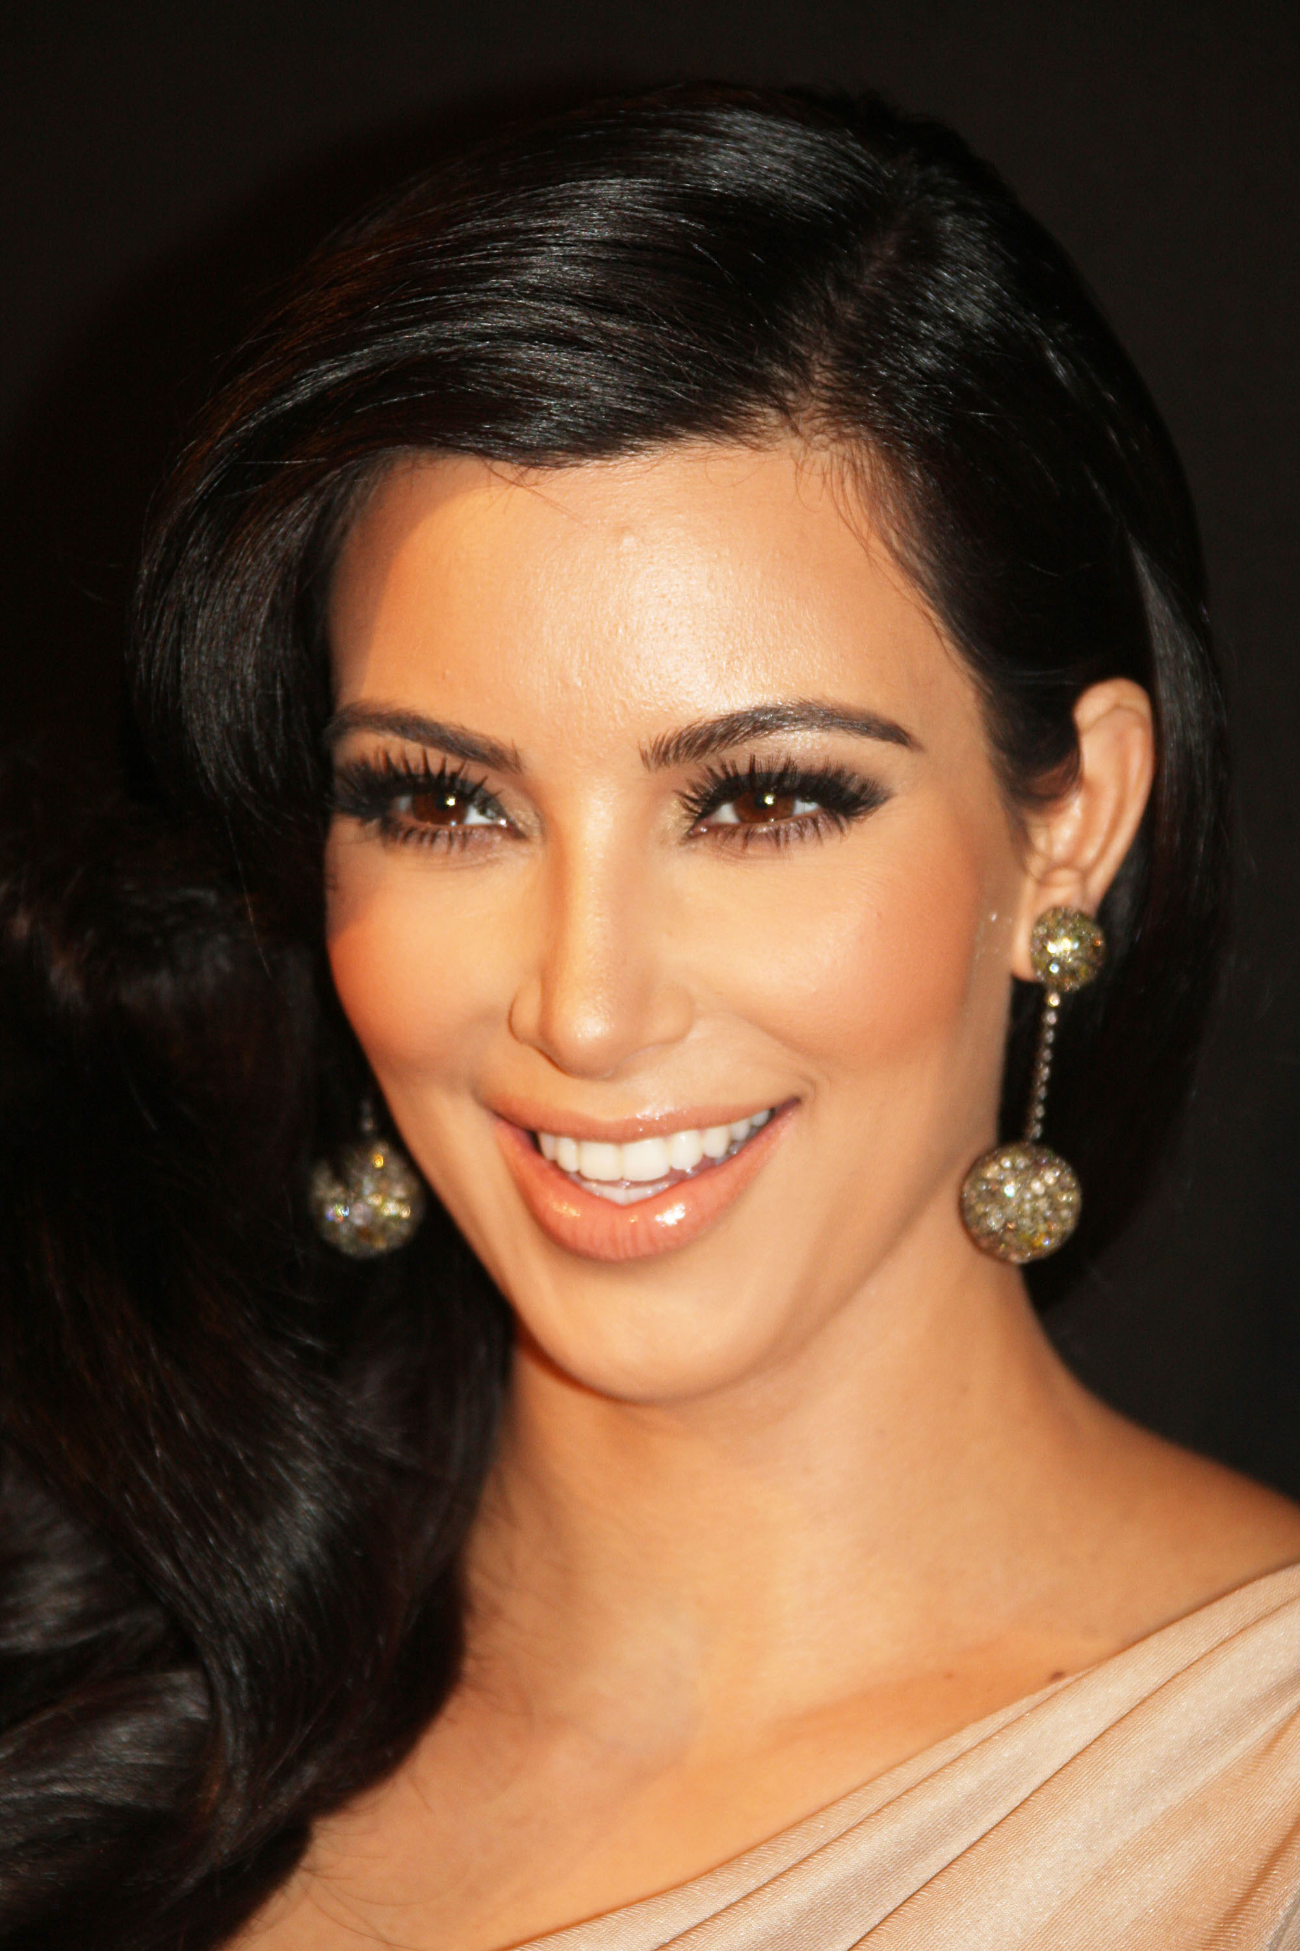
Kim Kardashian
Kim Kardashian an American media personality, model, businesswoman, socialite and actress with a huge digital footprint. Kim Kardashian posts and updates her location daily on medias like Instagram, twitter and Facebook.

Slide 3
Privacy
On instagram, Kim Kardasians account is fully accesible by anyone. Even people without accounts on instagram can see her public images. She has also had trouble with her account on twitter and her email, which were both toyed with by a hacker.
This Photo by Unknown author is licensed under CC BY-SA.

Slide 4
Infromation
Kim Kardashian does show people shes close to in her photos and shows places she been indirectly in the background, but she does not purpusly share her location to her followers directly. Kim Kardashian also advertises clothing in pictures poseing on her instagram.

Slide 5
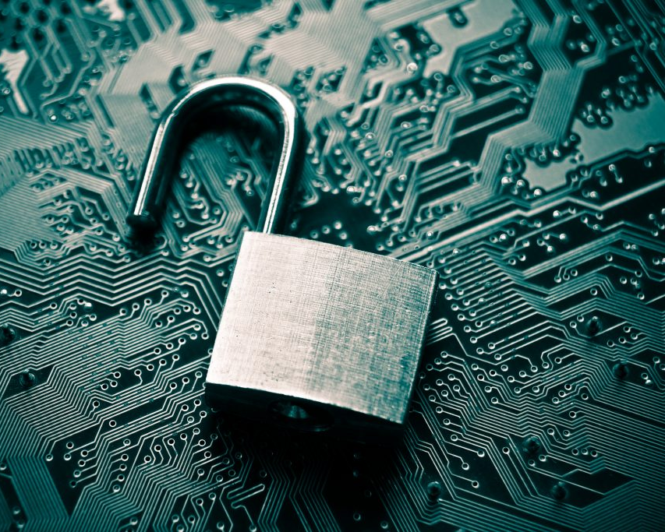
Oversharer?
This celebrity does fit as an oversharer

Slide 6
Advice
My advice would be, to make her account more private, allowing her followers only to view her photos.
Manage the inforomation she shares with her followers, like her close friends, location and events.

