Slide 1
Digital Footprint
Digital Learning 10
By Fernanda Galindo

Slide 2
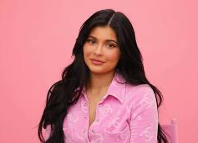
About Kylie Jenner
Kylie Jenner is a Keeping Up with the Kardashians star and the youngest billionare.
She is the founder of Kylie Cosmetics which is a make-up brand and has built up her empire using social media

Slide 3
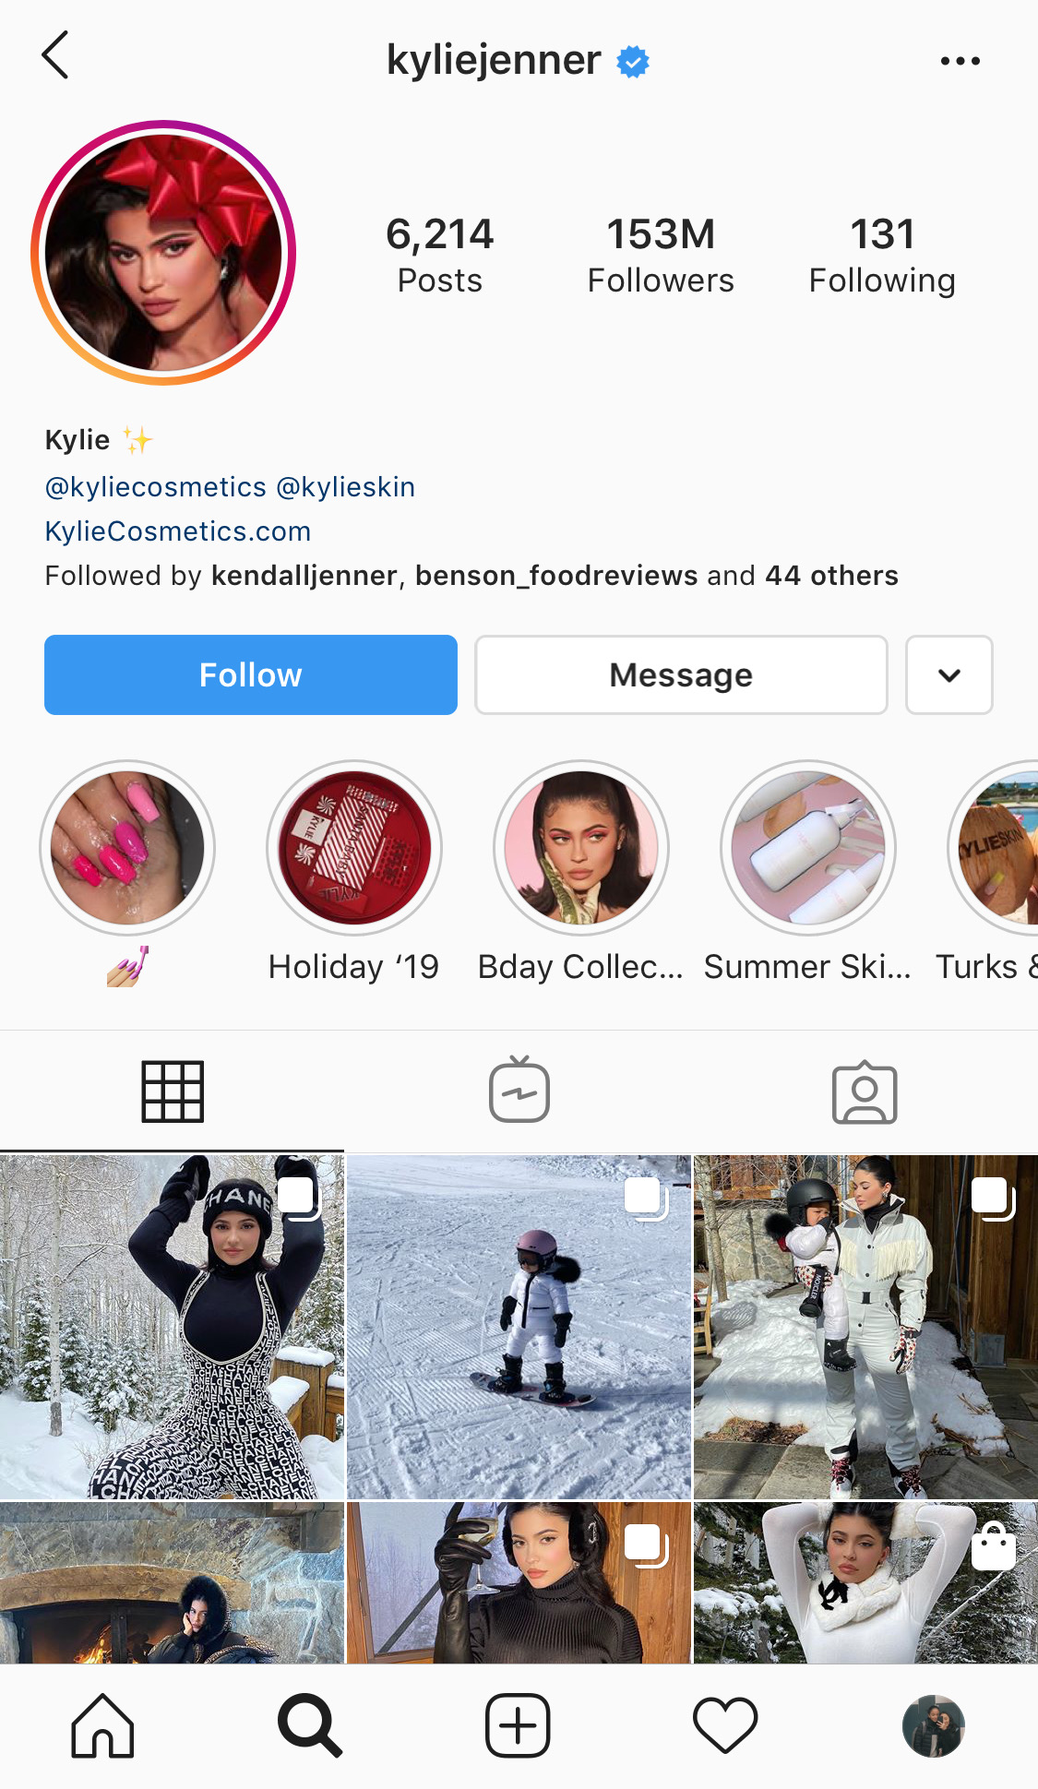
How expansive is Kylie Jenner’s digital footprint?
Kylie posts on multiple social media sites including: Instagram, YouTube, snapchat, twitter etc.
Kylie posts a lot during the week. She usually posts daily on multiple social media sites.

Slide 4
What protection does she put on her accounts?
I don’t think she puts a lot of protection on her accounts because her account on Instagram is public
According to “Teen Vogue” Kylie Jenner’s snapchat and twitter were hacked a few years ago. This means that she doesn’t put enough protection on her social media accounts.
https://www.teenvogue.com/story/kylie-jenner-snapchat-account-hacked

Slide 5
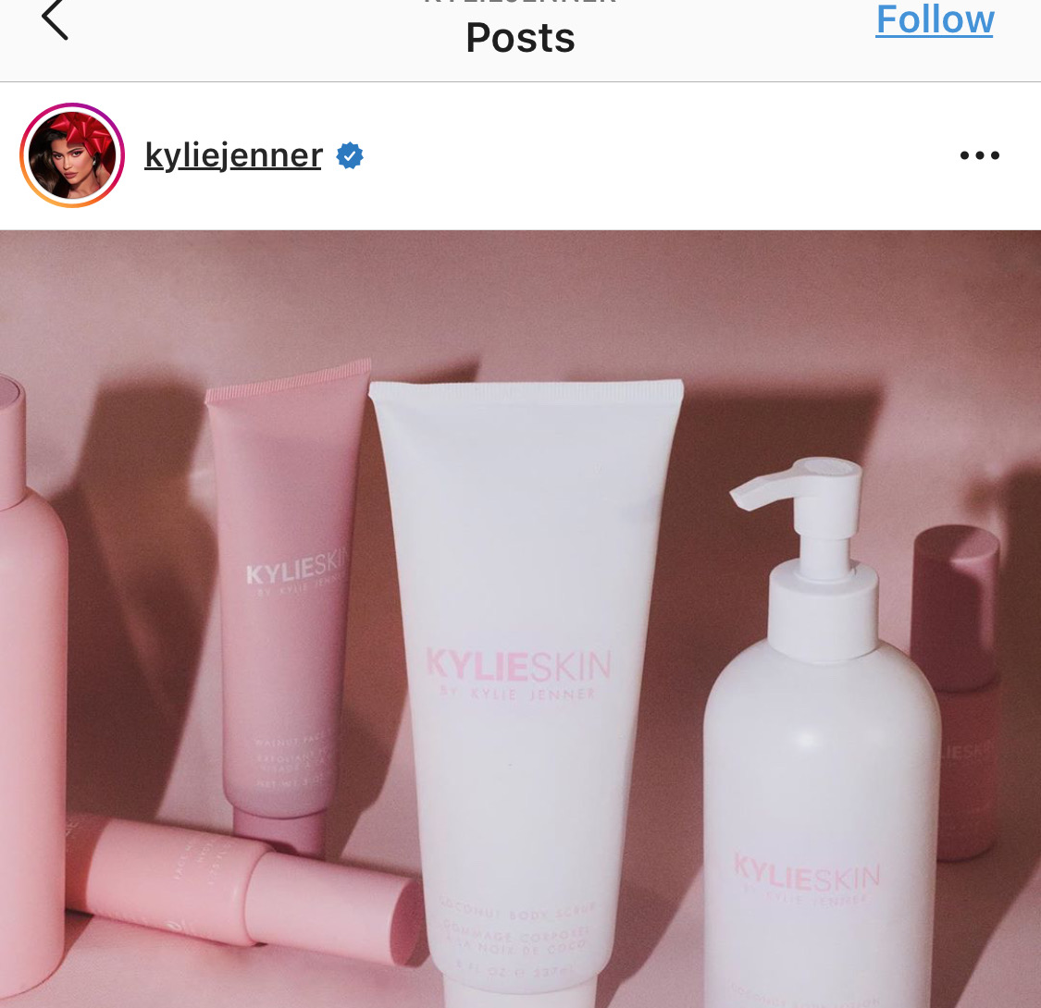
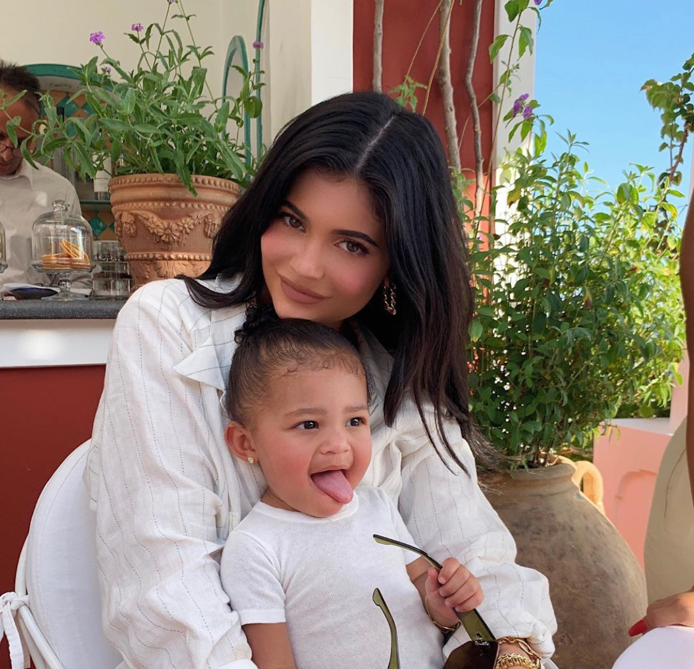
What info does she post?
She usually posts selfies, family pictures, advertisement for her brand, and make-up tutorials
She posts pictures of where she is and what she’s doing

Slide 6
Is Kylie Jenner an “oversharer?”
I think Kylie Jenner is an “oversharer” because she posts a lot of personal information on social media such as her location, family photos, pictures of what she’s doing etc.

Slide 7
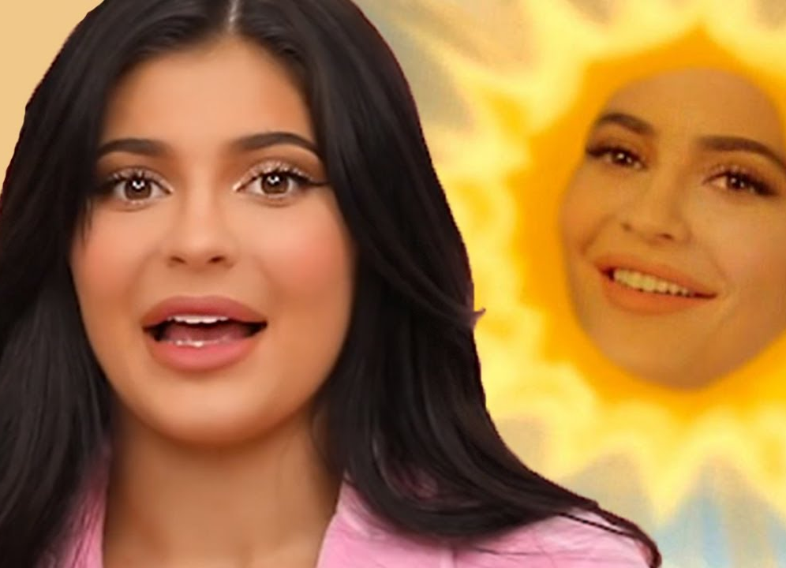
What advice would I give her?
My advice to Kylie Jenner is to not post personal information on social media. I understand that she is a “Keeping Up with the Kardashians” star and so the whole reason why she is famous is because of her family ‘s reality tv show, but this also causes a lot of problems for her and her family, so I think that she should start to post less personal information. She should use her social media account just to advertise her business and merch

