Slide 1
The Digital Footprint of Emma Watson
Digital Learning Assignment 3
Hanna Chau

Slide 2
Who is Emma Watson?
Emma Watson is an actress, and was known for her role as Hermione Granger in the Harry Potter Movies. She has gained recognition through some independent films, as well as her women’s rights work through social media.
EMMA WATSON

Slide 3
How expansive is Emma Watson’s digital footprint?

Slide 4
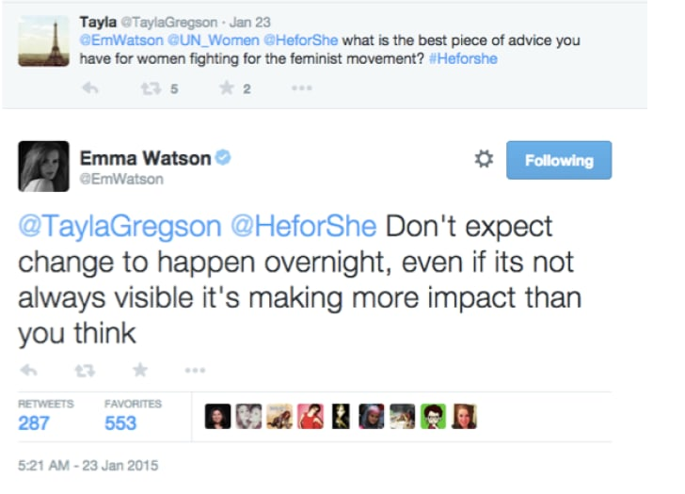
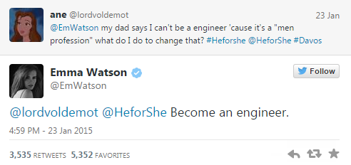
Emma Watson is on multiple social media platforms, including:
Instagram
Twitter
Facebook
Although she does have a very large digital footprint, it is not in any way negative. She only uses her social media accounts to promote social justice and for her acting career.

Slide 5
What protections does Emma Watson use on her social media accounts?

Slide 6
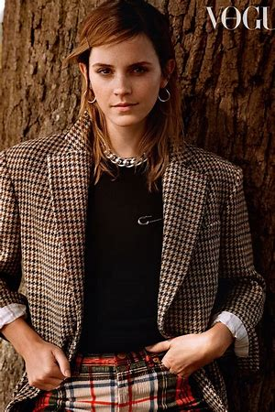
As far as I know, Emma Watson doesn’t have any private social media accounts. She allows everyone to view her posts and leave public comments.

Slide 7
Note: Emma Watson’s social media accounts have been hacked in the past, and at one point the hacker posted racial slurs on her status. Multiple personal photos of Emma have been posted online by hackers, so her digital footprint is slightly tainted…

Slide 8
What does Emma Watson share vs keep private?

Slide 9
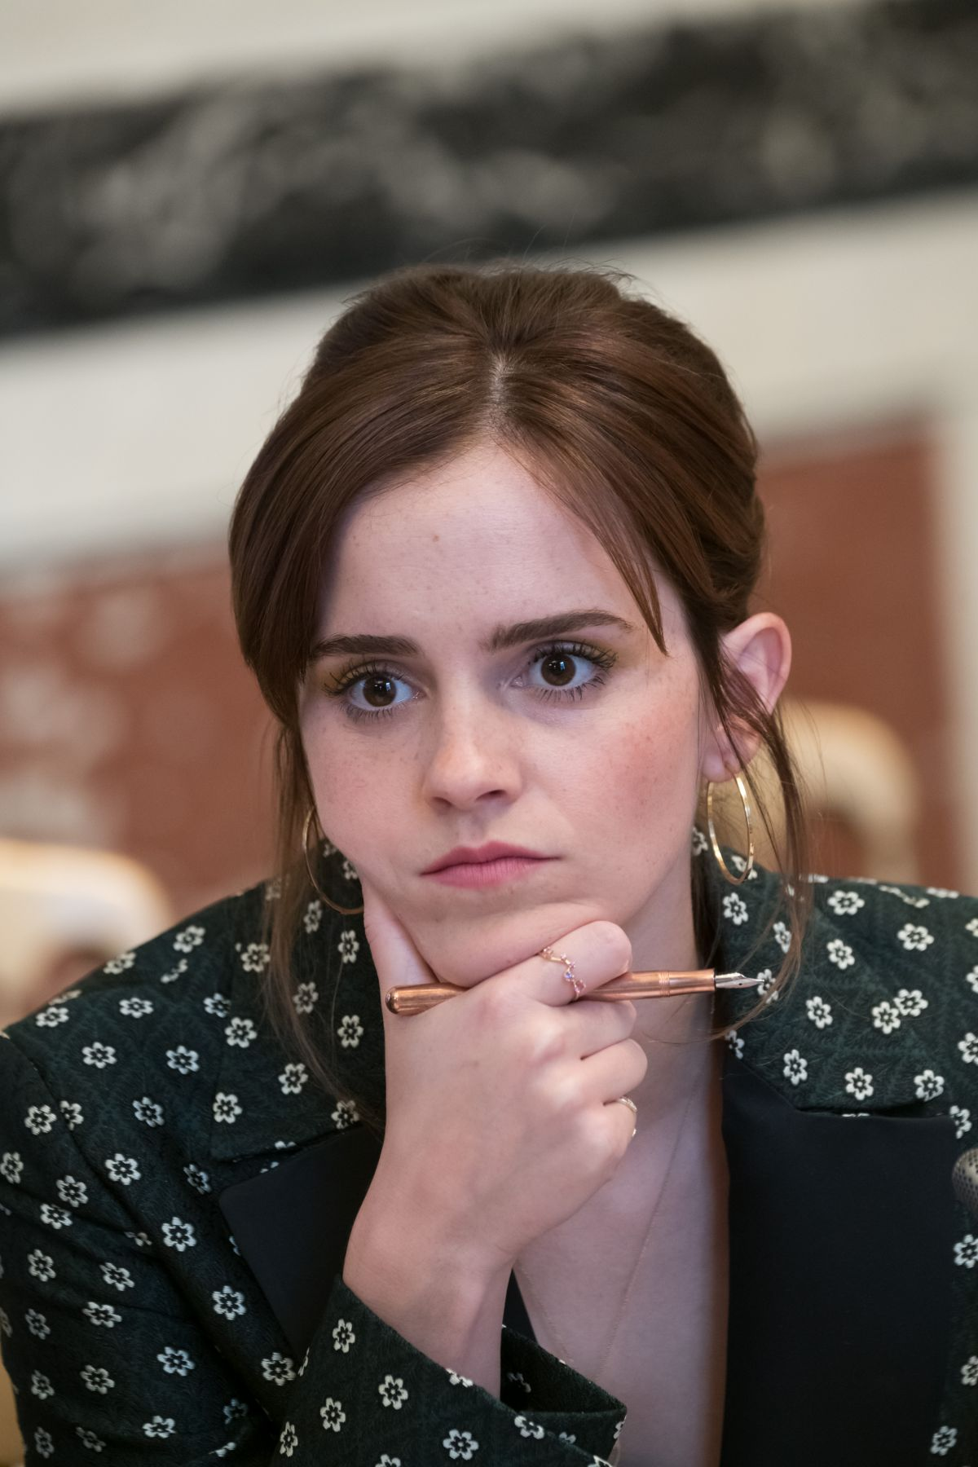
I really draw a super conscious line between what is public and what is private, and that has kind of helped me maintain a certain degree of sanity because having people weigh in and give an opinion on absolutely everything about me would just destroy me as a human.
-Emma Watson, Entertainment Weekly

Slide 10
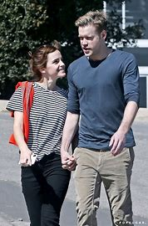
Emma Watson takes active steps to protect herself. She doesn’t post personal information that can be used against her, and is generally very responsible on social media. However, as much as she tries to keep certain details private, some things are inevitably public as a celebrity – like who she is dating.

Slide 11
Ever since July 202, Emma has withdrawn from both Instagram and Facebook, and people don’t really know why. Some think it’s because she was feeling a lot of hate from others from her posts on #blackouttuesday and wanted to take a bit of time for herself. If its true, that is very responsible of her to know when to take a break.

Slide 12
Is Emma Watson an example of an oversharer?

Slide 13
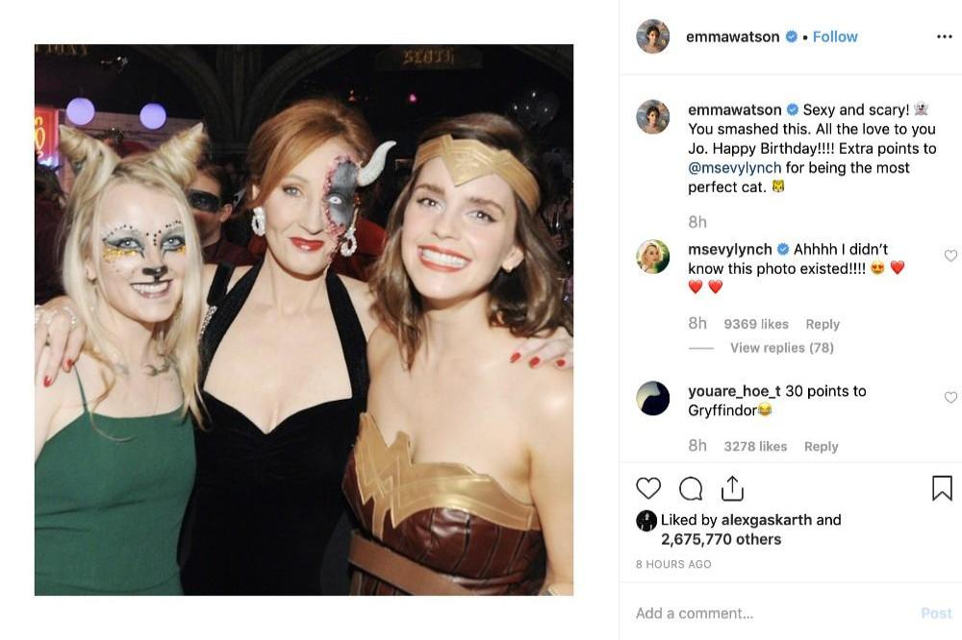
I don’t think Emma Watson was an oversharer because she didn’t post daily about all the details in her life. She did occasionally post pictures of her and her friends, but compared to other celebrities, she is definitely a responsible social media user. In the post on the right, she tags Evanna Lynch and wishes her a happy birthday. As Evanna Lynch is a famous actress and many already know her birthday, in my opinion, this was not oversharing.
EVANNA LYNCH’S BDAY

Slide 14
What advice would I give to Emma Watson on her digital footprint?

Slide 15
I would tell Emma Watson to continue her social activism and women’s rights work because it means so much to the female identifying population. However, she has been hacked a couple times already, so I would suggest upgrading to two-factor-authentication or something more secure so that her accounts aren’t hacked again. Other than that, she has a very positive digital footprint, so good job Emma Watson!

Slide 16
Thanks for Watching!
Hanna Chau

