Slide 1
Vision board
By: jonathan

Slide 2
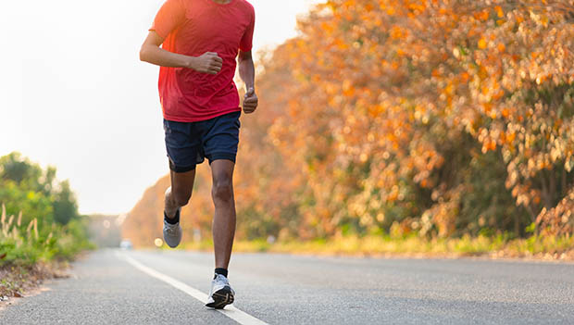
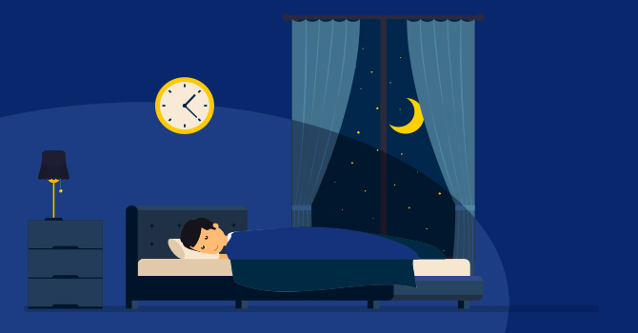
health

Slide 3
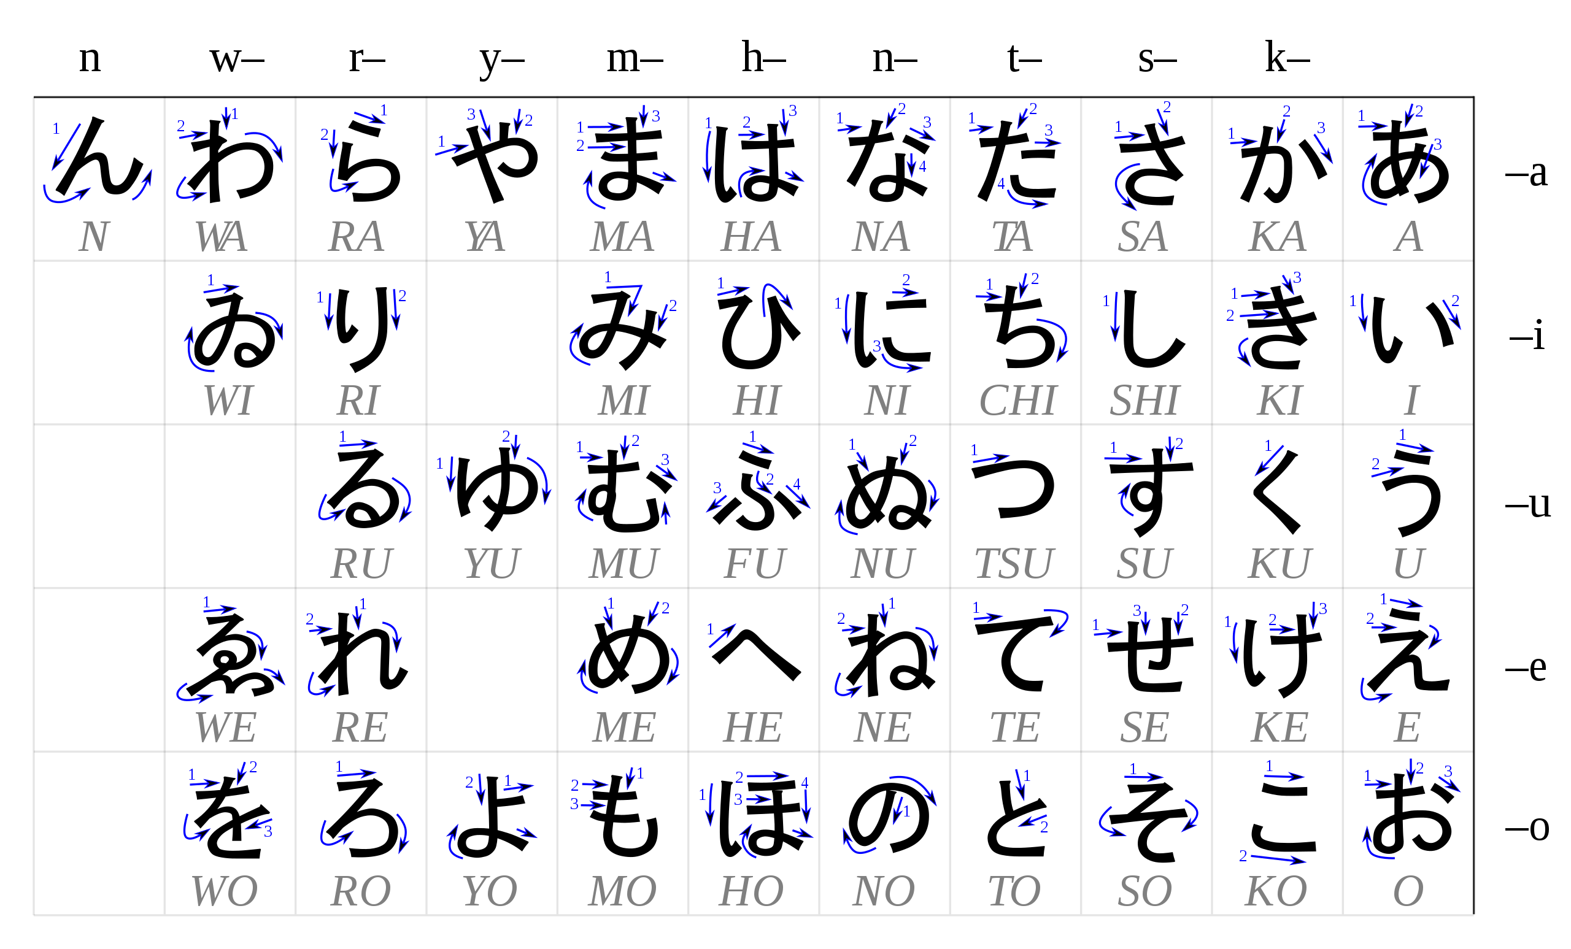
Education

Slide 4
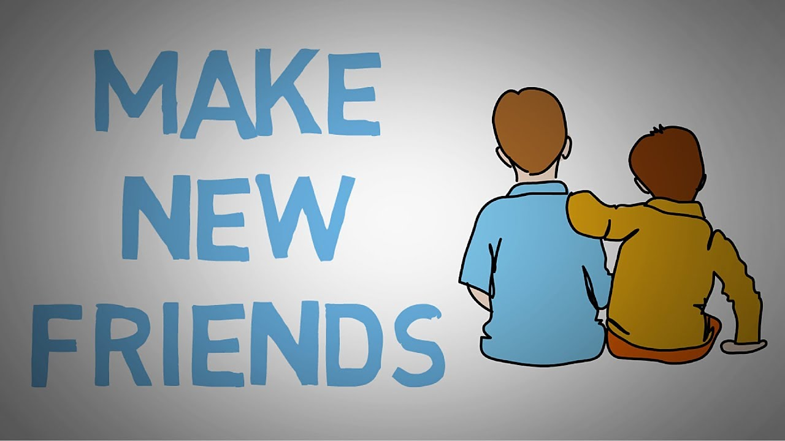
Relationships

Slide 5
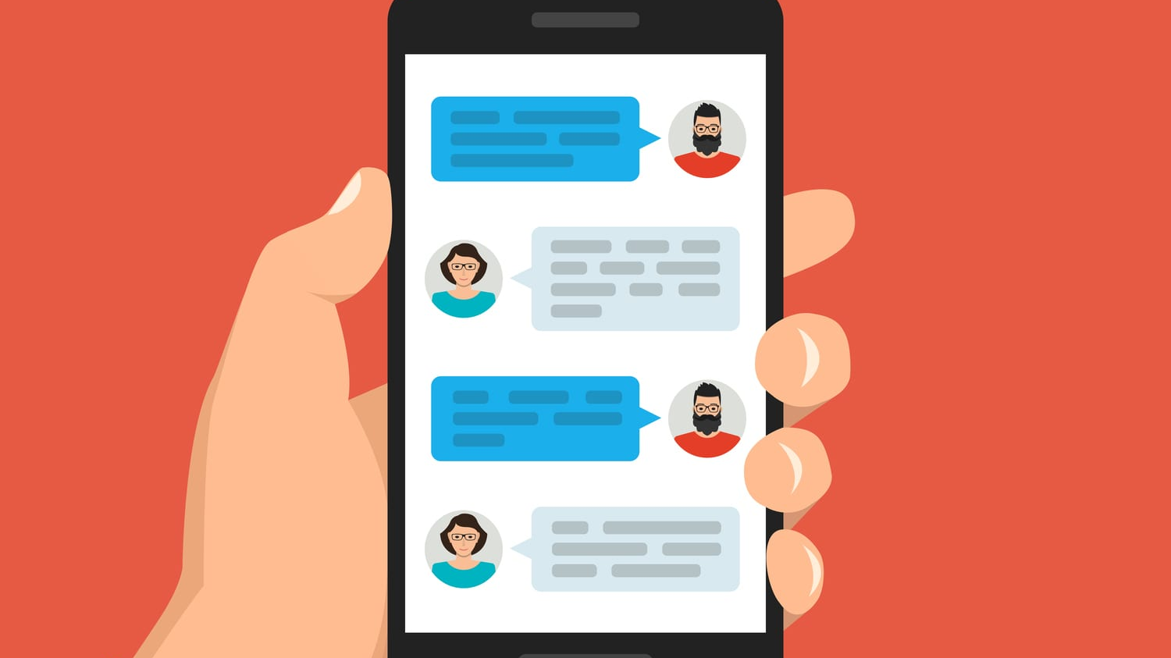
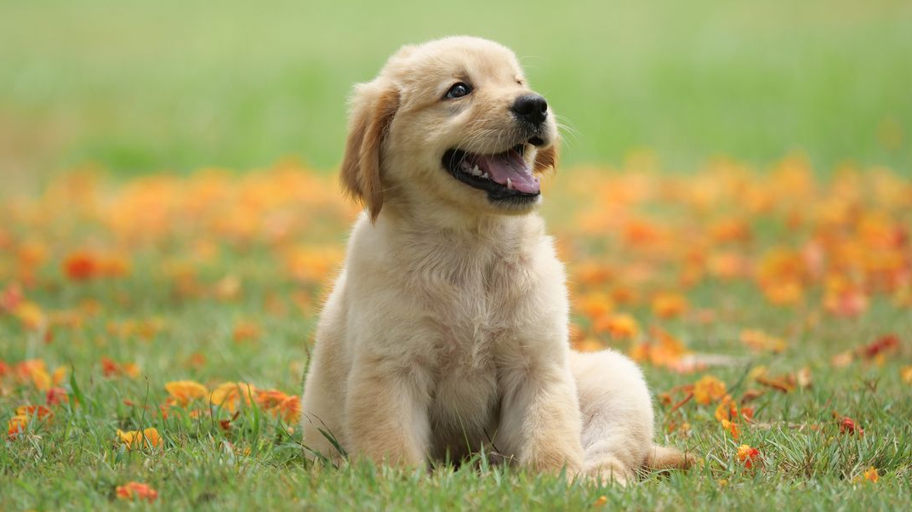
happiness

Slide 6
Final reflection
Health: For health I chose water, running, soccer, and sleeping. I chose water because I think I don’t drink enough water during the day and instead I drink pop. I chose sleeping because I want to fix my sleeping schedule a bit so I'm not as tired throughout the day. I chose soccer because I play soccer and its fun and very good exercise. Next, I chose running because it's important to go outside and exercise almost every day.
Education: For education I chose A+, B.C.I.T., books, and Japanese. I chose A+ because starting next year and the years to come after that I want to try my best and get as many as possible. Next, I chose books because I feel I don’t read enough so I want to read more. Next, I chose Japanese because I always wanted to learn Japanese and now, I have that chance and with Japanese that would make 3 languages I know, and it would make it easier to get hired in certain places. And last I chose B.C.I.T. because after high school I want to work my way into B.C.I.T. for a higher education.
Relationships: for relationships I chose make new friends, friends, family, and uno. I chose make new friends because I want to make new friends throughout the years and help them strive to want good grades if they don’t already. Next, I chose friends because I want to keep hanging out with my current friends throughout high school and help them strive for better grades too. Next, I chose family because without my family I wouldn’t be where I am today and when times get tough, they help me get through that. And finally, we have uno which is something me, my friends and my family play together and it helps us bond more and have fun together.

Slide 7
Addition to final reflection because I ran out of room
Happiness: for happiness I chose soccer, gaming, texting, and dogs. The reason I chose soccer is because I've played it since I was little, and it always brings me joy when I play especially against friends. Next, I chose texting because it my main form of communicating with my friends and it brings me joy talking to my friends. Next, I chose gaming because it helps me relax, it's fun and it's another way of communicating and bonding with my friends. Lastly, I chose dogs because seeing dogs and petting them brings me happiness because I love dogs.

