Slide 1
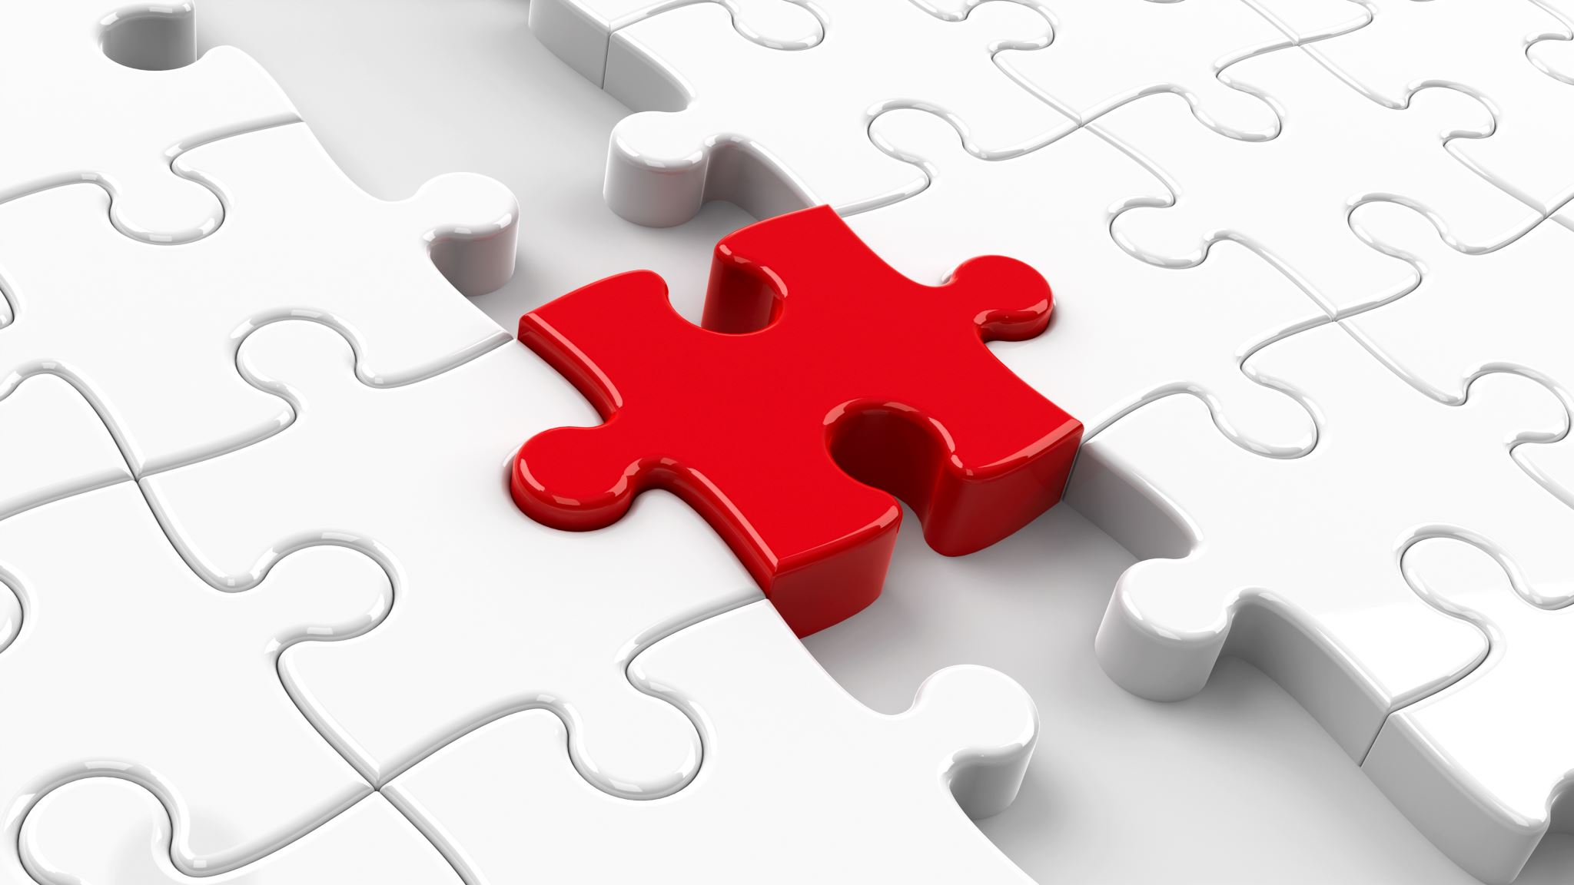
Reflection 1
BY JULIA OLIVEIRA

Slide 2
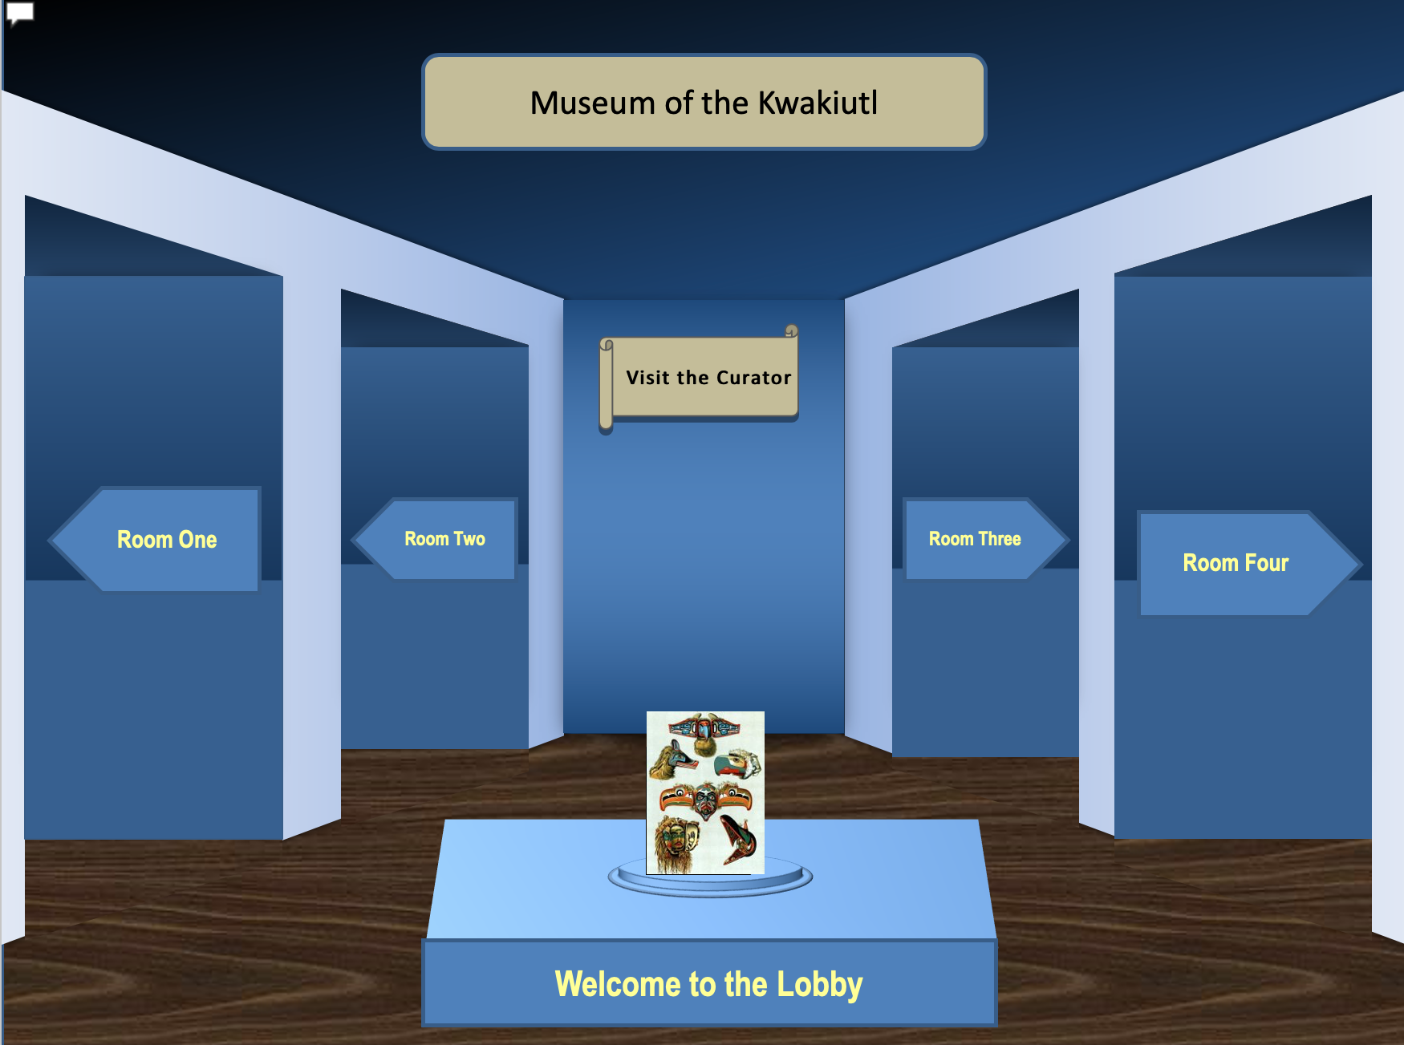

Slide 4
Background
This PowerPoint project was made to describe the native tribe, the Kwakiutl, who were settled in Vancouver island. We had two weeks to complete this and it was partner work. It might look like an ordinary PowerPoint but, when you click the arrows or pictures, it takes you to an exhibit room. When you click the one of the artifacts, it directs you to a slide with an explanation about it. This is One of the coolest projects I have ever done! My partner and I basically created a virtual museum, then presented it to our peers. My socials 9 class did this back in the beginning of quarter one. My personal goals for this project were:
1. put truthful information and cited the websites.
2. present it in a way people would understand everything.
3. since it was a large assignment, hand It in on time.
4. make sure my partner was also satisfied with the work.
-Partner goal
1. Get a good grade and be proud of our work!

Slide 5
What makes me proud
This project was quite large therefore the project was divided in four pieces:
Research and taking notes.
Insert the information in the PowerPoint and make some basic changes.
Make a word document with all the websites I used.
A personal written reflection.
My partner and I managed to do all this in about two weeks and a half. This was a big achievement for both of us. Putting together the assignment and watching it develop was the best part. Our marks made us very proud of our project, it also shows how much work we really put in. The research was one of the biggest parts of the project. my partner and I sat together for four days and spent the entire time on taking notes and research. The notes were really a foundation of our project. Overall, I am proud of our partner work, my persistency, the process and the results!

Slide 6
S
Challenges
During the making of the PowerPoint, we had a bit of trouble. The template we used for the virtual museum would glitch or not direct us to where we clicked. This problem occurred over and over; we were hoping this wouldn't happen during our presentations. Luckly, this did not happen, and the presentation was smooth. There was also a communicating problem, we would not see each other's messages until late at night making it hard to make changes to the PowerPoint. Every project has challenges and we got over ours.
Changes
AS I MENTIONED IN THE LAST SLIDE, MY PARTNER AND I HAD TROUBLE WITH THE POWERPOINT TEMPLATE. AT ONE POINT WE HAD TO RESTART THE ENTIRE POWERPOINT BECAUSE OF THE GLITCHING. IT WAS VERY FRUSTRATING BUT, THIS WAS NECESSARY SO, WE FOCUSED ON WRITING IT AGAIN AND IT ENDED UP BETTER THAN BEFORE! I DON'T THINK I WOULD HAVE DONE ANYTHING DIFFERENTLY; I THINK EVERYTHING WENT WELL INCLUDING GETTING OVER THE CHALLENGES.

