Slide 1
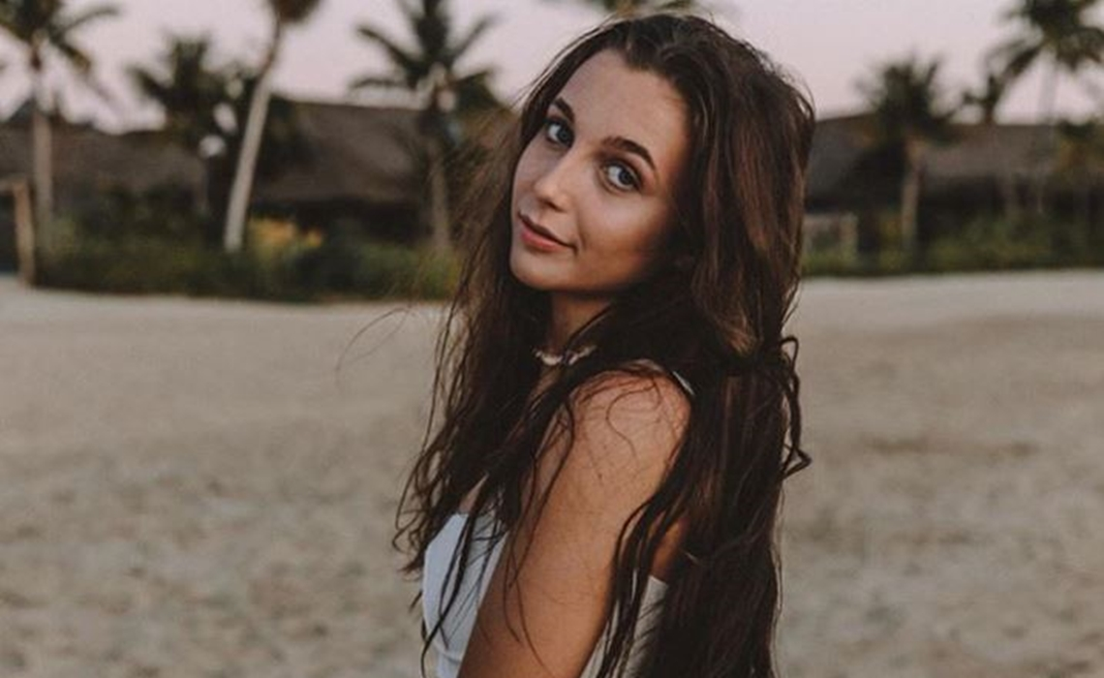
Emma Chamberlain
By Kashmir R

Slide 2
Introduction
Emma Chamberlain is a youtuber and podcaster. She was born in San Bruno California and now lives in Los Angeles. Emma is 18 years old. She posted her first video on June 2, 2017. She has about 8.5 million YouTube subscribers, about 8.4 million Instagram followers.
Link to YouTube Subscriber count : https://socialblade.com/youtube/channel/UC78cxCAcp7JfQPgKxYdyGrg/realtime

Slide 3
Digital Footprint
Social Medias Used By Emma
How Often Emma Posts
YouTube
Instagram
Tiktok
Twitter
Snapchat
To conclude Emma chamberlain posts on multiple social media sites.
Emma chamberlain frequently post on all social media sites. In one of her YouTube videos she mentions that she has a goal of uploading once a week on YouTube, but she does not always follow the schedule.

Slide 4
Protections on Emma’s Social Media
All of Emma Chamberlain’s social media accounts are public, this includes YouTube, Instagram, Tiktok, Snapchat, and Twitter.
Emma Chamberlain has not announced anything about being hacked, but there is a tweet from June 2018 that appear to be a joke between her and James Charles (another a social media influence). Some other social media influencers she is associated with have been hacked (James Charles). In conclusion she has not been hacked, and therefore no personal information has been reveled.

Slide 5
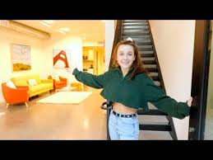
Information Shared by Emma
Most of Emma Chamberlain’s YouTube videos take place in her apartment in rooms such as the living room, kitchen bedroom etc. She has also made vlogs on YouTube showing a tour of her apartment, and you can easily find online the city she lives in (Los Angeles). In her Instagram post she doesn't typically tag a location but there are some locations tags of places she goes that aren’t Los Angeles such as New York and San Francisco. There is some posts on her Instagram with stores in the background which could be used to find her location at the time the photo was taken. In conclusion Emma Chamberlain doesn’t directly share the location of her home but shares videos with her home in them and places she visits on social media.

Slide 6
Is Emma Oversharing?
Yes, Emma Chamberlain is oversharing. Her YouTube channel is mostly about vloging and making funny content. One way she over shares is though Instagram where she has posed for pictures with stores in the background, as well as tagging locations. She also overshares on her YouTube channel; an example would be she has made vlogs about giving a tour of her apartment. Another example would be her talking about her career, her life experiences and her struggles with depression. Emma Chamberlain shares aspects of her life that she wants her followers to know about though social media. I think that she fits the idea of someone who overshares, but she is aware that she is oversharing.

Slide 7
My Advice to Emma Chamberlain
My advice to Emma would be to stop post pictures on social media that have distinctive stores or locations in the background and to not post apartment tours because that is where is she lives therefore it is unsafe to post about her house. I would not advise her to stop make YouTube videos about her life's experiences because that is what her YouTube channel is about, and it is oversharing, but it isn’t not putting her in danger because she wouldn’t be sharing her location.

