Slide 1
Digitial footprint
By:kevin

Slide 2
Dhar man
Dhar mann is a influencer who teaches and gives life lessons to people in society he has multiple social media accounts including his instagram, youtube and tik tok he post every day and he has 5 videos up a week.

Slide 3
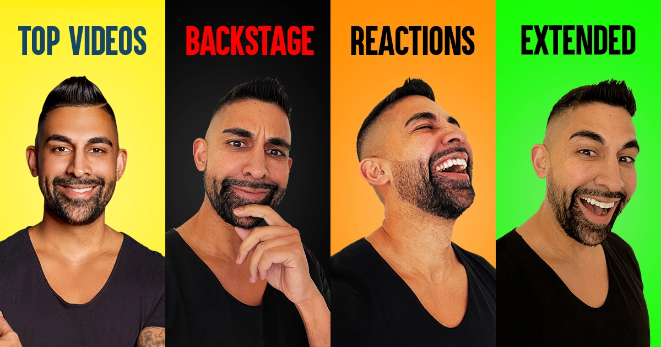
Protection
Dhar mann has more than 1 million followers on youtube he has never been hacked but he does have some protections like having a password on every TYPE of personal information. He has given his real name and his jobs and what he does.

Slide 4
What information they want you to see
People know where he lives but he's constantly everywhere because he creates videos about life lessons. The main information he wants to see is his youtube videos.

Slide 5
Is he an oversharer
No he does not share a lot of information unless he wants to. His actors are known and they give out there personal information if they want to.

Slide 6
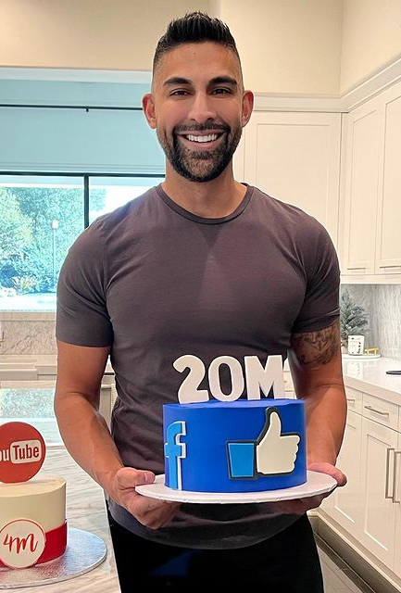
Advice
I have found no way or any clues to help dhar mann to protect his digital footprint but when technology becomes more advanced there might be ways that can help him to protect his digital foot print more.

Slide 7
The end

