Slide 1
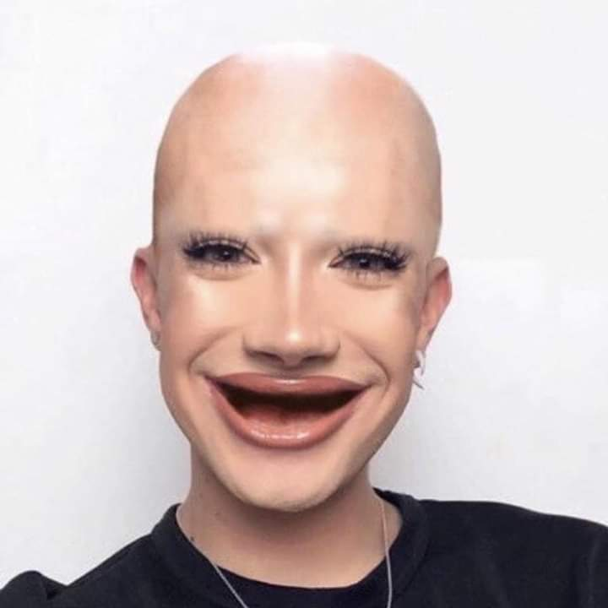
James Charles footprint
By kia.h

Slide 2
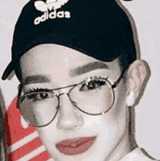
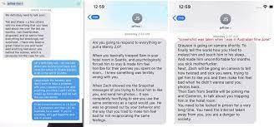
James Charles DM’s with minors
James Charles said very inappropriate things to people who were underaged, he sent them messages that they could screenshot and they shared the screenshots publicly.

Slide 3
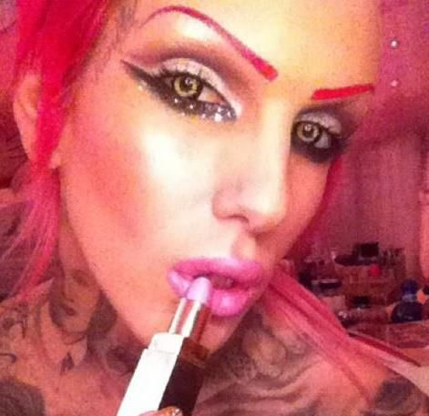
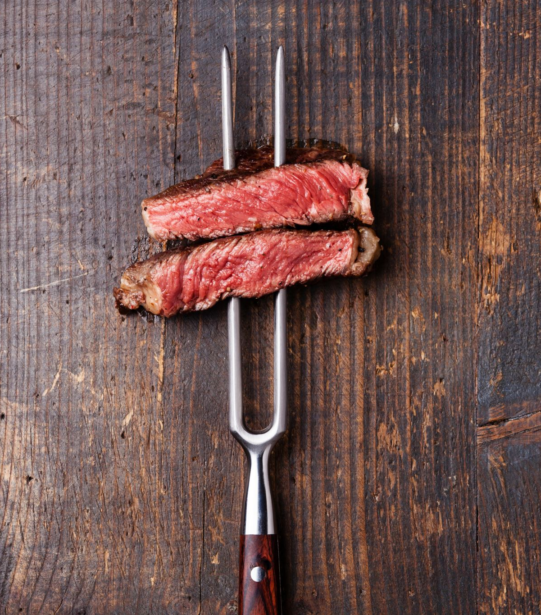
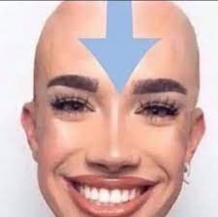
James Charles and Jeffree star had controversy/beef

Slide 4
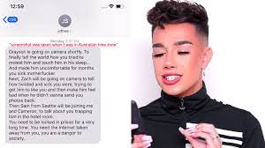
Dms
their controversy wasn’t supposed to be leaked but it was leaked because of screenshot

Slide 5
End

