Slide 1
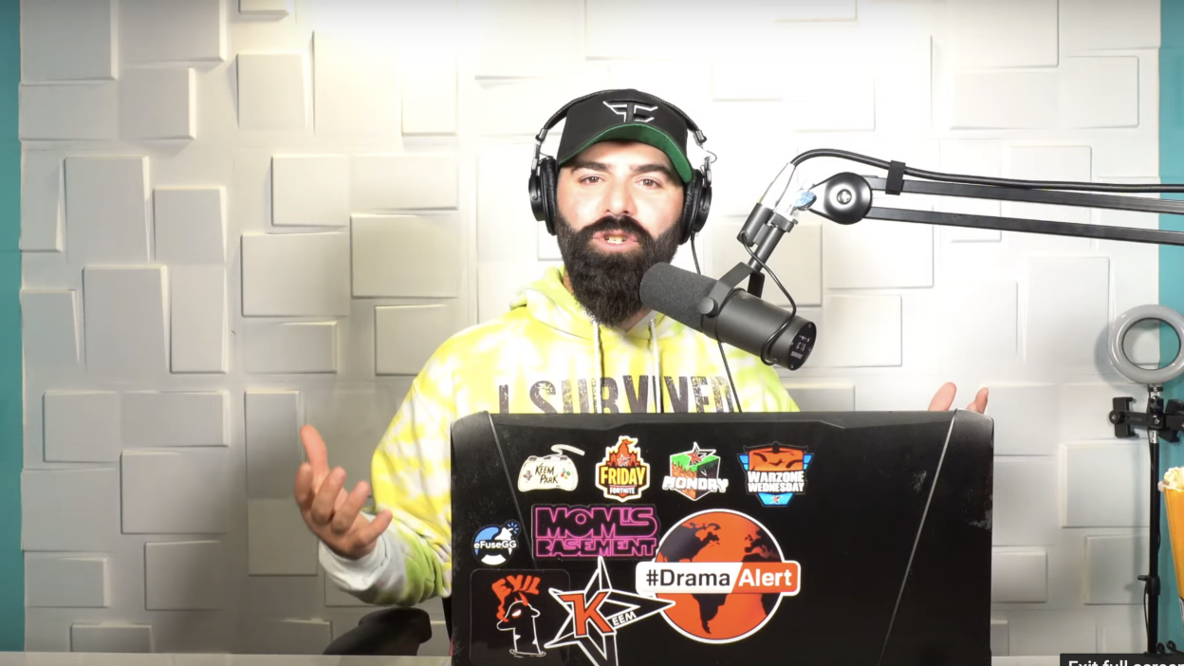
KEEMSTAR’s digital footprint
By kia.h

Slide 2
1. Where does this person post online? Do they use multiple social media sites? How often do they post in a week?
1. KEEMSTAR posts on mainly YouTube and twitter but he also has a YouTube channel by the name of DramaAlert where he goes over drama that’s going on between the YouTube community.
2. yes KEEMSTAR uses multiple social medias such as twitter, Instagram, YouTube, Facebook and Snapchat.
3.KEEMSTAR likes to post on his YouTube channel DramaAlert once a day and his twitter typically about once an hour.

Slide 3
2. Is it a fully public account? Have they ever had any issues of someone hacking into their account or personal information being revealed?
1. yes almost all of KEEMSTAR’s social media accounts are public.
2. in 2019 KEEMSTAR had his twitter hacked by an unknown person, the information that the hacker put out included: His daughters full name, his house address and full name the hacker also proceeded to put out a bunch of tweets promoting the hackers twitter and making fun of other celebrities

Slide 4
3.How they pose their photos or videos? Do they show parts of their home? Are there any identifying marks to show the city or place they may be? Do they use location tags to show their movements?
KEEMSTAR wants you to see him as an enthusiastic positive youtuber that does absolutely no harm and just positively interviews people and goes over drama between big celebritys but that’s not really how KEEMSTAR is in real life. KEEMSTAR is a selfish, messed up and he is also a racist and that’s been shown from his past behaviors such as when he called Alex wassabi the n word or when he used to bully children on online games when he was drunk.
Yes KEEMSTAR has done house tours on his channel and showed his studio around he also showed the outside of his house and even the basement.
KEEMSTAR has had his house address and a lot of other important information leaked in the past and has been forced to move places, but at the current moment there aren’t many ideas where he is located.
Sometimes when KEEMSTAR is doing cons, shows or meetups he likes to tell his fans where he is so they can catch up in time, in the past when KEEMSTAR was a smaller influencer he has tagged his location on his Instagram story when travelling or going somewhere such as Mexico.

Slide 5
4. From the information in the videos above, does this account fit the idea of an oversharer?
Yes I believe KEEMSTAR is a great example of an oversharer because of all of the times he has gotten hacked (3 times).

Slide 6
5. Taking in all of the information you have gathered, what would you say to this person about how to better protect their digital footprint?
To be honest I would tell them to get off the internet for a while or just stop using the internet by itself all in general, because I believe if you aren’t able to handle hate or backlash just don’t be an influencer.

Slide 7
Big questions

Slide 8
How expansive is this person's digital footprint?
I’d estimate to somewhere around 5k-40k based off research.
What protections does this person put on their accounts?
KEEMSTAR doesn’t really have anything special put onto his accounts he just uses a normal password
What information do they want you to see? What information do they keep private?
KEEMSTAR usually likes to hide his dark past because of all the messed up things he’s said and done, one of the things he’s done to keep his past mostly private is by going back and deleting his old tweets
Is this person an example of an "oversharer”?
For the most part yes I believe that KEEMSTAR falls into the same category of an oversharer.
What advice would you give to this person about their digital footprint?
To be honest I would tell them to get off the internet for a while or just stop using the internet by itself all in general, because I believe if you aren’t able to handle hate or backlash just don’t be an influencer.

Slide 9
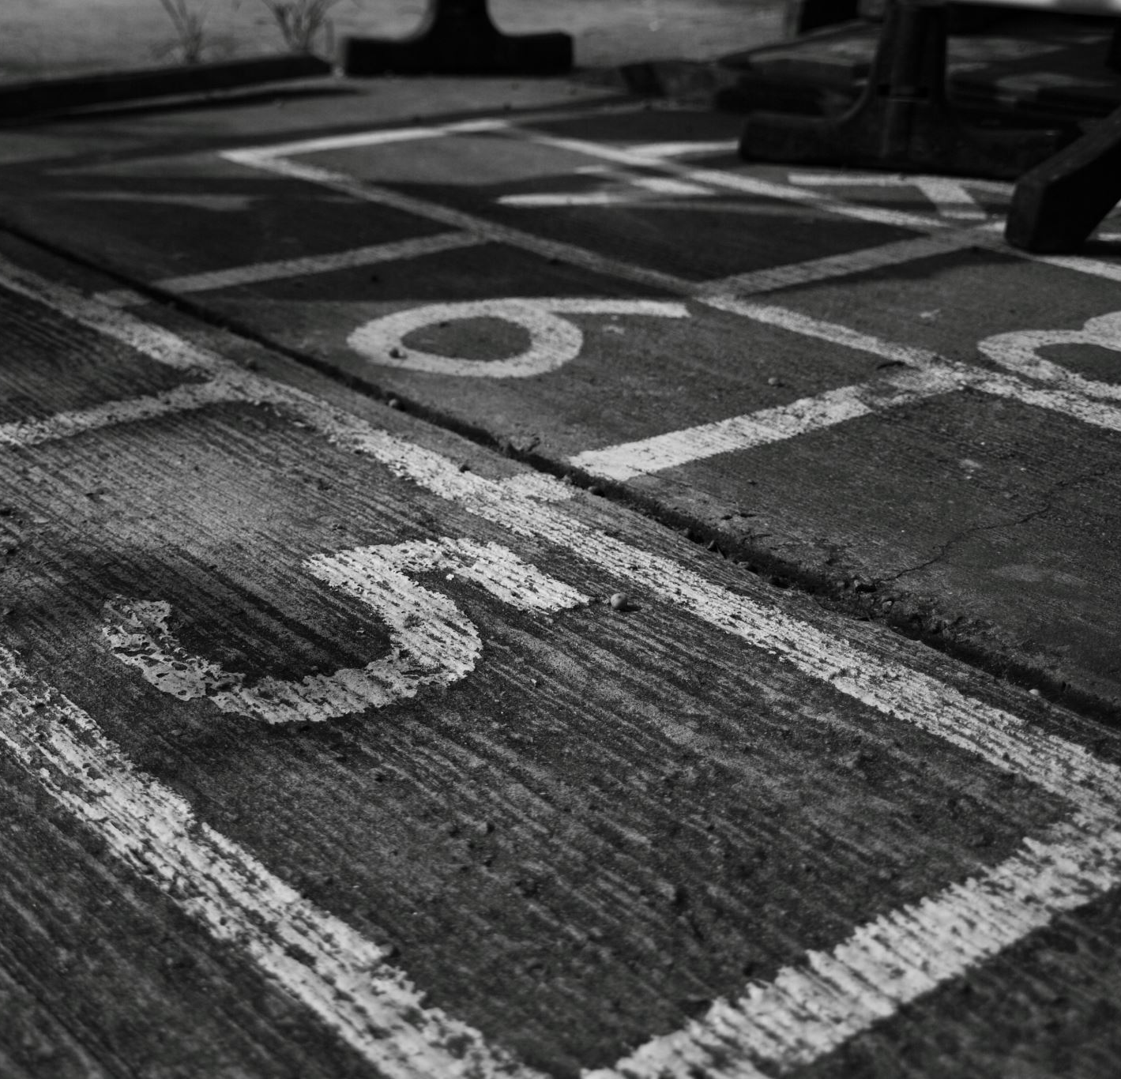
The end

