Slide 1
Digital footprint on Tom Holland
By: Liam

Slide 2
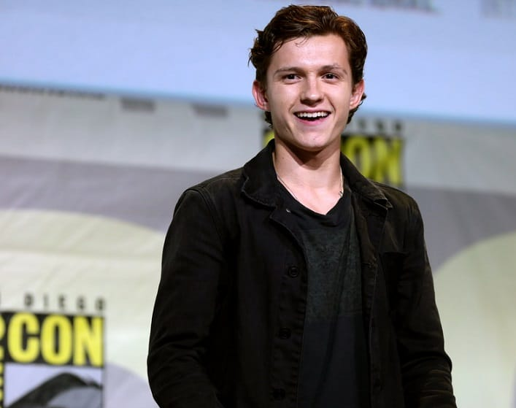
1. How expansive is this person's digital footprint.
Tom Holland, a famous actor posts on Instagram and twitter.
He explained why he's careful about sharing his life on social media.
He stated that if it were up to him, he would quit social media altogether. He thinks Marvel and Sony wouldn’t be happy.
He doesn’t post often, but he does post pictures of himself acting, pictures at special events where he is celebrating his new movies, and pictures of his personal life.
This Photo by Unknown author is licensed under CC BY-SA-NC.

Slide 3
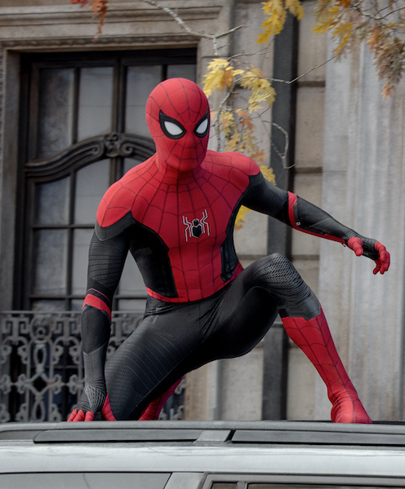
2. What protections does this person put on their accounts?
Tom Hollands Instagram account is public, which means anyone can follow him.
He doesn’t have any history of getting hacked into his social media accounts, and most of his personal information hasn’t been revealed. Although paparazzi has taken some photos that revealed who he is dating, which is a bit of an invasion of privacy.

Slide 4
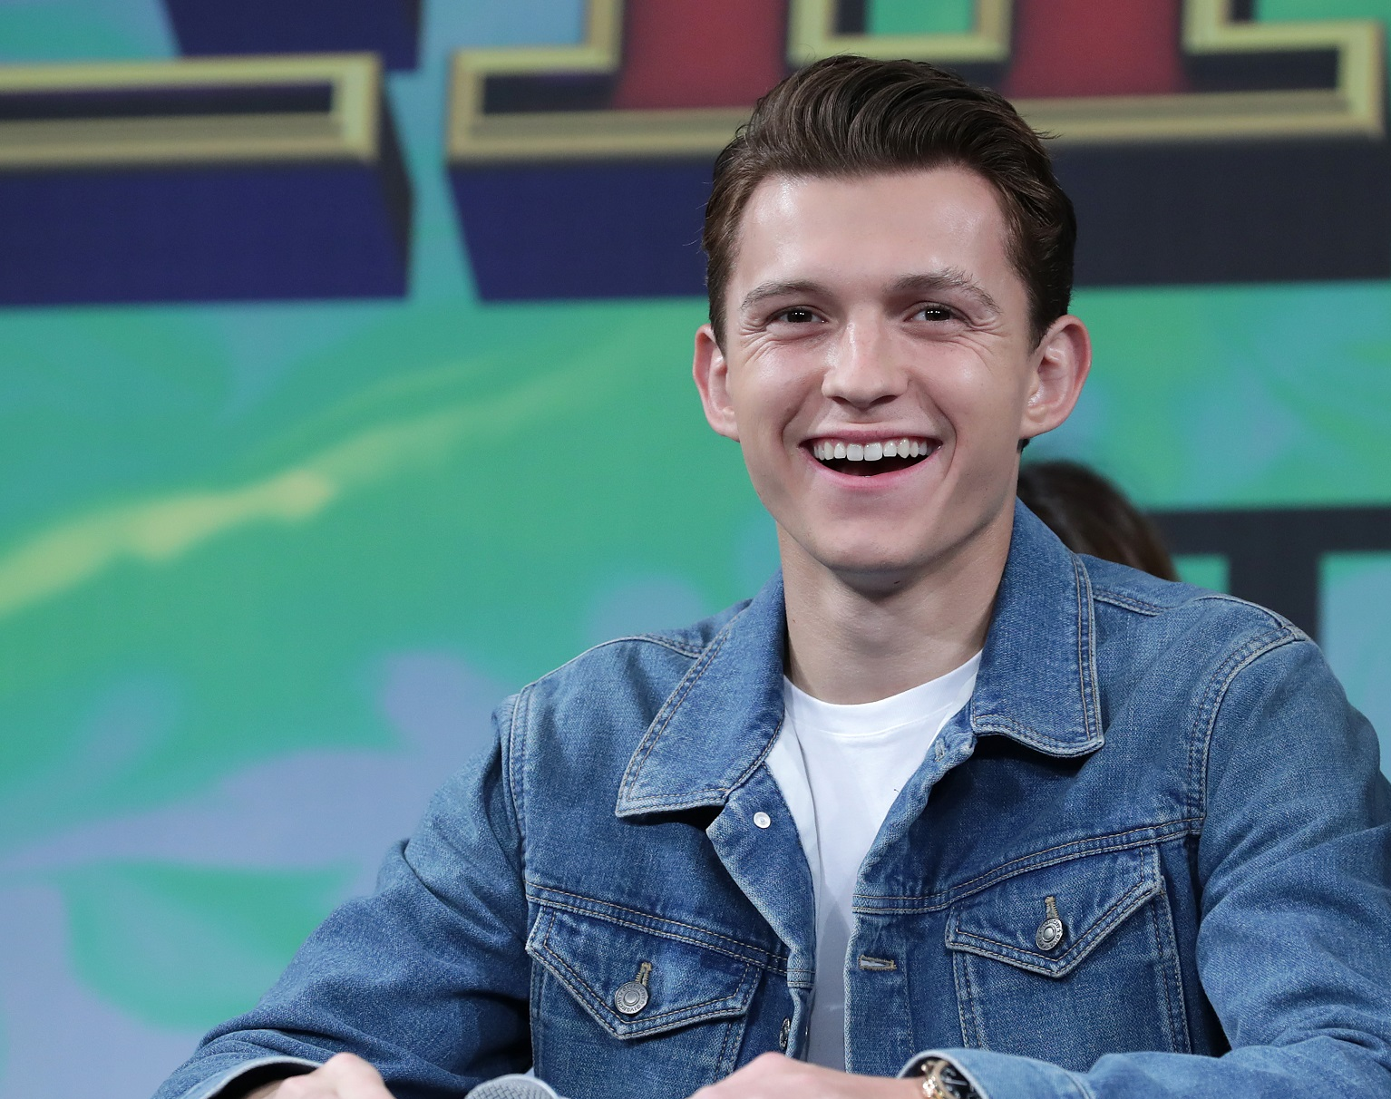
3. What information do they want you to see? What information do they keep private?
He wants people to view his new movie trailers, and pictures of his new movies.
Tom Holland keeps some of his personal life private, but does post occasional photos of him with friends, and when he is on vacation.

Slide 5
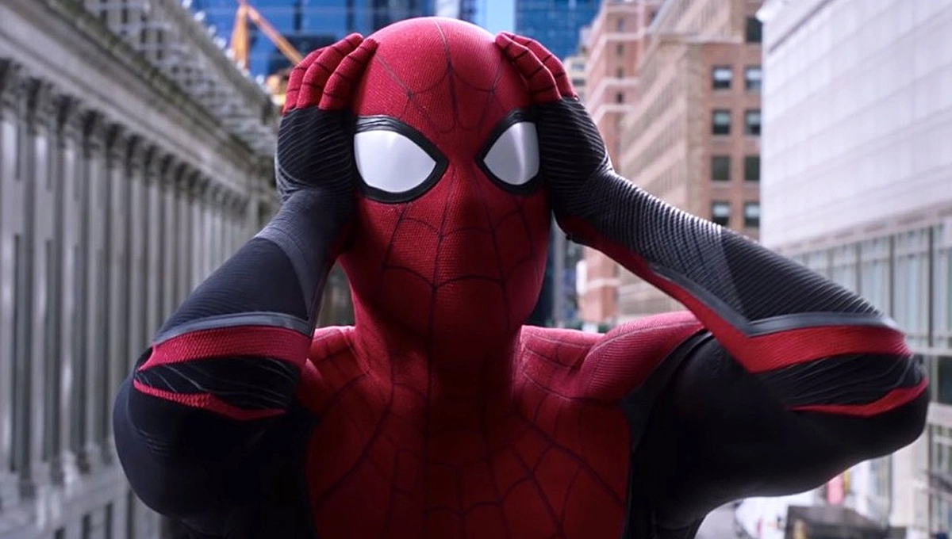
4. Is this person an example of an over sharer?
I don’t think Tom Holland is an example of an over sharer because he doesn’t reveal too much about his personal life.
Like many famous actors he does post talking about his new movie releases and posts photos of himself.
I don’t feel he overshares anything personal and posts mostly with people he's close to. There was a time when Tom Holland accidently leaked an Avengers Infinity War poster before the trailer and date were released to the public. This was on his Instagram live video in 2017.
The link to the video: https://www.youtube.com/watch?v=FKFy_pyK7E8

Slide 6
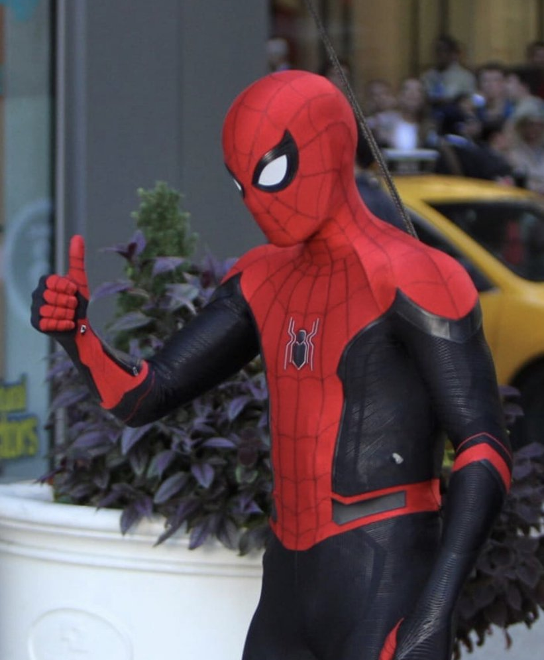
5. What advice would you give to this person about their digital footprint?
My advice would be to continue being a kind and positive social role model to the fans of spiderman. Its courageous to see a younger actor to be engaged in social media but express that there are more important things in life.

