Slide 1
James Charles’s Digital Footprint
By Lorena

Slide 2
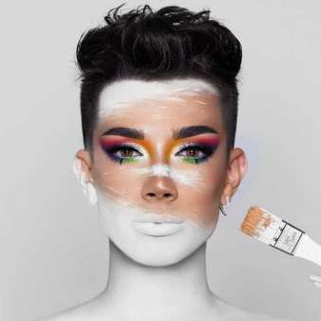
How expansive is this person's digital footprint?
James Charles posts regularly on his many social media platforms such as Instagram, Snapchat, Twitter, YouTube and TikTok. He posts a YouTube video every week and sometimes multiple pictures on Instagram and tweets on Twitter.

Slide 3
What protections does this person put on their accounts?
James Charles’s social media accounts are all public and are free to follow or watch. Anyone can access them easily.
His twitter account has been hacked before, and personal things were posted.

Slide 4
What information do they want you to see? What information do they keep private?
James Charles lives in Los Angeles, where he posts most of his pictures. He occasionally tags his location, such as which restaurant or mall he is at, but usually sticks to his main focus of the posts; him or his makeup.
James Charles has spoken about his neighbor being Selena Gomez, so if for some reason, a person knew where Selena Gomez lived, they could possibly also find James Charles.

Slide 5
Is this person an example of an "oversharer?"
Though he sometimes posts about where he is at the moment, I think James Charles is an over sharer because he has had his account hacked before, as well as is always posting where he is so the paparazzi can find him.

Slide 6
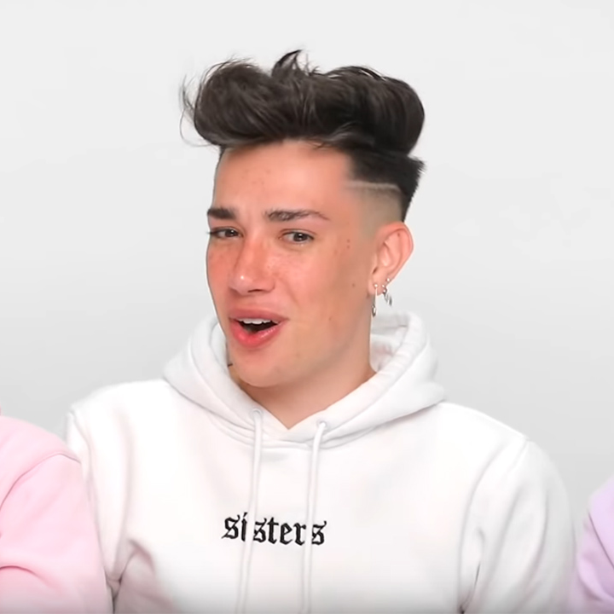
What advice would you give to this person about their digital footprint?
Advice I would give to James Charles would be to stop posting where and what place he is currently at, as well as make more protective passwords to use for his accounts.
He could also post where he is, but post it maybe a day after because less of a risk to be followed or kidnapped

