Slide 1
Faze Rug
Faze Rug is a famous YouTuber and he has over 19 million subscribers (people that follow him) on YouTube.

Slide 2
1. How expensive is Faze Rug's digital footprint?
Faze Rug's digital footprint is very expensive because he has a lot of followers. Faze Rug posts on YouTube, Instagram, Twitter, and Tiktok and he uses multiple social media sites that I mentioned above. Faze Rug posts 3-4 times a week on YouTube, which is what he's known for.

Slide 3
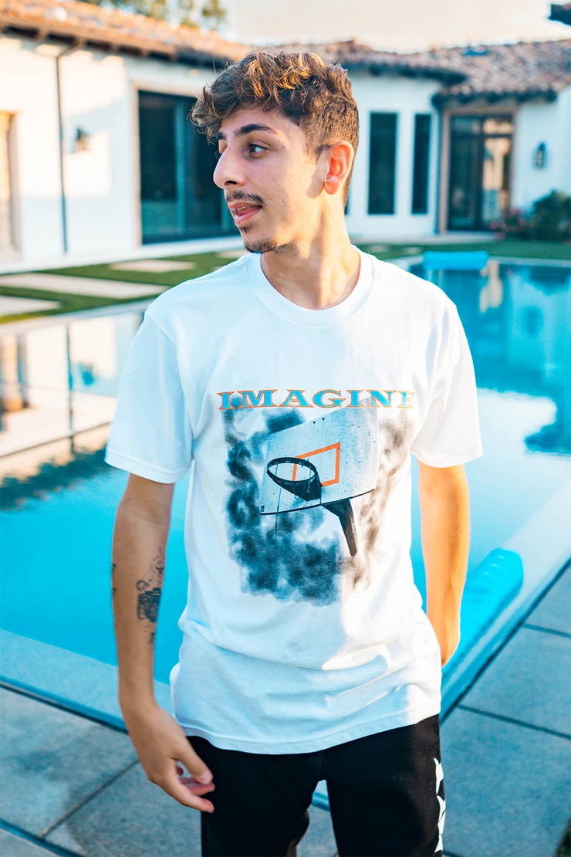
2. What protections does Faze Rug put on his accounts
Faze Rug has passwords for all his accounts and he has with the owners of platforms such as Instagram and YouTube. His accounts are public in social media and social media is kind of his job. It is where he makes his money from. Once a fan found his house and shared it on social media, so he had to move places because fans showed up to his house.

Slide 4
3. What information does Faze Rug wants us to see? What information does he keep private
Faze Rug wants us to that he's a humble person because every 3 months he goes and helps homeless and he donates charities. He only shows his mom, dad, his brother, and cameraman on camera, and he doesn't show his other family members. He records most of his videos with his cameraman and he has shown some parts of his house but not the whole thing. Ever since, someone shared his address on social media, he has been very careful to not show his address and he does not use location tags to show his movement.

Slide 5
4. Is Faze Rug an example of "oversharer?"
I don't think Faze Rug is an oversharer because he knows what to share and what not to share. The one time that his address got leaked, he turned down the video immediately by reporting the person that shared his house address online. His account does fit the idea of an oversharer but social media is kind of his job and he makes his money from social media.

Slide 6
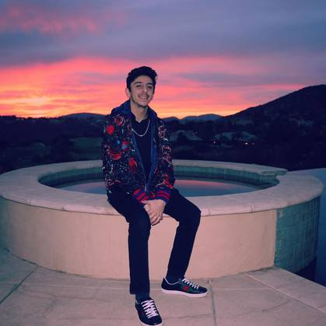
5. What advice would I give Faze Rug about his digital footprint?
The advice that I would give Faze Rug is that I would tell to post less on social media because he posts too much on social media. Other than that I don't have any other advice for him because he knows the consequences if he shows private information.

