Slide 1
Digital Footprint
Robin Hwang

Slide 2
Tag
No1: His activity at social media
No2: The protections of his information
No3: Main activity and management of his account
No4: Overshare
No5: Advise

Slide 3
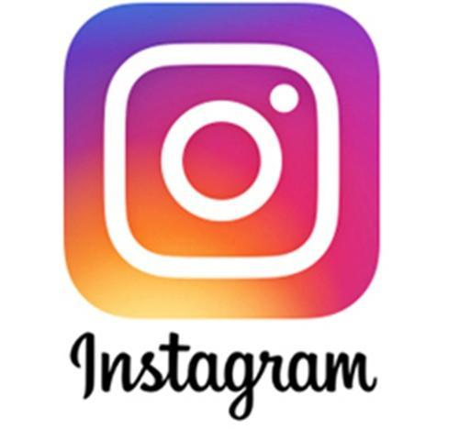
His activity at social media
He is one of the famous youtuber of North Korea who has 1.3 million subscribers. He manages his YouTube channel with his Instagram and Facebook account. He uploads his information once.

Slide 4
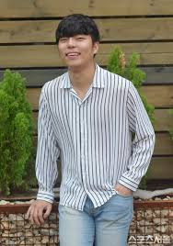
The protection of his information
He does not hide any information and it is exposed to public. Even though, we can find the information of his family number through social media. It is very dangerous that in the worst situation his personal information may be abused such as scam or hacking.

Slide 5
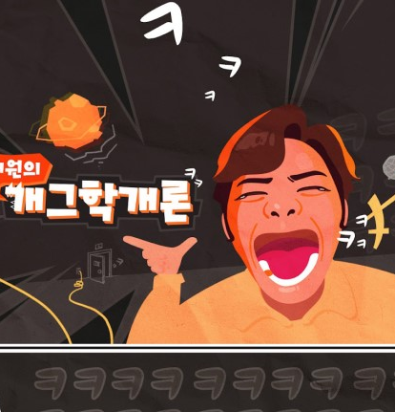
Main activity and management of his account
He has 1.3 million subscribers. He manages his YouTube channel focused on entertainment and Vlog. He uploads video to his channel once a week. By uploading videos, he shares his life with others.

Slide 6
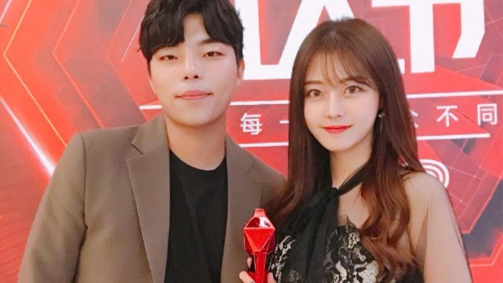
Overshare
He shares detail part of his daily life. He opens and shares his life with other people, even though his family information. However this oversharing may bring some problems that his personal information might spread to internet without his recognition.

Slide 7
Advise
He needs to control and regulate his information to spread through internet.
I think he should be more careful about spreading his information to social media, it may cause lots of problems such as scam or hacking his personnel information.

Slide 8
Thank you for listening!

