Slide 1
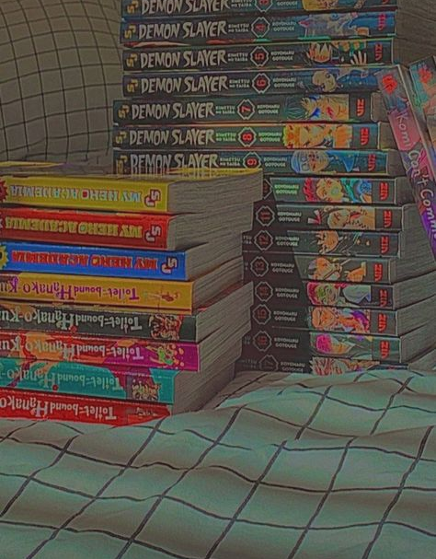
iwazuimn
By: Rounika

Slide 2
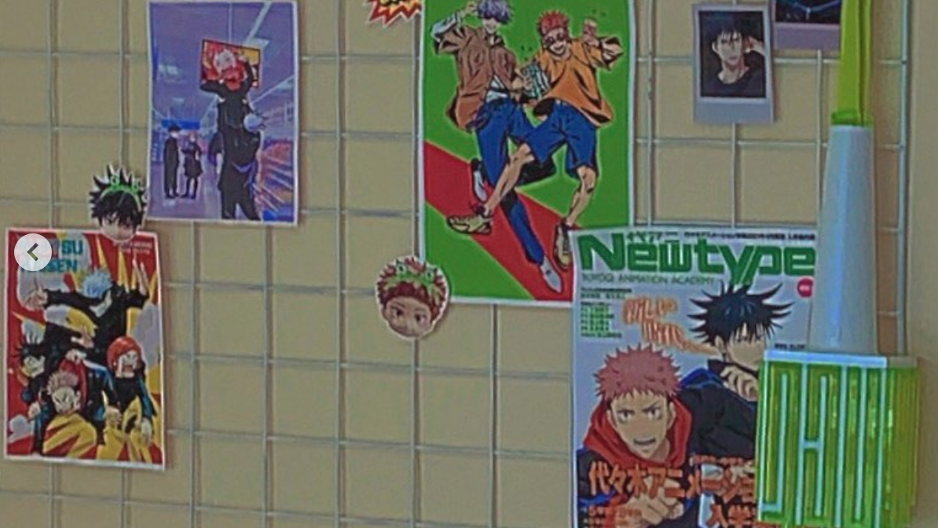
iwazumin's digital footprint
iwazumin is a small youtuber with about 247k subscribers. She also has platforms on Pinterest, Instagram and Spotify. With 32.8k on Pinterest, 28.8k on Instagram and 16.1k on Spotify. She only posts about twice a month but is active on Instagram stories often. Her content is vlogs/ what she does in a week. She occasionally uploads diy's and room tours. She also takes aesthetic photos for her Pinterest.

Slide 3
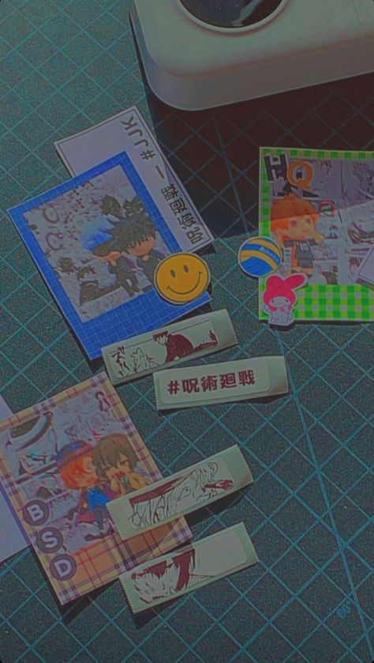
Protections
All of her social media accounts are public, for all to see. Anyone is able to comment or view her posts. She has not had any experiences in hacking as she is relatively new to YouTube and only just started growing her popularity.

Slide 4
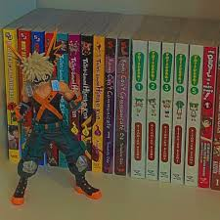
Information
iwazuimn's videos are made without being able to see her face and hear her voice. She makes montages of her day and edits them with subtitles and music in the background. She usually films in her room and has done a room tour before. Other than that, she doesn’t show any other rooms in her house. She has clips of car trips and it is quite difficult to see where she lives just by how the streets look. She does not have any tags that can identify her location.

Slide 5
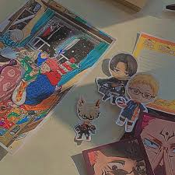
Is she oversharing?
By looking through iwazumin's social media I have come to the conclusion she is not an overshare. She does not show her face, nor do we know what she sounds like. This is already enough to know she does not overshare. She also does not reveal her privacy, like showing her address or saying what school she goes too. She has revealed her name, but only her first name not her last name as well. Although on her Instagram, she frequently does q and a's but she does not reveal to much information on those. Her content is still enjoyable without her oversharing.

Slide 6
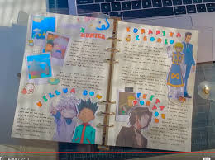
Advice
The only advice I would give iwazumin is to continue what she does. She is able to provide enjoyable content without oversharing. She should not overshare on her q and a's because of the questions she may get.

