Slide 1
Digital Footprint
By Sean Lee ; PACK 906

Slide 2
introduction
The person I am looking at is Markiplier

Slide 3
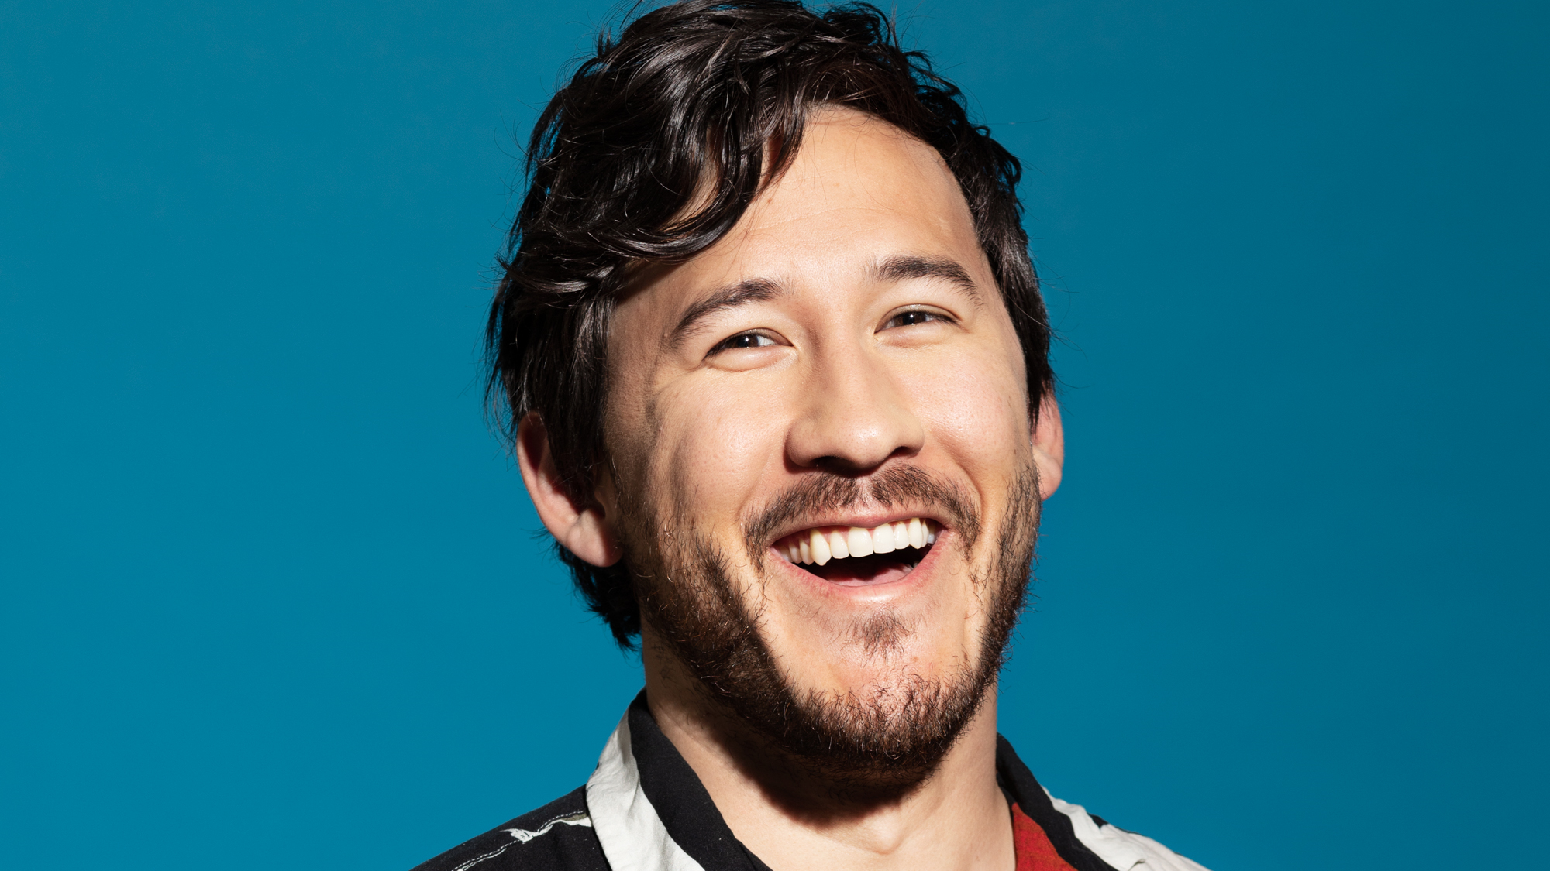
Question 1
They use multiple social media sites to share their experiences. They tend to post on their account with not much of an intent to show what they are doing actively during the day. He uses YouTube as a way to engage to the audience

Slide 4
Question 2
Their account is a fully public account, and everybody around the world that ISNT blocked can see the account/videos

Slide 5
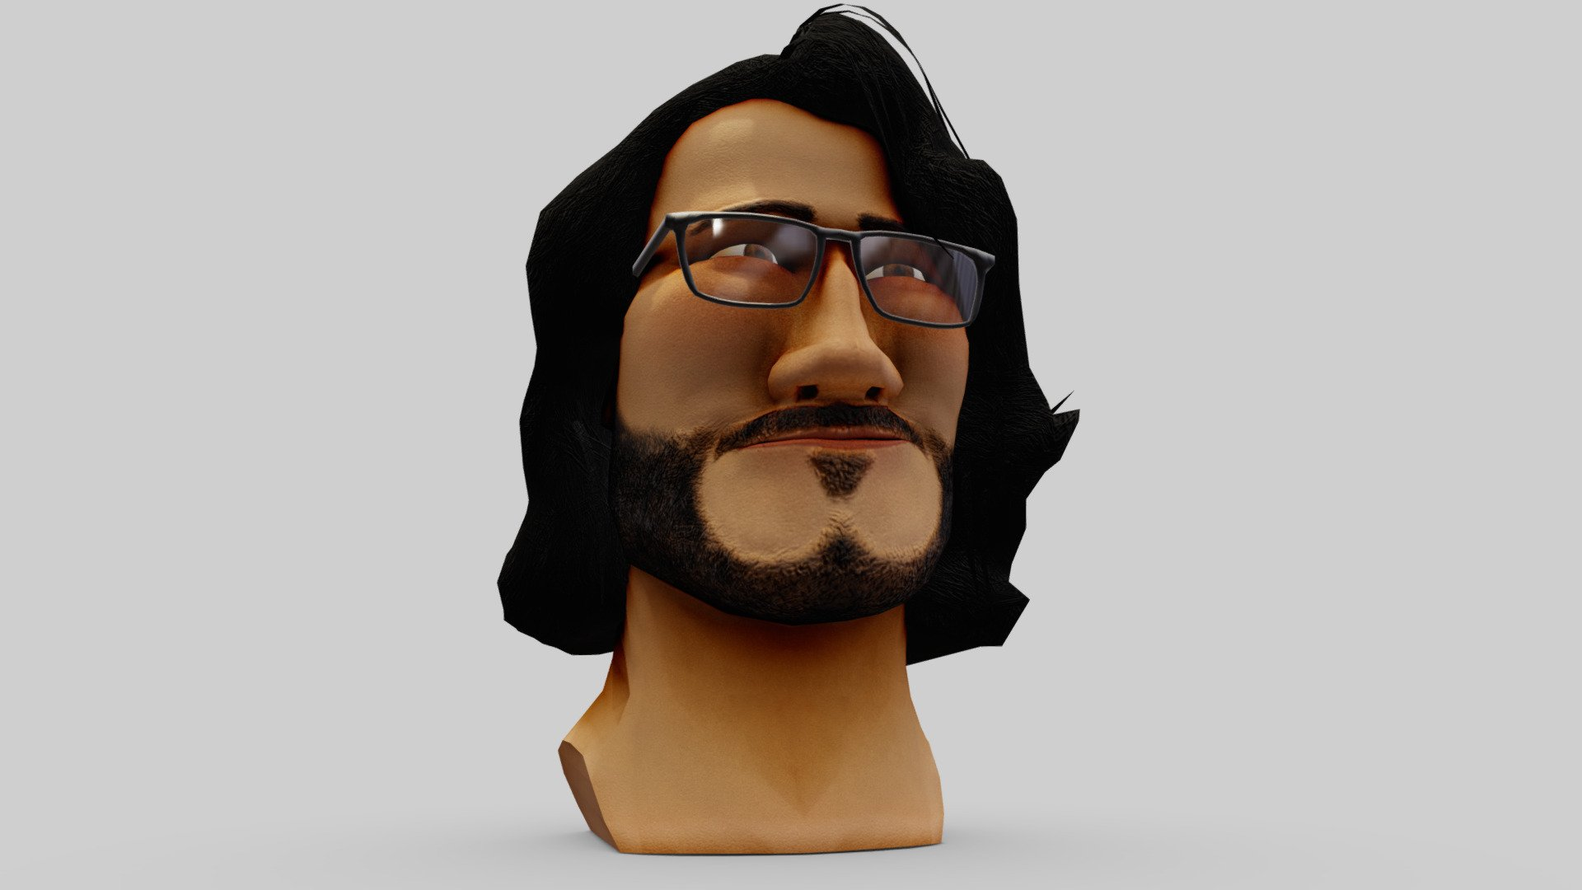
Question 3
They do not show their homes or personal family. Majority of the items they post online is from vlogging, or doing activities that draw attention to themselves. He does not share his information of his house, or family, online.

Slide 6
Question 4
No. This person is aware he is a popular youtuber and is very careful about what he posts online.

Slide 7
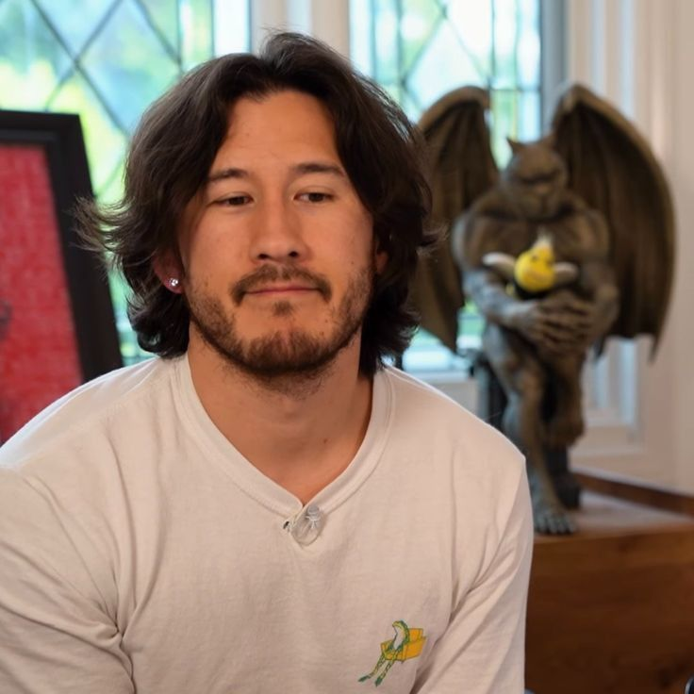
Question 5
He can continue to keep his personal identity safe and a secret. I think he is already fully aware of what he is posting and he can continue to do how he does today.

