Slide 1
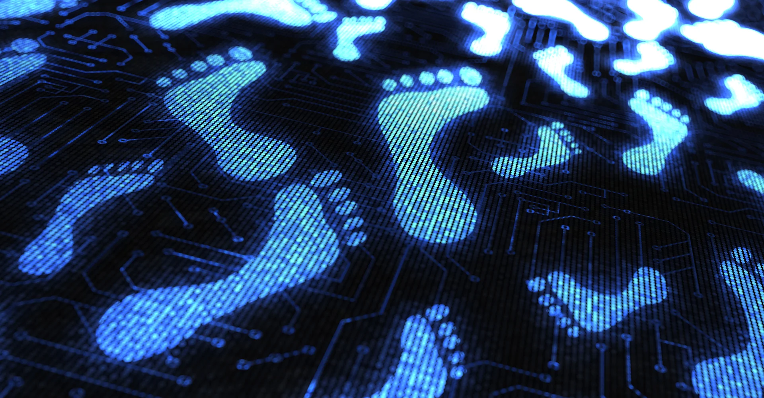
Kylie Jenner’s Digital footprint
By: Selina

Slide 2
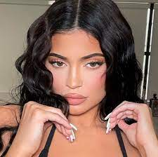
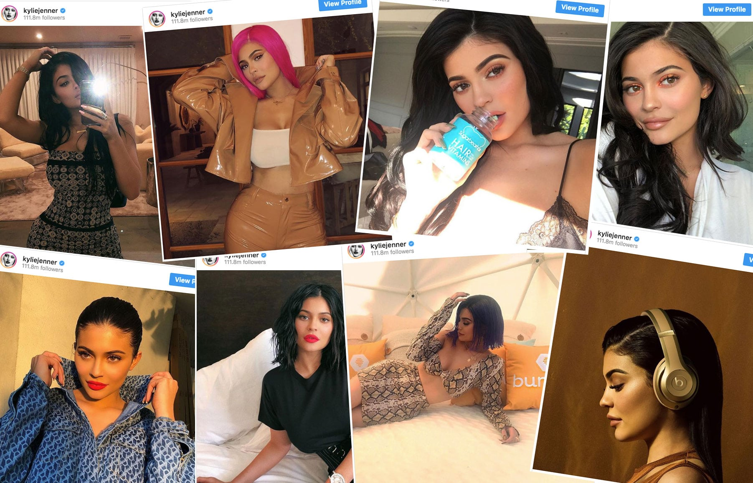
How expansive is their digital footprint?
- Kyle Jenner uses social media handles such as Instagram, Twitter, Snapchat. She also uses Tiktok and YouTube but not as often
She is generally known through people who watch Keeping up with the Kardashians and has a big platform on Instagram and Snapchat.
She posts on Instagram a few times a week, and posts on her Snapchat story nearly everyday.

Slide 3
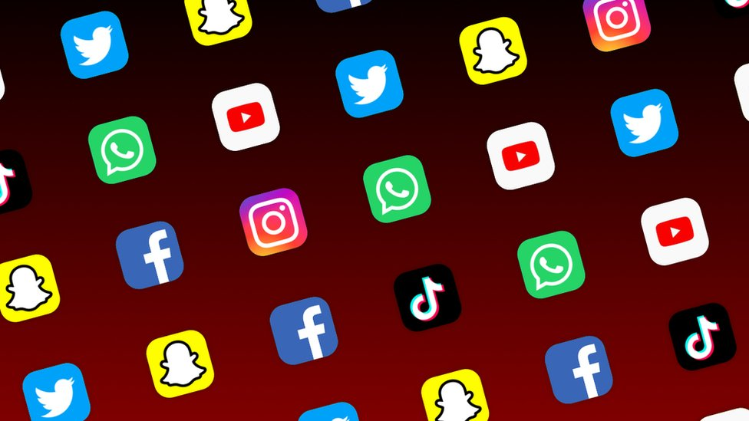
What protection does she use on her accounts/has she ever been hacked?
All of Kylie Jenner’s social media is open to the public eye.
She is not the only one managing her accounts, she has hired a social media manager that takes care of and manages her accounts and helps with promoting her businesses.
Kylie Jenner has been hacked on Twitter as well as Snapchat however the situations were delt with relatively quick and everything was back to normal.
Nothing serious came of the hackings and no personal information was released it was simply someone just trying to make her look bad by making pretty rude comments on her Twitter.

Slide 4
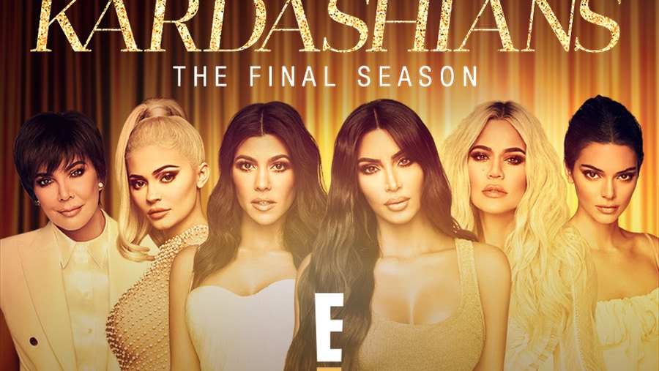
What she posts and what we see/don’t see
Kylie usually keeps her posts limited to promoting her businesses, her daughter Stormi, photoshoots of herself, and if she goes on vacation anywhere.
She usually just posts about big things in her life and updates on anything. She doesn’t usually put location tags on her posts unless she is travelling away from where she lives.
Kylie never really posts anything that would reveal her exact location and it would be hard/impossible to able to track her.

Slide 5
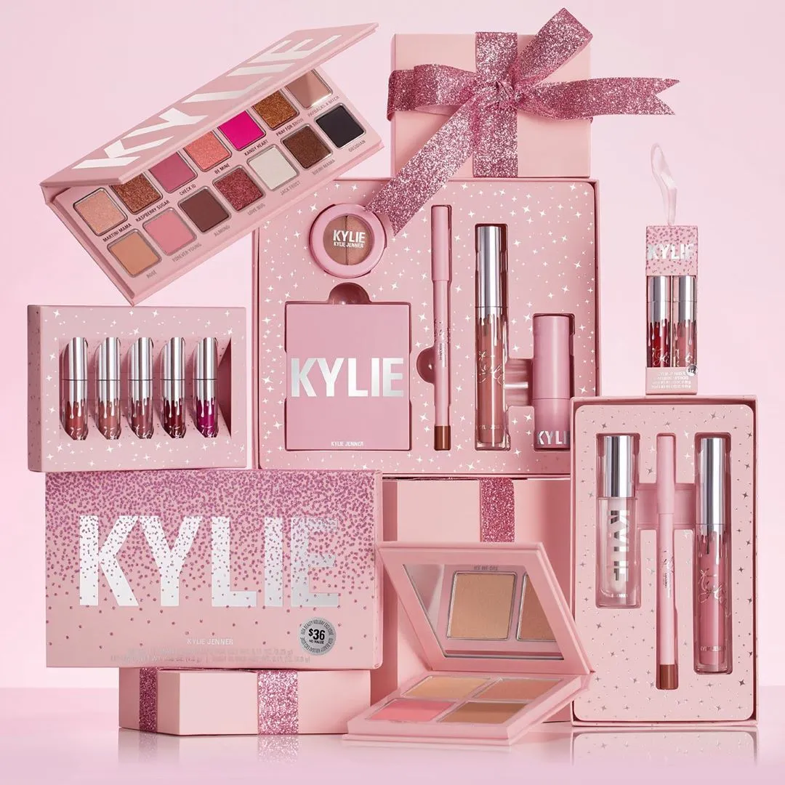
Does she fit the title of an oversharer?
I wouldn’t say Kylie overshares at all. She keeps things informational to her audience but also doesn’t give too many details about what’s going on in her life.
All her posts are mostly surface area of what’s going on in her life and we rarely get to see details of whatever is happening as she is good at hiding things about her personal life.
She managed to successfully hide 2 pregnancies.
In my opinion Kylie isn’t an over sharer and keeps thing pretty minimal and gives her audience just enough information.

Slide 6
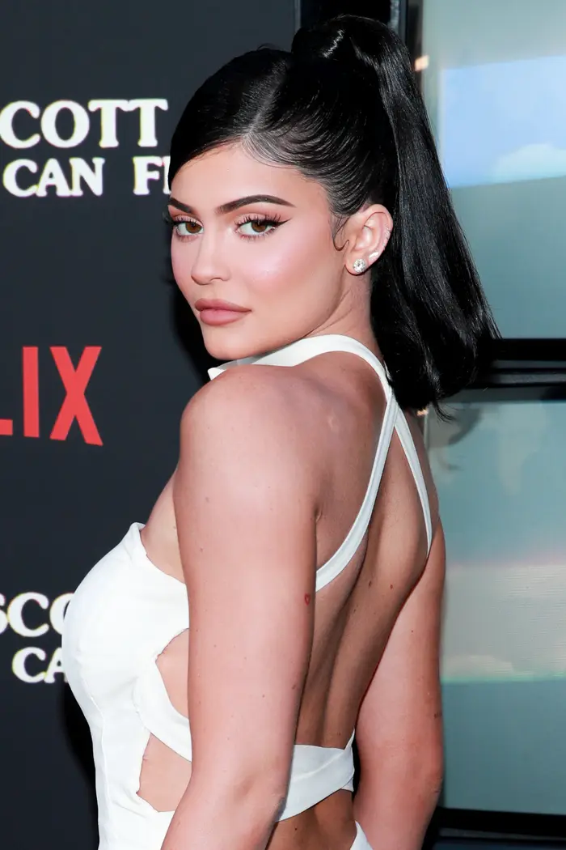
Advice?
I think Kylie has done a pretty good job with her social media and keeping herself safe also seeing as she comes from a well-known family. She has shown good responsibility and accountability for everything she posts. She seems to be an independent women doing good things with her life and my only advice would be to show her fans a little bit more of the real her.

