Slide 1
JoJo Siwa

Slide 2
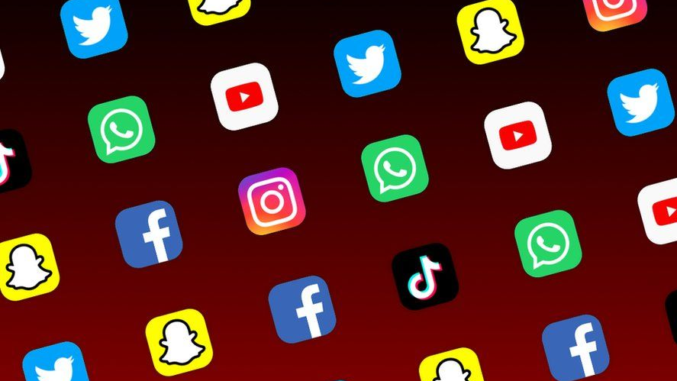
Digital Footprint
Joelle Joanie Siwa is an American dancer, singer, actress, and youtube personality. She is well known for her part in the show Dance Moms. Jojo Siwa has multiple social media accounts. She posts on her twitter, Instagram, Youtube channel, Tiktok, Facebook, and has her own website. Jojo mostly retweets things on her Twitter every few days but not often. She is very active on her Instagram and puts things on her story lots of the time. Every few days or weeks she posts pictures on there. Jojo posts vlogs or music once every week or so on her Youtube, or sometimes once a month. Her TikTok is posted on a couple times a month. Her Facebook is not posted on very often, and her Website seems to post updates on Music or tours when they happen.

Slide 3
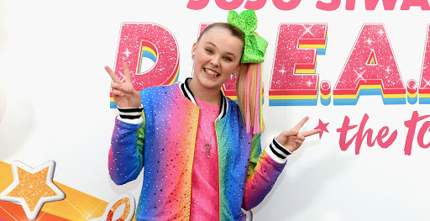
Protections
Jojo Siwa's Social Media accounts are fully public. Anybody can view and comment on her posts. None of her socials have ever been hacked thankfully.

Slide 4
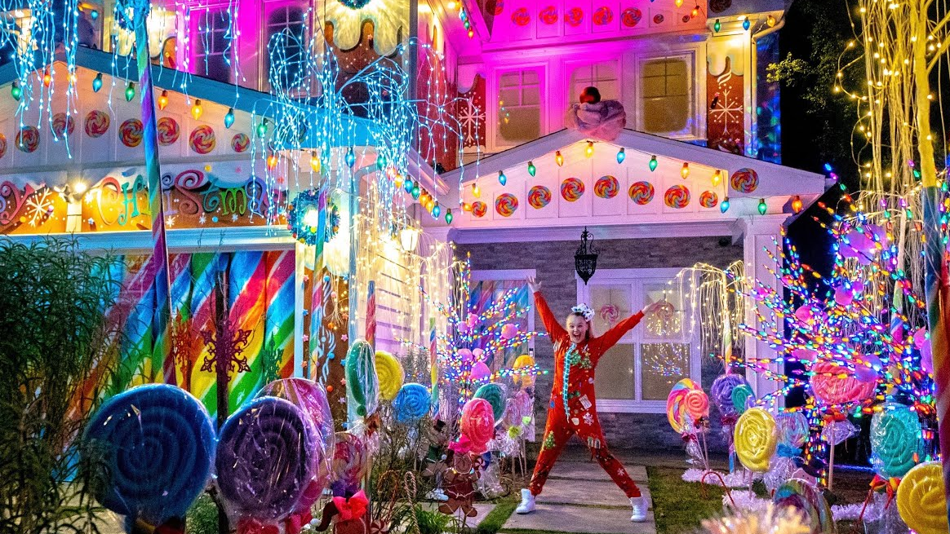
What does she want us to see
Jojo Siwa is open about where she goes and lives. It is open to the public that she lives in LA California, and she has posted House Tours that showcase the outside and inside of her home on her Youtube Channel. Jojo does not use location tags to show where she is but she does put in captions where she may be sometimes. On January 26th she made an Instagram post with the caption "Caught me arriving In Canada to start filming something REALLY exciting!". Jojo is not very private about herself, she has posted videos on her Youtube channel and pictures on her Instagram of her unique car that anybody may be able to spot. Multiple videos have shown on the internet of people passing Jojo's residence or car in public because we know what it looks like.

Slide 5
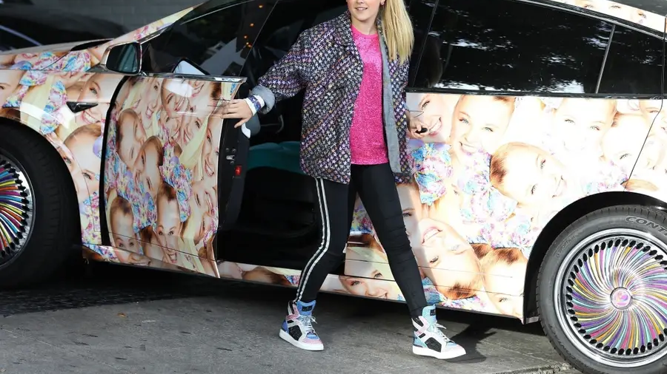
Is Jojo oversharing?
Jojo has obviously never shared her exact location or address before, but I think she is oversharing.
Examples include her unique car that would be difficult to replicate that anybody could spot if they saw it on the road or parked in her driveway. This is a security hazard since anyone could follow her. Another example of oversharing is videoing the inside of her home and especially the outside and posting it online. People could recognize it, easily find the area, etc. People can take advantage of her sharing her home online and go there which no one would want.

Slide 6
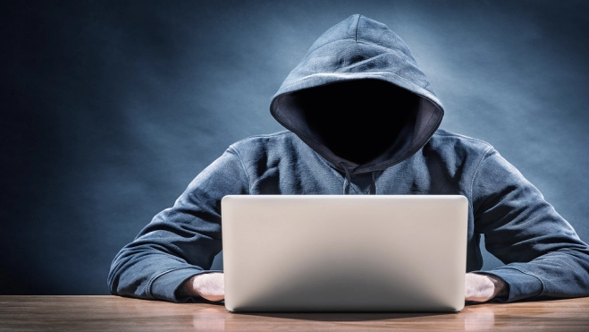
My advice for Jojo
Jojo is a known person who has made a brand for herself. She has gained lots of money and fans from her brand and being herself, fame comes with a bad side of people who would want to take advantage of her. It's obvious Jojo has a high net worth due to the amount of things she's participated in, and her expensive car. This makes her target to creeps and stalkers no matter what.
My advice for Jojo would be to be more private when it comes to her residence and car. Those are things that can be easily identifiable if you saw them, and you just would not want to take any chances.

