Slide 1
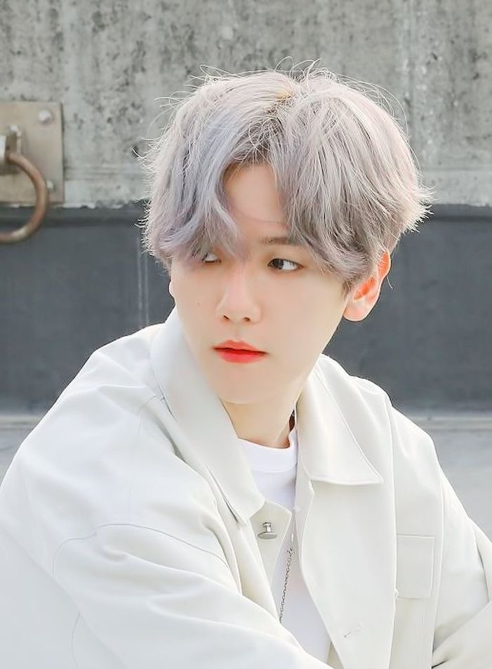
Baekhyuns digital footprint
(•ө•)ෆ

Slide 2
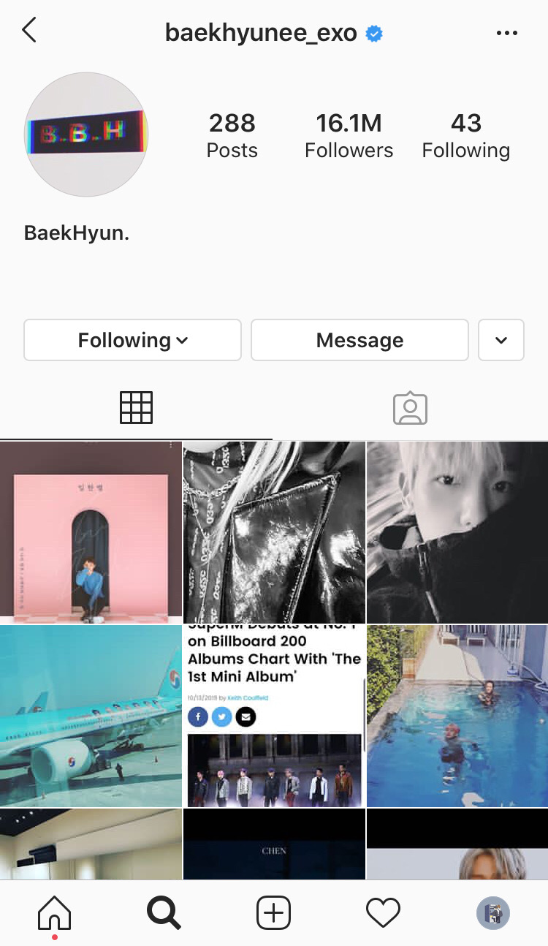
Digital Footprint
Byun Baekhyun is a Korean idol and made his debut with Kpop boy group, EXO in 2012. In 2016, he started his acting career and starred in Moon Lovers: Scarlet Heart Ryeo as the 10th prince, WangEun. In the same year, he debuted in a sub-unit of EXO, EXO-CBX. In June of 2019, it was revealed that Baekhyun would be collaborating with Privé, a clothing brand, and coming out with his own brand, Privé by BBH on July 1. On July 10, this year, he has made his solo debut with his mini-album, City Lights. Later on, he debuted once more in SM's(his agency) and Capitol Records, K-pop Super Group, SuperM. He is currently promoting his latest song with EXO, Obsession.
He has a public Instagram account made in May of 2014 with 16.1M followers and public Twitter account, made in May of 2018 with 3M followers. He also has a Youtube Channel with 2.22M subscribers as of December 2019. He posts once in a while, usually once or twice a month. His posting and uploading schedule varies time to time.
made his
debut with
EXO
opened a
instagram
opened a
twitter
made a
youtube
channel

Slide 3
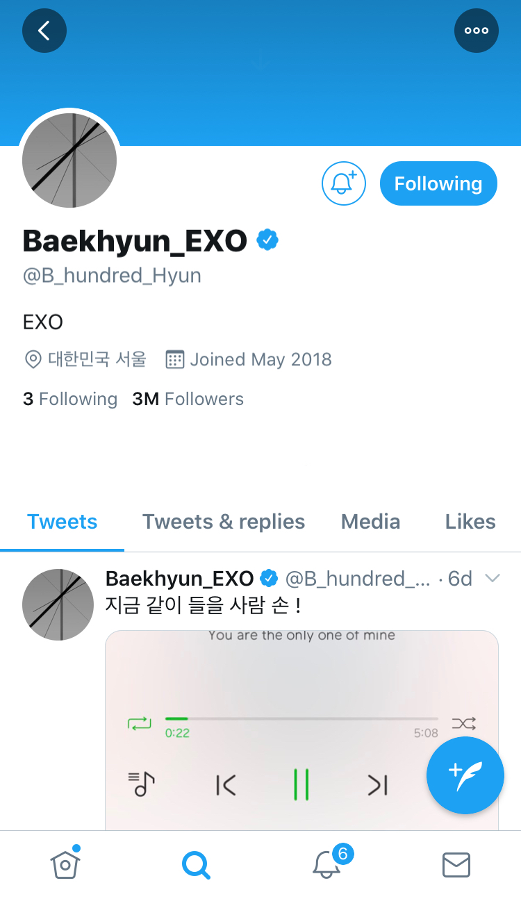
Over-sharing?
He posts few things each month. These posts range from congratulating other members or label mates, recommending songs, sharing pictures of himself and informing fans.
Baekhyun never puts the location of where he is so fans won't go and possibly cause harm to the staff working there and him. Even though this is his account, his agency can have control of the things he post and such.

Slide 4
what he wants us to know
Recent songs
News
Pictures
vlogs
He shares recent songs he's enjoying and helps support the artist.
He shares news and recent achievements.
He shares pictures of himself and his members.
On his YT, he posts backstage vlogs and behind the scene videos as well.

Slide 5
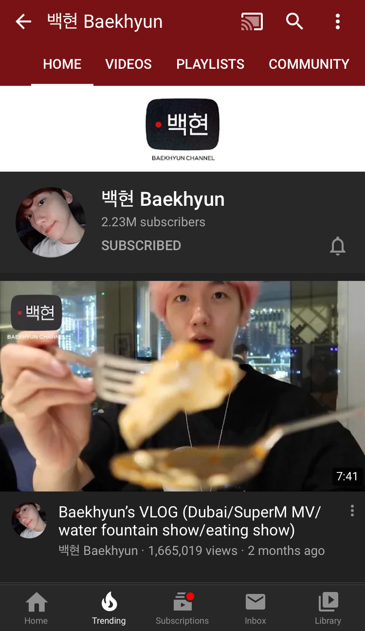
Advice
3
He knows what he's doing and his agency (SM Entertainment) is able to control what he posted and makes sure that nothing personal is being posted. Since his job is an idol, he must unsure that he doesn't make a bad influence to others. I personally don't think that he is exactly over-sharing, however he should still be aware and be careful of these things.
2
4
1
5

