Slide 1
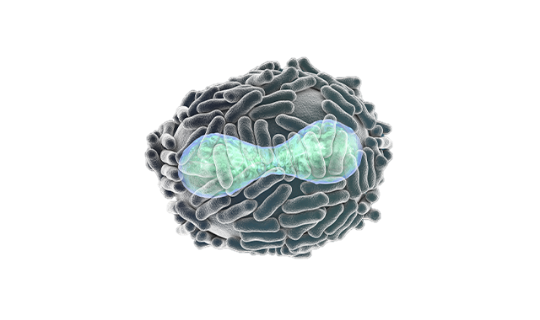
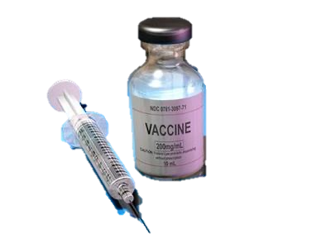
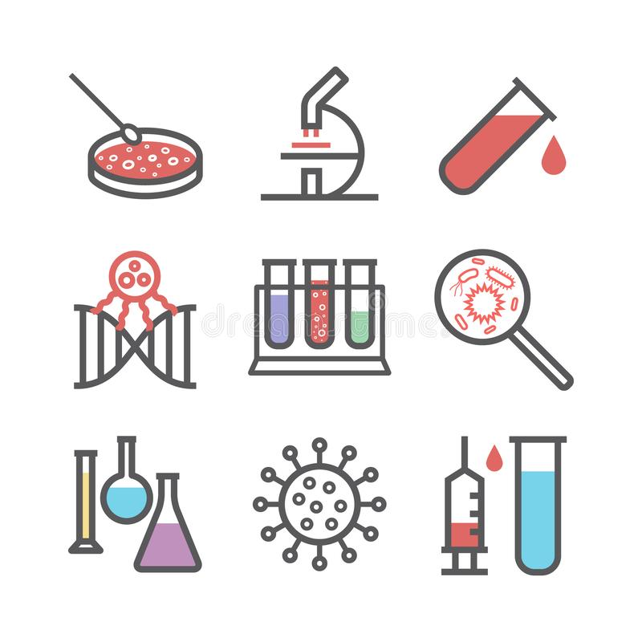
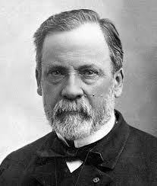
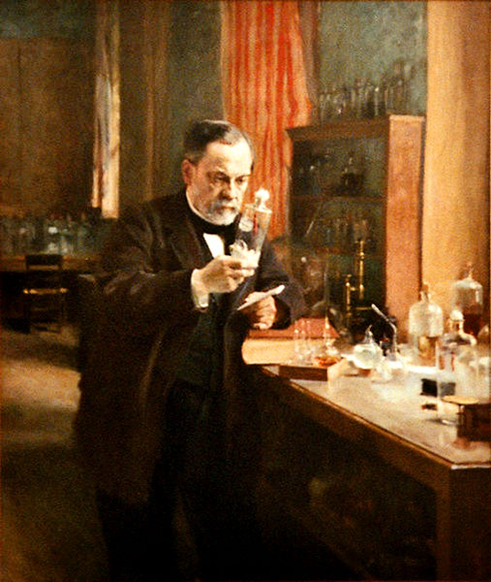
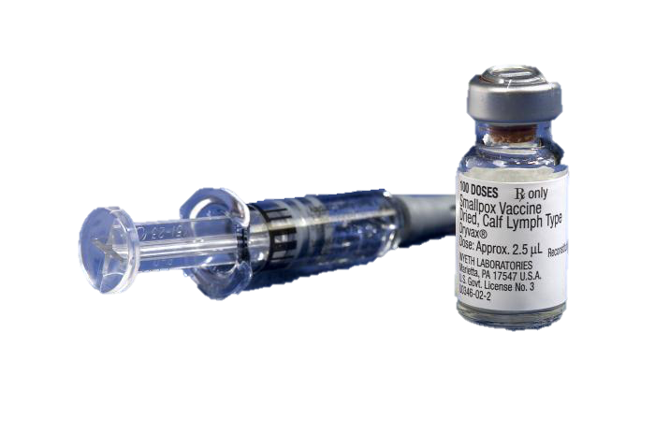
Vaccinations
Louis Pasteur(1822-1895) is a French chemist and micro-biologist
Vaccines
Vaccines have been able to save several lives in the past and even in the future as it strengthens and helps the immune system fight of deadly bacteria, viruses, diseases etc.
Pasteur was an average student in studies and was gifted in art (Painting+ Drawing) when younger
On July 6, 1885, Pasteur vaccinated a 9-year-old boy (Joseph Meister) that was bitten by a rabid dog
Pasteur expanded his Germ Theory and developed + found out the causes and vaccinations for other diseases that were major problems such as, anthrax, cholera and TB
1822-Born in Dole, France
1840-Bachelor of Arts degree
1842-Bachelor of Science degree
1845-Masters degree
1847-Doctorate
1868-Left side is partially paralyzed (did not interfere with studies)
1885-Vaccine to treat rabies
1895-Death

