Slide 1
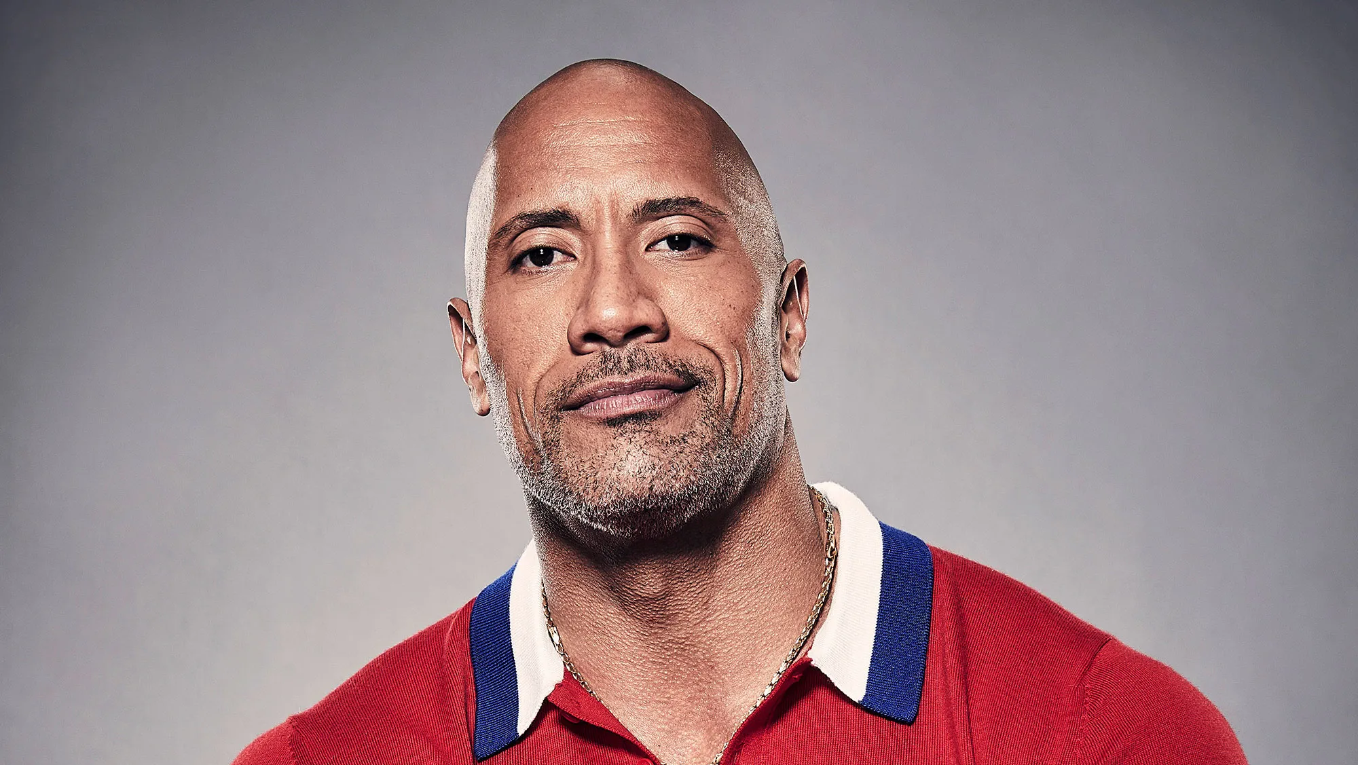
Dwayne Johnson
The person I survey
By Stephan

Slide 2
1. His digital footprint
Dwayne Johnson has his own account on most famous social networking sites and apps, such as twitter, instagram, and YouTube, and publishes at least one post every day.

Slide 3
2. Account basic information
Dwayne Johnson's account is completely public. On the surface, Dashi Johnson did not add much protection to his account, but you can’t find information about the invasion of Dashi Johnson’s account or the disclosure of privacy on the Internet. So it is possible that Dashi Johnson added multiple protections to his account, but we don't know it.

Slide 4
3. Account security
In Dashi Johnson's Instagram account, he has repeatedly posted information about his fitness, interacting with children, and about his family. Not only that, he has also posted pictures of his house many times and related information about pictures of places in his city. However, he has never released geographic information about his location, except for some travel locations.

Slide 5
Analysis of whether Dashi Johnson is an over-sharer
In my opinion, I think Dashi Johnson is an over-sharer, because he posts a post every day, which can be said to be a very qualified over-sharer.

Slide 6
Suggest
In my opinion, Dashi Johnson can protect his privacy by reducing his posting speed, and reducing the number of appearances of his family in posts can also help a lot.

Slide 7
Thank you
By Stephan

